Slide 1
Researching online and Referencing
Wood Manufacturing & Finishing

Slide 2
researching online Where to go …………..
CAPOW
Currency
Authority
Purpose
Objectivity
Writing style
Wadding through the web can be very time consuming.
Tips for effective search strategies
https://youtu.be/LTJygQwYV84

Slide 3


Things you should know about Internet Researching Skills
Google is the world's most popular search engine, 87.35 % Sept. 2020.
How to Google like a pro.
Introduction to academic research
https://youtu.be/LdQeaDN9Qic
Using a checklist can help students new to Internet research remember CAPOW.

Slide 4
Be Smart About Your Learning methods
Visual learners may need an alternative teaching strategy for online. Tips for Visual learning.
Tips for Studying for Visual Learners Online
Organise work and living space to avoid distractions, turn volume down on mobile.
Sit in the front of the room to avoid distraction and away from doors or windows where action takes place. Take breaks every 30mins. Look away from the screen every 20mins for 20seconds.
Separate sheets/copy for each module.
Use visual association sometimes a lecturer might make a comment that may help you to recall this information at a later stage so write that comment down.

Slide 5
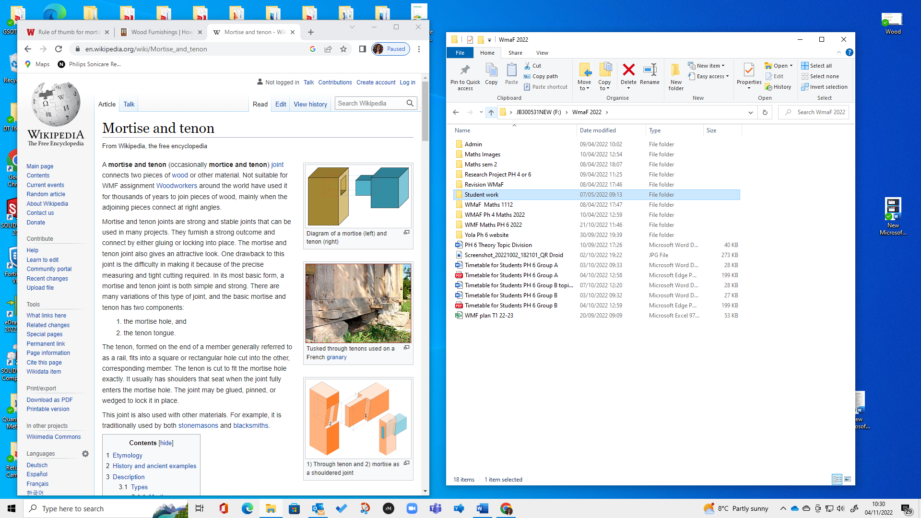
Wikipedia
Is Wikipedia a creditable source for research?

Slide 6
Wikipedia
Put your hand up when you notice
Wikipedia

Slide 7
Wikipedia
A mortise and tenon (occasionally mortice and tenon) joint connects two pieces of wood or other material. Woodworkers around the world have used it for thousands of years to join pieces of wood, mainly when the adjoining pieces connect at right angles.
Mortise and tenon joints are strong and stable joints that can be used in many projects. They furnish a strong outcome and connect by either gluing or locking into place. The mortise and tenon joint also gives an attractive look. One drawback to this joint is the difficulty in making it because of the precise measuring and tight cutting required. In its most basic form, a mortise and tenon joint is both simple and strong. There are many variations of this type of joint, and the basic mortise and tenon has two components:Not suitable for WMF assignment
Previous edit.
Anyone can edit Wikipedia!!!!!
Wikipedia

Slide 8
Tips
Use digital calendar to create to-do lists, and other forms of reminders e.g. when assignments are due.
Reconstruct images in different ways - try different spatial arrangements and take advantage of blank spaces on the page.
Use underlining, highlighting in different colours, you can do this to PDFs.
Practice turning visual cues back into words as you prepare for exams, word association.
Allow sufficient time for planning and recording thoughts when doing problem-solving tasks.
Use test preparation strategies that emphasize organisation of information and visual encoding and recall.

Slide 9
More things you should know about
Internet Researching Skills
Properly citing Internet sources can be tricky.
Owl Purdue Writing Lab is a great
resource to help you with your
academic writing and researching
https://owl.purdue.edu/owl/purdue_owl.html
Any Questions?????

