Slide 1
Drawer Construction
Wooden

Slide 2
Traditional dovetails
Dovetails are one of the strongest joints because of all of the surfaces that can be glued.
Dovetails are also very pleasing to look at.
They can be a feature of the item of furniture.
Dovetails slope at 1:6 or 1: 8
Front drawer dovetails 1:8 back 1:6
For lap dovetails the socket is aprox ¾ of the front thickness
For appearance the tails are usually equal in width.

Slide 3
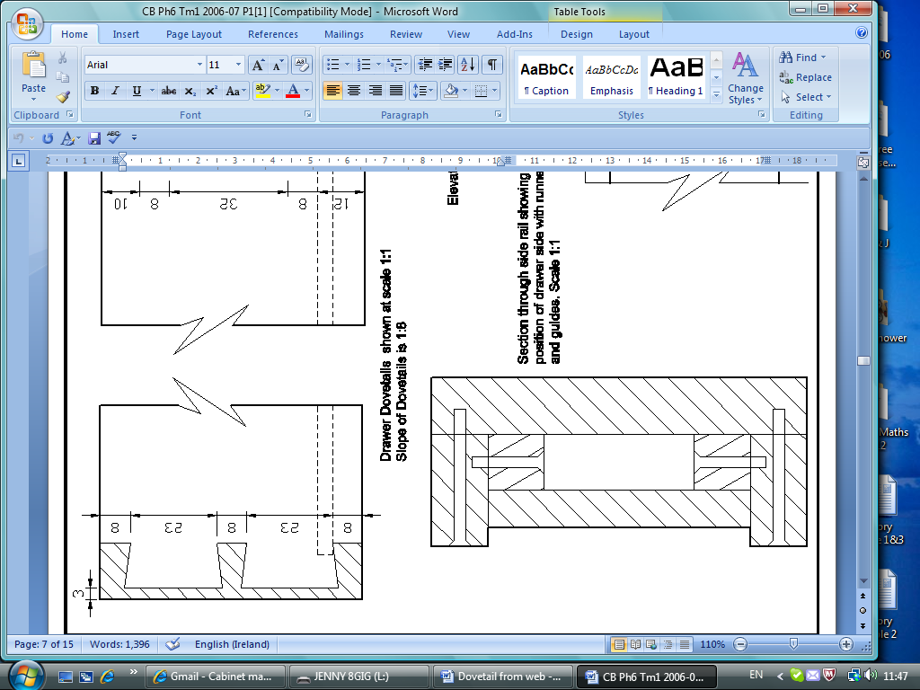
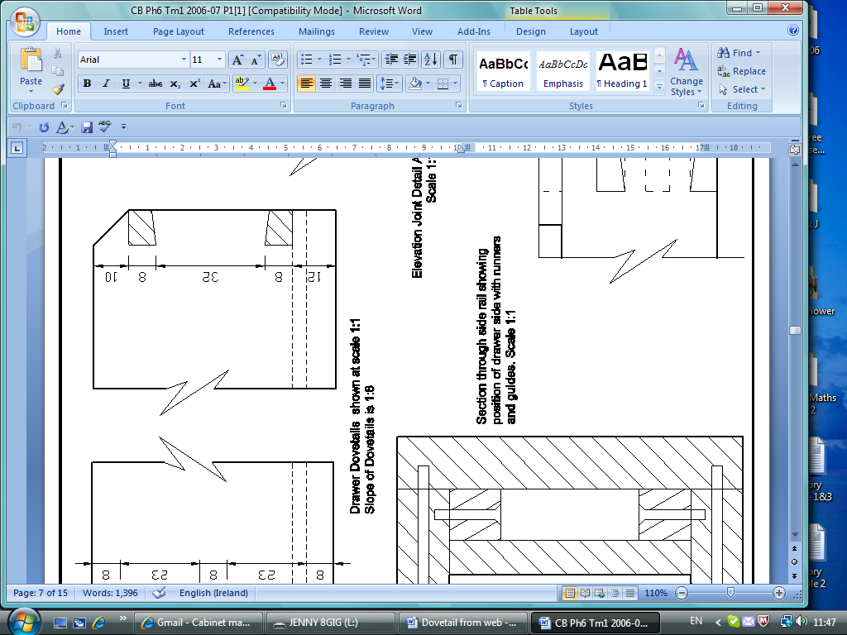
Drawer
Lapped dovetails are used on the front of drawer, no end grain showing on the front.
Through dovetails are used on the back, end grain showing on both sides.
This view is from the outside notice drawer bottom is dotted ie. Hidden detail
Drawer bottom should always be grooved inside the socket so that it does not show on the outside.
Drawer back is usually lower than sides.

Slide 4
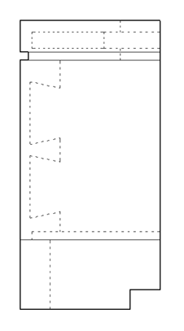
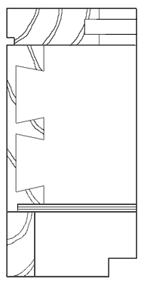
Drawing Dovetails
All hidden detail
is dotted
Section through Trinket Box
Carcase is rebated to accommodate the bottom

Slide 5
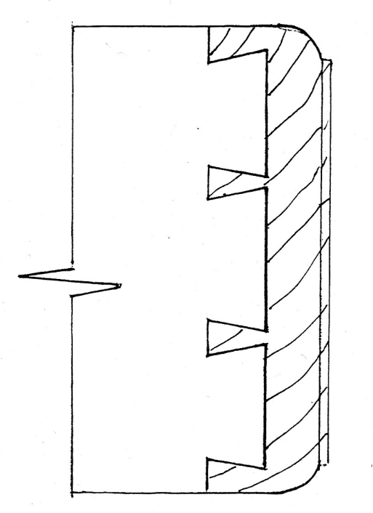
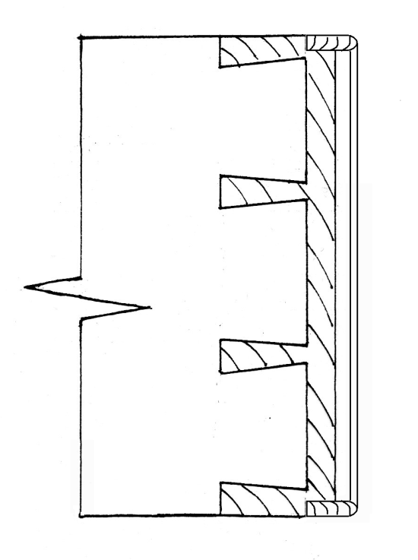
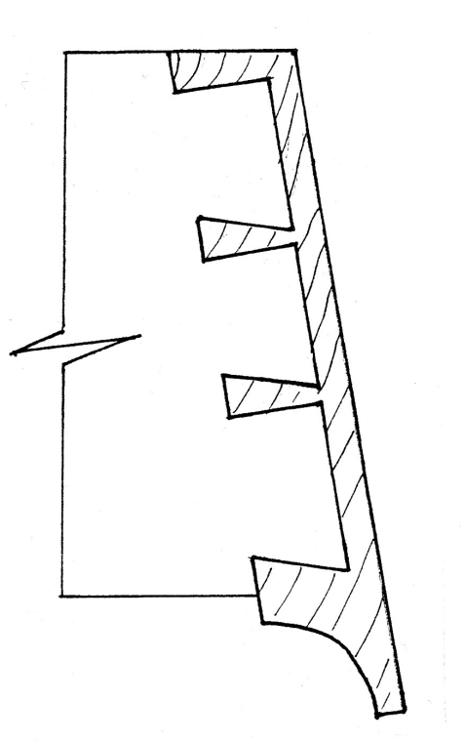
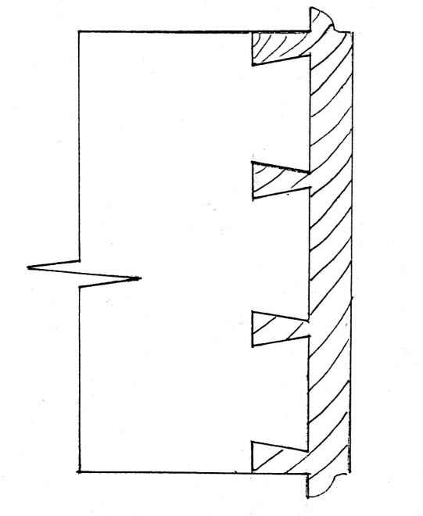
Types of Drawer Fronts
Moulded Front
Cock Beaded
Louvered Front
Moulded & Overlapped

Slide 6
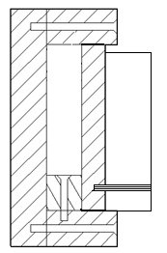
Drawer Terms
Drawer Kicker
Drawer
Drawer
Guide
Drawer Runner
Drawer Runner: This supports the drawer sides.
Drawer Kicker: This prevents the drawer from tipping downwards when opened.
Drawer Guide: This guides the drawer in straight between the frame.

Slide 7
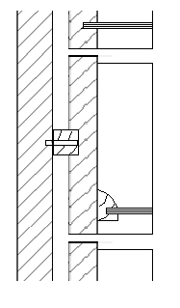
Drawer Terms
Drawer side grooved
to accommodate runner
Drawer Runner
Glued & screwed to carcase
Drawer
Grooved slip glued
to drawer side

Slide 8
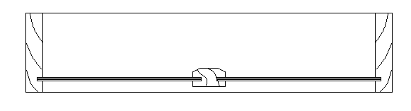
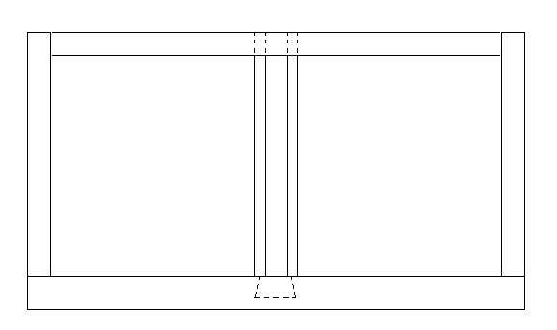
Drawer Terms
For wider drawers a Muntin is used.
It is grooved on both sides to take the drawer bottom.
Section through drawer showing muntin
View from top looking down on drawer

