Slide 1
Web Search
Wood Manufacturing & Finishing
Using the web to search for information

Slide 2
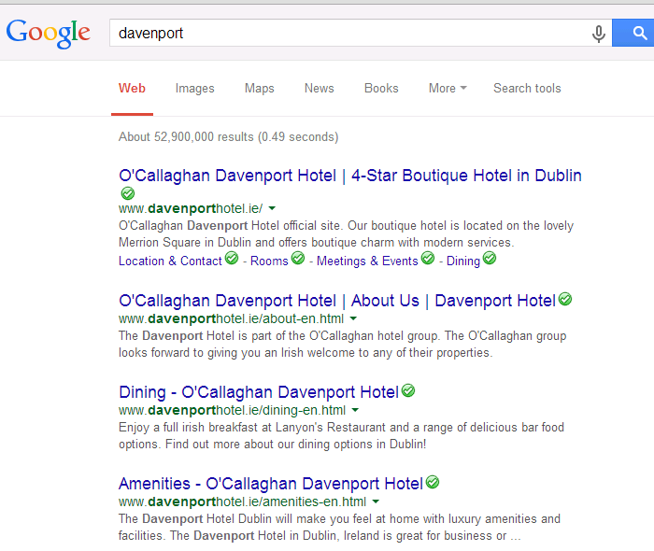
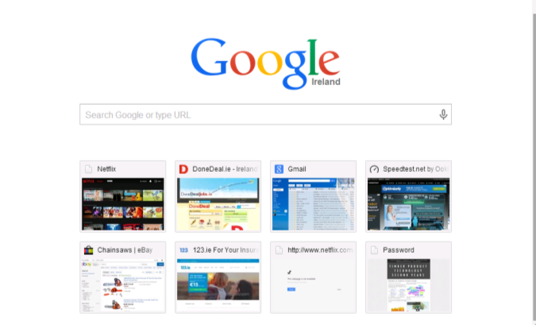
Using Google
Davenport
Type in the word Davenport
Click images to bring you to a different page

Slide 3
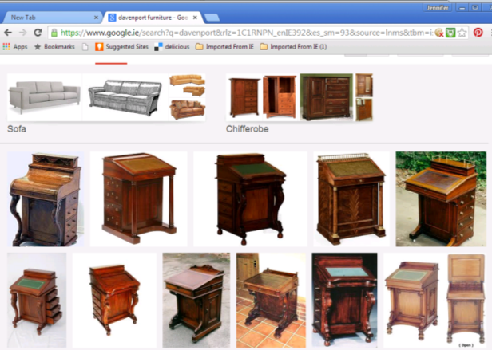
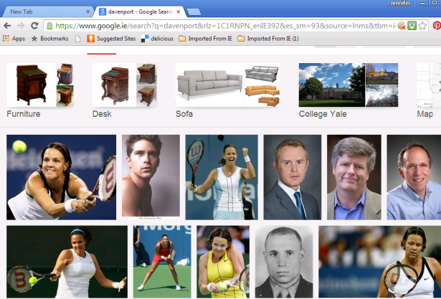
You can see we get lots of images of a Tennis Player with the surname “Davenport” so we have to narrow our search more.
Click Furniture image.
You can click on any of these images and they will bring you to the site that they originated from.
Now we have lots of choice.

Slide 4
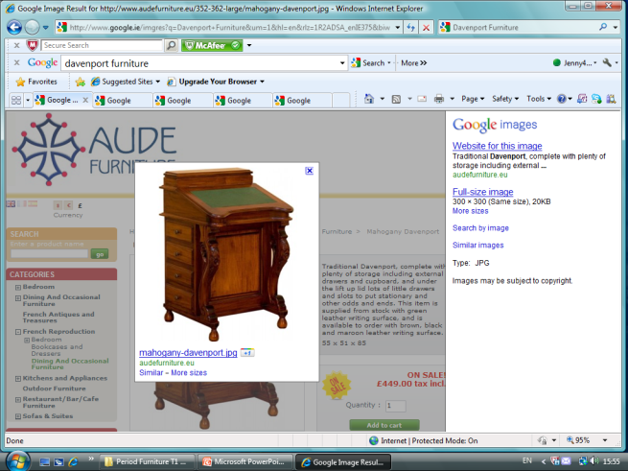
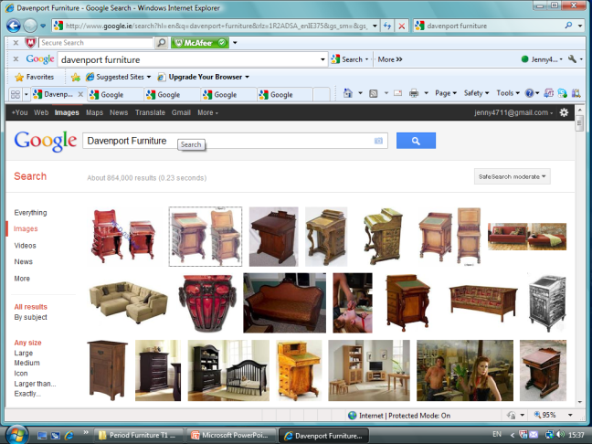
Some images will come from sites that are auctioning or selling items like these.
You will only get limited information on these sites such as material type & selling price, occasionally some information on the designer.
This image has brought us to a website selling Furniture

Slide 5

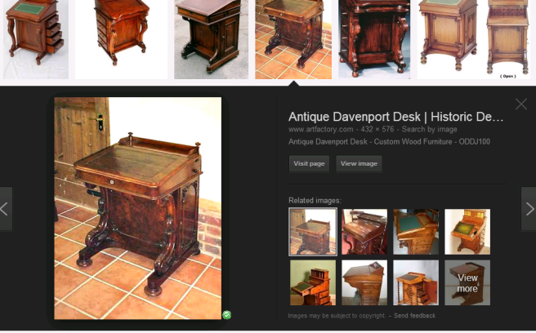
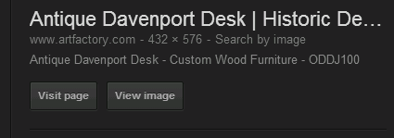
Using Google Chrome
You can now view the name of the website it is from. You can either visit image or visit site.
If you use this image you MUST reference the site.
Eg. Image obtained from
Image courtesy of Artfactory.com
http://www.artfactory.com/antique-davenport-desk-custom-wood-furniture-oddj100-p-3971.html

Slide 6
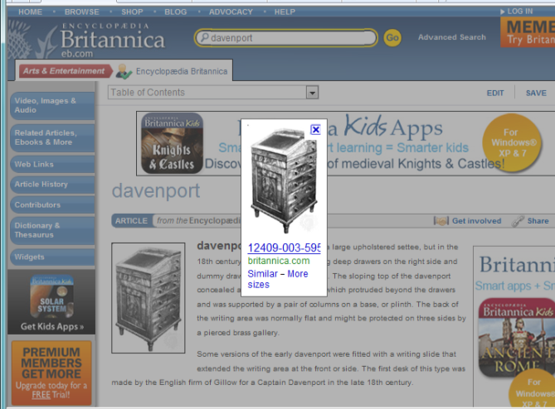
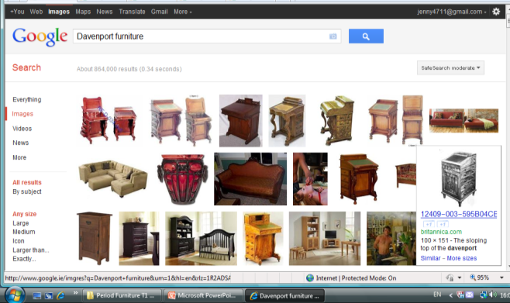
If we click on another image.
We are now on the Encyclopaedia Britannica website where we will get more useful information.

Slide 7
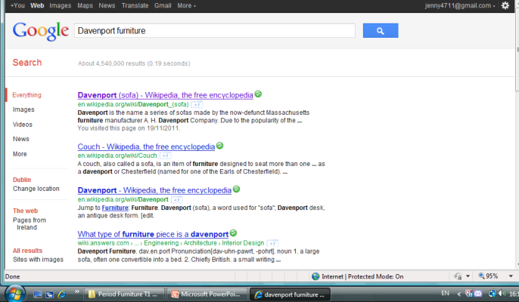
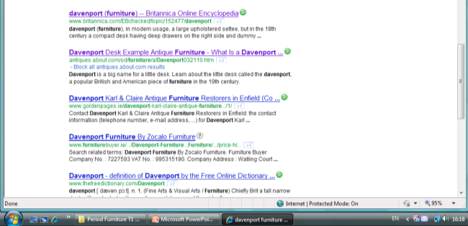
Now that you know what a Davenport is and looks like you can now click the web button to bring you to more informative sites.
Here you will be able to gather enough information to write a few lines to describe the Davenport.
Scroll down through them until you find one that gives the most accurate information.

Slide 8
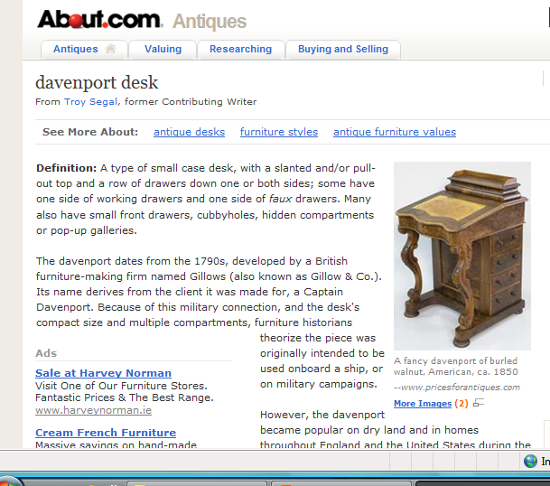
Re-write in your own words the description of The Davenport.
Remember you must reference the site where you obtained the information from.

Slide 9
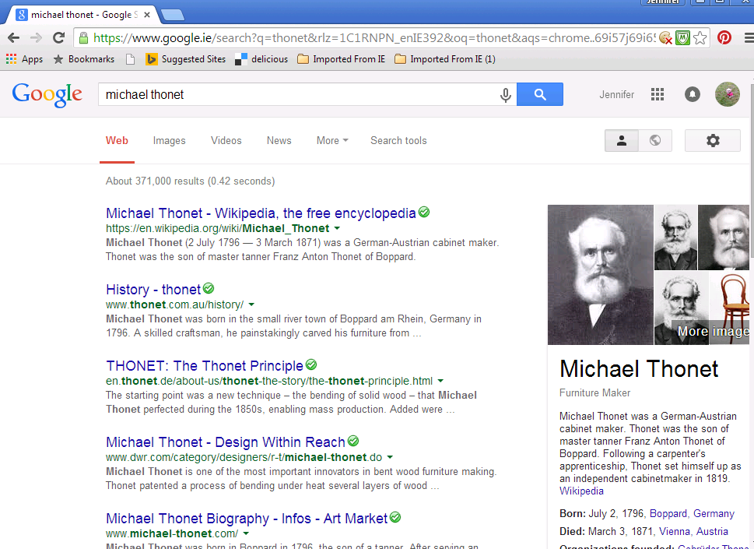
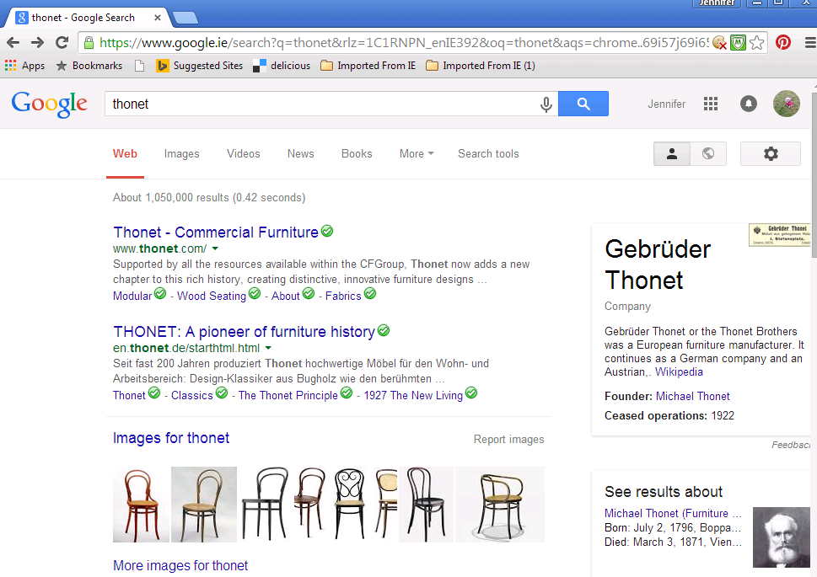
If you are researching a Name it is best to use the web first.
Be careful that you have the right person and not just some person with the same name from Face book.
Verify using at least three sources.

Slide 10
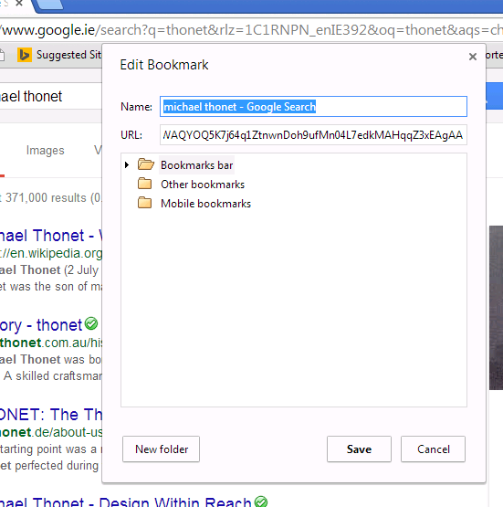
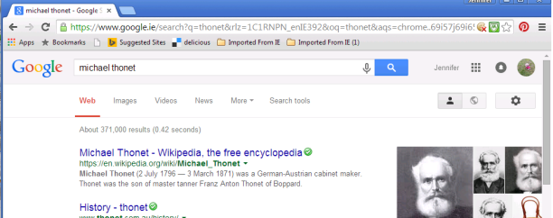
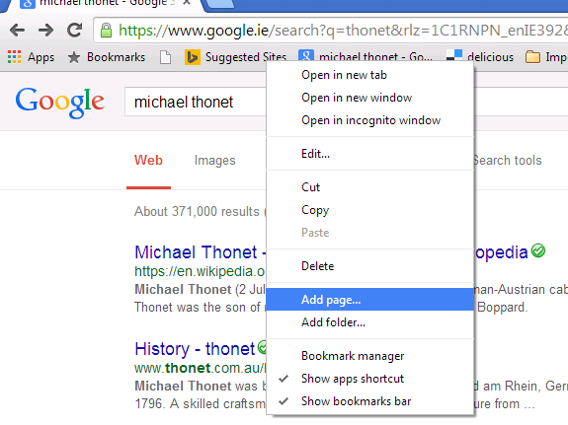
Using the Web can be very useful or very misleading. You need to look in a few places in order to check that you have the right information.
There is also a tool called suggested sites that other users have used. You may find this useful.
When you come across a good site you should save it/ bookmark it.
Go to sugested sites.
Right click your mouse.

Slide 11
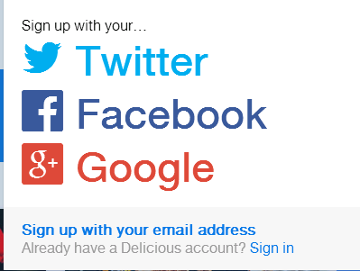
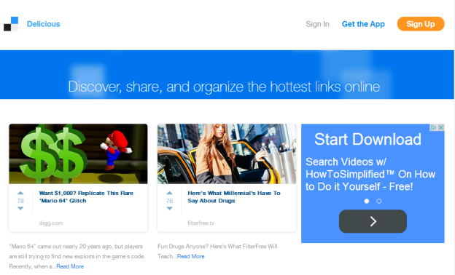
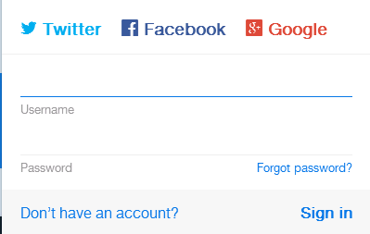
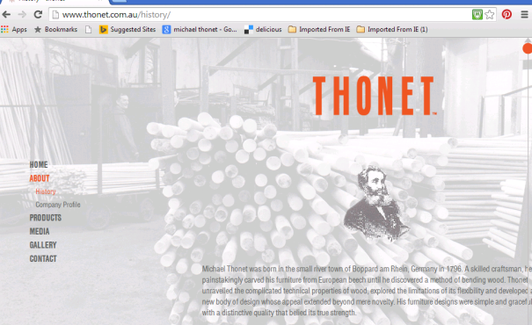
Social Bookmarking Service
If you use more than one computer the problem is your favourites may not be on the computer you are using.
Delicious.com is the world's leading social bookmarking service (2017)
https://www.brandwatch.com/blog/10-popular-social-bookmarking-websites/
You must sign up. You can also download the app to your phone or tablet.
What is the advantage of this tool compared to using suggested sites?

Slide 12
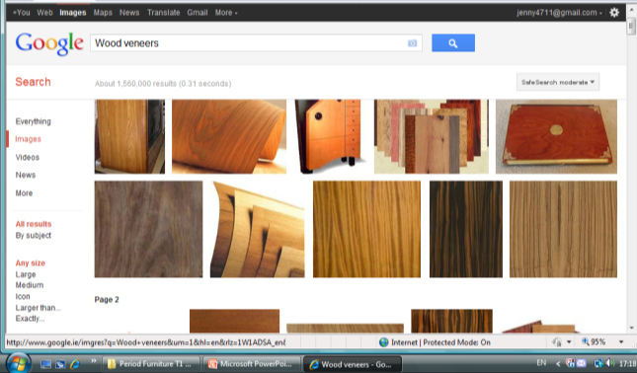
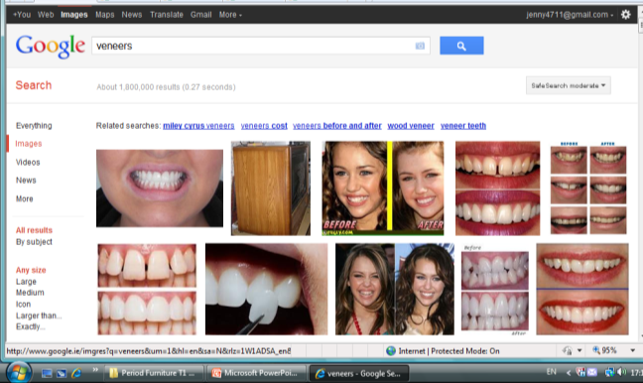
How times change.
Word search : Veneers
Wood Veneers
Happy searching
If all else fails there is a really ancient but trusting tool called
A Book !

Slide 13
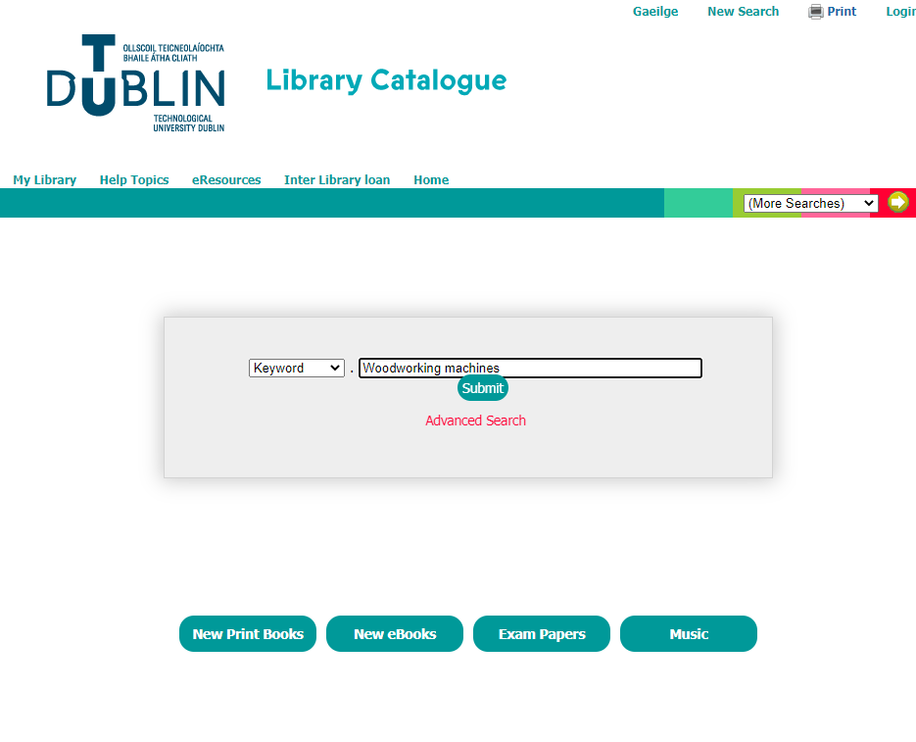
Library
Located in main building Bolton Street directly above the canteen area.
Search by topic
https://library-cc.tudublin.ie/#

Slide 14
Task: You will each be assigned an item and given 10 mins to carry out a quick internet search.
You will then have to describe what this item is to your classmates.
Give a brief description of the following:
Ladder Back Chair:
Sofa Table:
Carlton House Desk:
Pembroke Table:
Card Table:
Chest on stand:
Secretaire:
Commode:
Roll Top Desk:
Bureau:
Chair no. 14
Veneer Hammer:
Rent-table:
Tall Boy:
Tilt Top Table:
Lyre Table:

Slide 15
Task: You will each be assigned a name or period and given 10 mins to carry out a quick internet search.
You will then have to tell your classmates who this person is and something they designed or what dates each period is and style of furniture during that period.
Gustav Stickley:
Michael Thonet:
Arts & Crafts Furniture:
Thomas Chippendale:
Eileen Grey:
Regency Period Furniture:
George Smith Furniture:
Gerrit Rietveld:
Georgian Furniture:
Marquetry:
Shaker Furniture:
Thomas Sheraton:
Victorian Furniture:
William Morris:
Sam Maloof:
George Nakashima

