Slide 1
Drawer Construction
Machine methods

Slide 2
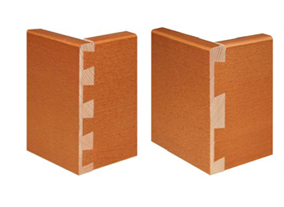
Machine dovetails
The same rules apply to machine Dovetails regarding sizes etc.
Machine dovetails look the same as traditional dovetails from the outside.

Slide 3
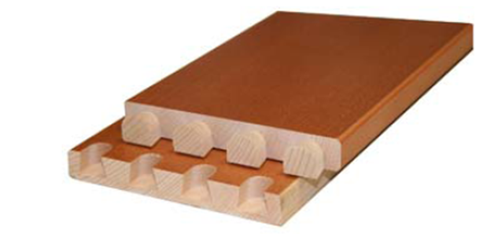
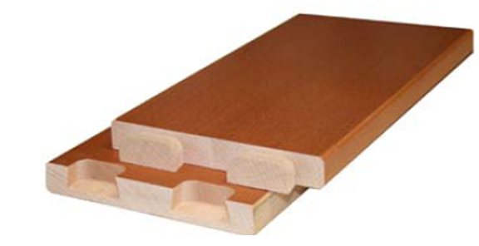
Machine dovetails
Its only when you take them apart that you see the difference.
The inside face on the tails and sockets are rounded

Slide 4
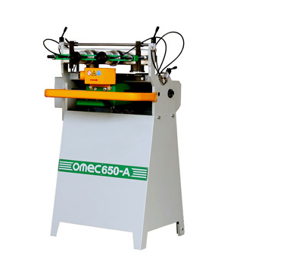
Automatic Dovetailing Machine
This Omec 650 is an automatic dovetailing machine. It has one milling head that cuts out all the sockets and pins in one operation.
https://youtu.be/-Ywp7UJthB4 Manual
https://youtu.be/j7W5DY0gJXg Auto.

Slide 5
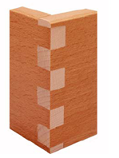
Automatic Dovetailing Machine
The dovetail milling head can be replaced with a straight milling head to create finger joints.

