Slide 1
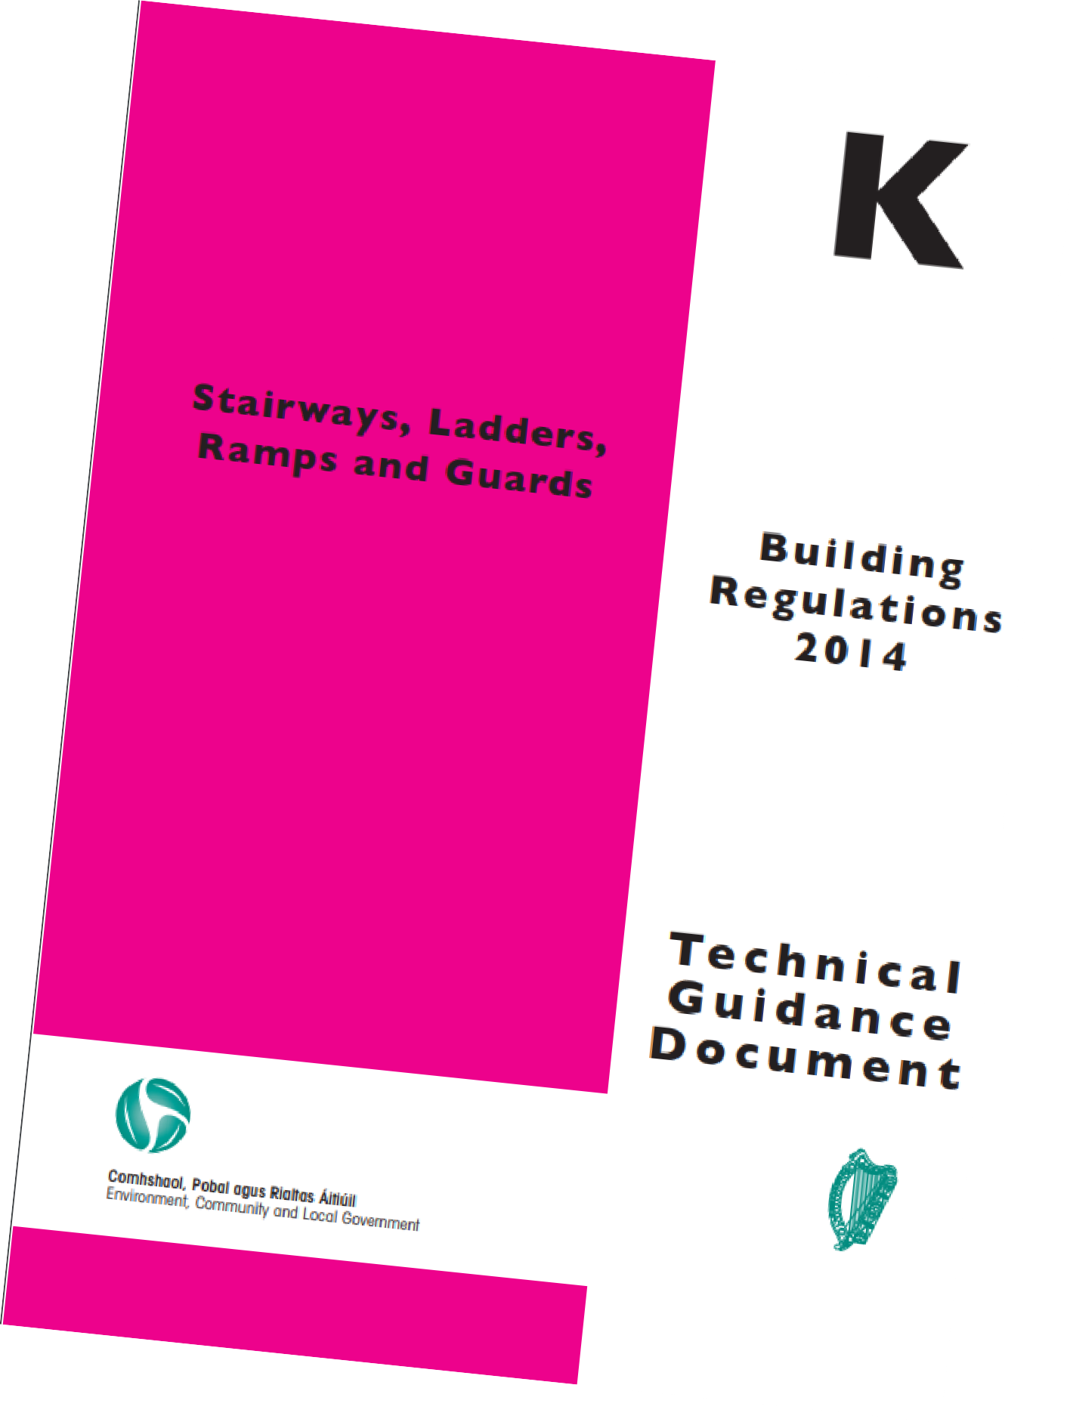
STAIR REGULATIONS
Due to their very nature, stairs are a trip hazard.
For this reason, the Building Regulations are very clear regarding what is allowed and this information can be found in the Technical Guidance Documents – Part K.

Slide 2
Taken from: https://www.hsa.ie/eng/Topics/Slips_Trips_Falls/High-risk_Areas/Stairs_and_Steps/

Slide 3
STAIR REGULATIONS
Regulation | Private | Semi-private | Public
Pitch (degrees) | 42 degrees max | 38 degrees max | 33 degrees max
Headroom | 2 metres min. | 2 metres min. | 2 metres min.
Rise | 220 mm max | 190 mm max | 180 mm max
Going | 220 mm min. | 250 mm min. | 280 mm min.
Twice rise plus going (2r + g) | 550 – 700 mm | 550 – 700 mm | 550 – 700 mm
Width (unobstructed) | 800 mm min. | 1 m min. | 1 m min.
Handrail height (sloped) | 900 – 1000 mm | 900 – 1000 mm | 900 – 1000 mm
Handrail height (landing) | 900 – 1100 mm | 1100 mm min. | 1100 mm min.
NOTE: Regulations regarding Semi-Private and Public buildings are provided for information purposes only, and students should focus on Private.

Slide 4
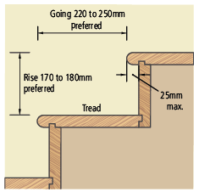

Stair Safety
Twice the rise plus the going should equal between 550mm and 700mm
Overhang
Min. 16mm - Max. 25mm

Slide 5
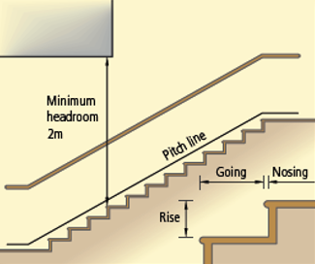
Stair Safety
Max. rise = 220mm (optimal height 175mm)
Min. going = 220mm (optimal depth 250)
Headroom = 2m at least
Max. pitch = 42° (optimal 35°)

Slide 6
STAIR REGULATIONS
The rises and goings should all be the same in any one flight.
There should be no more than 16 risers in any one flight.
A sphere of 100mm diameter should not be able to pass through any point of the stairs.
If the width of the stairs exceeds 1m a second handrail is required.
Landing should be at least as great as the width of the stairs.

Slide 7
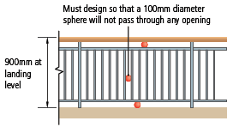
Stair Safety
Handrail = 900mm above pitch line
Handrail = 900mm at landing
Balusters spaced no further than 100mm apart
Max. 16 steps in a flight
Min. stair width 800mm

Slide 8
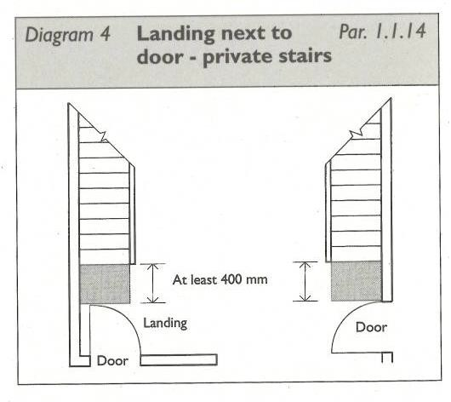
STAIR REGULATIONS
Top and bottom of stairs should be at least 400mm clear of door opes

Slide 9
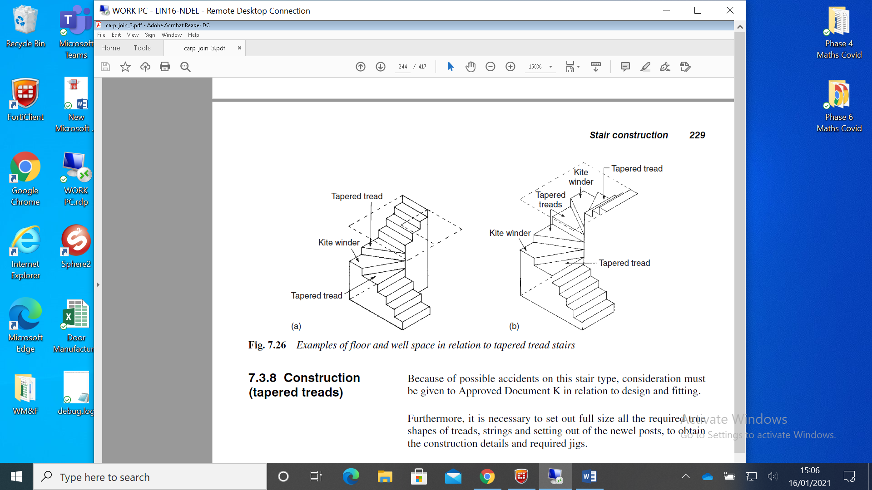
STAIR REGULATIONS
Tapered Steps
Image taken from Carpentry and Joinery Book 3 by Brian Porter

Slide 10
STAIR REGULATIONS: Tapered steps
The regulations as above apply to tapered steps as follows:
If the flight is narrower than 1000mm – measure in the centre.
If the flight is 1000mm or wider – measure in 270mm from each side.
In addition: The going should measure at least 75mm at the narrow end.

Slide 11
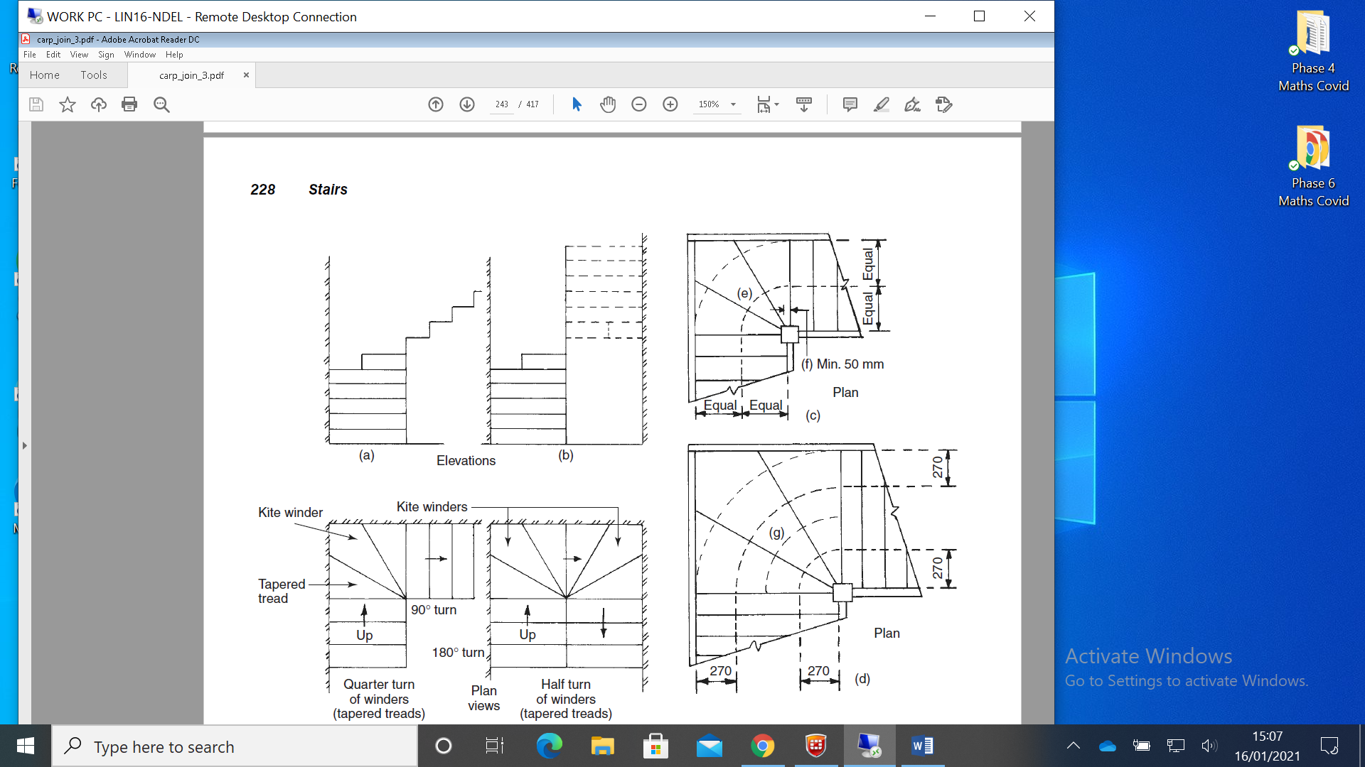
Image taken from Carpentry and Joinery Book 3 by Brian Porter

Slide 12
STAIR REGULATIONS:Revision
Regulation | Private | Semi-private | Public
Pitch (degrees)
Headroom
Rise
Going
Twice rise plus going (2r + g)
Width (unobstructed)
Handrail height(wall)
Handrail height(flight)
Handrail height(landing)

Slide 13
STAIR REGULATIONS:Revision
Regulation | Private | Semi-private | Public
Pitch (degrees) | 42 degrees max | 38 degrees max | 33 degrees max
Headroom | 2 metres min. | 2 metres min. | 2 metres min.
Rise | 220 mm max | 190 mm max | 180 mm max
Going | 220 mm min. | 250 mm min. | 280 mm min.
Twice rise plus going (2r + g) | 550 – 700 mm | 550 – 700 mm | 550 – 700 mm
Width (unobstructed) | 800 mm min. | 1 m min. | 1 m min.
Handrail height(wall) | 900 – 1000 mm | 900 mm | 900 mm
Handrail height(flight) | 900 – 1000 mm | 900 mm | 900 mm
Handrail height(landing) | 900 – 1100 mm | 1100 mm min. | 1100 mm min.

Slide 14
STAIR REGULATIONS:Revision
The ________________ should all be the same in any one flight.
There should be no more than ____ risers in any one flight.
A sphere of ________ diameter should not be able to pass through any point of the stairs.
If the width of the stairs exceeds _____ a second handrail is required.
Top and bottom of stairs should be at least ______ clear of door opes.
Landing should be at least as great as ____________ of the stairs

Slide 15
STAIR REGULATIONS:Revision
The Rise and Goings should all be the same in any one flight.
There should be no more than 16 risers in any one flight.
A sphere of 100mm diameter should not be able to pass through any point of the stairs.
If the width of the stairs exceeds 1000mm a second handrail is required.
Top and bottom of stairs should be at least 400mm clear of door opes.
Landing should be at least as great as the width of the stairs

Slide 16
STAIR REGULATIONS:Revision
The regulations apply to tapered steps as follows:
If the flight is narrower than 1000mm measure in the centre.
If the flight is 1000mm or wider – measure in 270mm from each side.
In addition: The going should measure at least 75mm at the narrow end.

