Slide 1
Tips for the PowerPoint Presentation

Slide 2
Preparation is Key!
Do the research. Know your topic. Create your presentation to guide you.
Be confident in what you are presenting.
Be prepared to answer questions on what you are presenting.
Create good visually appealing slides. If the content is boring the presentation may come across as boring.
Have nice good quality visuals. Font minimum 24 point, used Sans serif font Verdana or Calibri. Do not use cursive script.
Know what is on the next slide.
Remember that your audience will read faster than you can talk.

Slide 3
The PowerPoint
Choose your presentation design wisely.
Watch contrasting colours, white on dark backgrounds can be hard to read.
Be careful of using different coloured fonts on the one slide.
Recommendation from Universal Design for Learning (UDL) is to use Sans-Serif Font. Veranda or Calibri. Don’t use cursive fonts. OR ALL CAPS…. VERY HARD TO READ.
Use size 24 font or larger to allow audience to read comfortably.
Make sure images are not pixelated or stretched/squashed.
Keep the same animations on each slide (presentation) unless making a point, same with transitions.

Slide 4
The PowerPoint
You can add arrows and text box to images, which will reduce the number of slides you need to use.
Do not waste the last page with the words “Thank You” instead have something there to encourage your audience to ask questions on.
Image of your topic area you want to answer questions on.

Slide 5
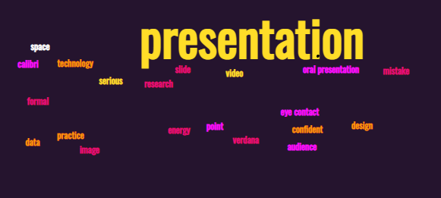
Thank you! Any Questions? Using Word Cloud
Top Ten Word Cloud Generator https://monkeylearn.com/blog/word-cloud-generator/
Word cloud generator: https://monkeylearn.com/word-cloud/

Slide 6
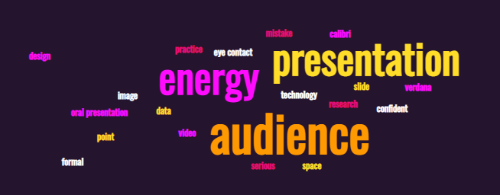
Thank you any Questions?
Word cloud generator: https://monkeylearn.com/word-cloud/

Slide 7
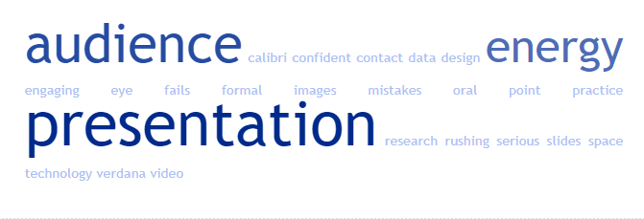
Thank you! Any Questions? Using Tagcrowd
Word cloud generator: https://monkeylearn.com/word-cloud/

Slide 8

Remember!
You are expected to create a presentation to show and tell your peers what you learned from the research.
You should be able to take information from your report.
There is no need for you to carry out additional research.
You should be having fun when presenting.
https://youtu.be/X50StnWVh9I
Do’s and Don’t’s in making Presentations more effective 2.55Mins

