Slide 1
Stairs Design
WMF Phase 6

Slide 2
Stairs
There are several things to look out for when measuring up on site before deciding on stair design and layout.
These include:
  Stair well dimensions
  Overall Rise (Finished floor to finished floor)
  Overall Going available
  Minimum landings required
  Possible obstructions (eg. Doors, bulkheads)
Technical Guidance Documents: TGD

Slide 3
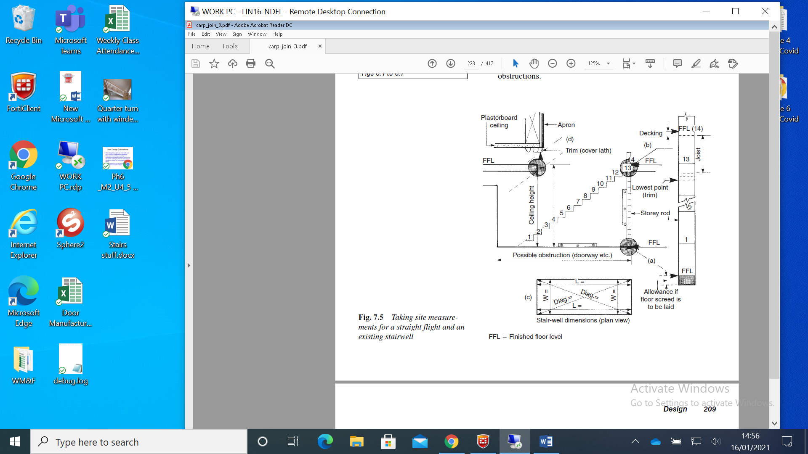
Stair Design
  Stair well
  Overall Rise
  Overall Going
  Minimum landings
  Possible obstructions
When designing a stairs you must make sure that it conforms to all building regulations.

Slide 4
Stair Design calculations
When designing a stairs you must make sure that it conforms to all building regulations.
Stairs vary from building to building. It is important to calculate the rise and going to suit the specific building in which the stairs is to be installed to ensure that every rise will be exactly equal.
The dimensions of the rise and going are calculated in a couple of stages.
First you must consider that there can be no more than 16 risers in any one flight. This means that the overall rise must be broken up into 16 or less individual rises of max height 220mm.
Second there is always one less going than rise, so the overall going has to be broken up by total number of risers less one (i.e. 16 rises = 15 goings, 15 rises = 14 goings, etc). If no overall going is given, care must be taken of bulkheads, landings and door opes.
Third, and most important, you must subject the chosen figures to the maths to check for building regulation compliance.

Slide 5
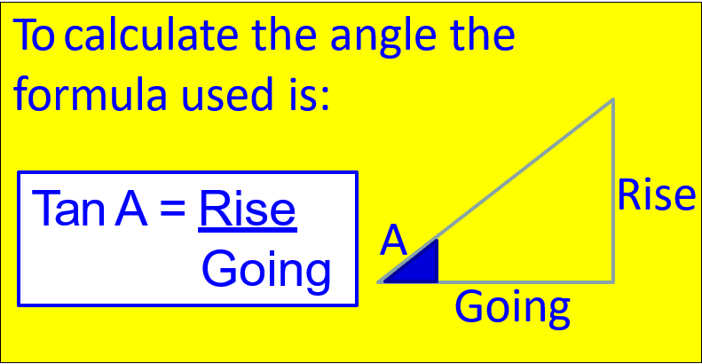
Maths Stair Check
The two key regulations that must be checked out mathematically to make sure that they comply are:
Twice the Rise plus the Going must fall between 550 and 700mm
The Pitch must be less than 42 degrees
Both regulations (and all other regulations) must be satisfied for the stairs to be deemed acceptable
(2R + G = 550 -700)

Slide 6
The following examples will demonstrate how this applies:
Example 1:
Rise 180mm, Going 250mm
Example 2:
Rise 210mm, Going 290mm
Example 3:
Rise 210mm, Going 230mm

Slide 7
The following examples will demonstrate how this applies:
Example 1:
Rise 180mm, Going 250mm
2(180) + 250 = 550 – 700
360 + 250 =
Example 2:
Rise 210mm, Going 290mm
Example 3:
Rise 210mm, Going 230mm
2R + G = 550 – 700mm
610mm

Slide 8
The following examples will demonstrate how this applies:
Example 1:
Rise 180mm, Going 250mm
2(180) + 250 = 550 – 700
360 + 250 =
Tan A = 180
250
Tan A = 0.72
A = Tan¯¹ 0.72
A =
Example 2:
Rise 210mm, Going 290mm
Example 3:
Rise 210mm, Going 230mm
2R + G = 550 – 700mm
610mm
Tan A = Rise
Going
35.754°
Both are Acceptable

Slide 9
The following examples will demonstrate how this applies:
Example 1:
Rise 180mm, Going 250mm
2(180) + 250 = 550 – 700
360 + 250 =
Tan A = 180
250
Tan A = 0.72
A = Tan¯¹ 0.72
A =
Example 2:
Rise 210mm, Going 290mm
2(210) + 290 = 550 – 700
420 + 290 =
Tan A = 210
290
Tan A = 0.724
A = Tan¯¹ 0.724
A =
(no need to calculate pitch)
Example 3:
Rise 210mm, Going 230mm
2R + G = 550 – 700mm
2R + G = 550 – 700mm
610mm
710mm
Tan A = Rise
Going
Tan A = Rise
Going
35.754°
35.91°
Both are Acceptable
Not Acceptable

Slide 10
The following examples will demonstrate how this applies:
Example 1:
Rise 180mm, Going 250mm
2(180) + 250 = 550 – 700
360 + 250 =
Tan A = 180
250
Tan A = 0.72
A = Tan¯¹ 0.72
A =
Example 2:
Rise 210mm, Going 290mm
2(210) + 290 = 550 – 700
420 + 290 =
Tan A = 210
290
Tan A = 0.724
A = Tan¯¹ 0.724
A =
(no need to calculate pitch)
Example 3:
Rise 210mm, Going 230mm
2(210) + 230 = 550 – 700
420 + 230 =
Tan A = 210
230
Tan A = 0.913
A = Tan¯¹ 0.913 A =
(no need to calculate 2R + G)
2R + G = 550 – 700mm
2R + G = 550 – 700mm
2R + G = 550 – 700mm
610mm
710mm
650mm
Tan A = Rise
Going
Tan A = Rise
Going
Tan A = Rise
Going
35.754°
35.91°
42.397°
Both are Acceptable
Not Acceptable
Not Acceptable

