Slide 1
Door Styles
Know the different types of doors, door joints and components.
Test yourself!

Slide 2
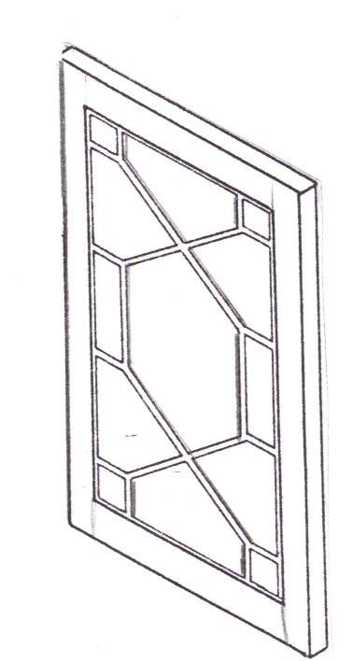
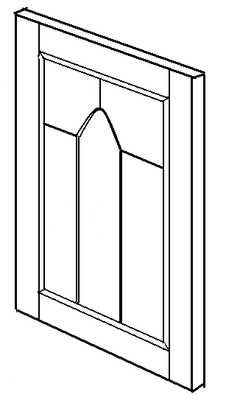
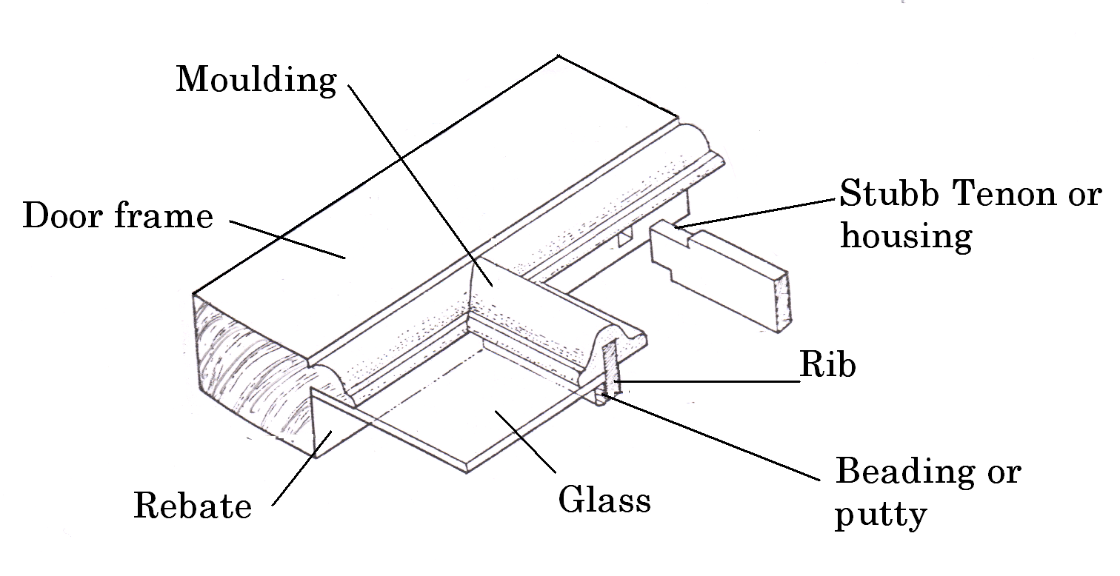
Glazed Bar Doors: Name The Parts
Name___________ Name____________

Slide 3
Glazed Bar Doors
13 Pane Bar Door
Tracery Bar Door

Slide 4
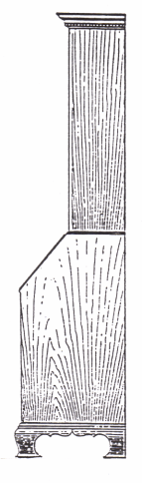
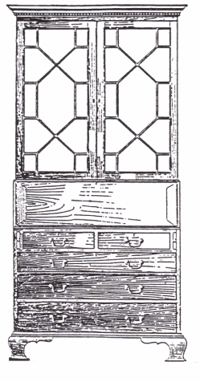
Chippendale Bureau
1_______
2_______
3 ______
4______
5 _________
Can you name each of the parts above?

Slide 5
Chippendale Bureau
Cornice
13 Pane
Bar Door
Fall flap
Lopers
Bracket feet

Slide 6
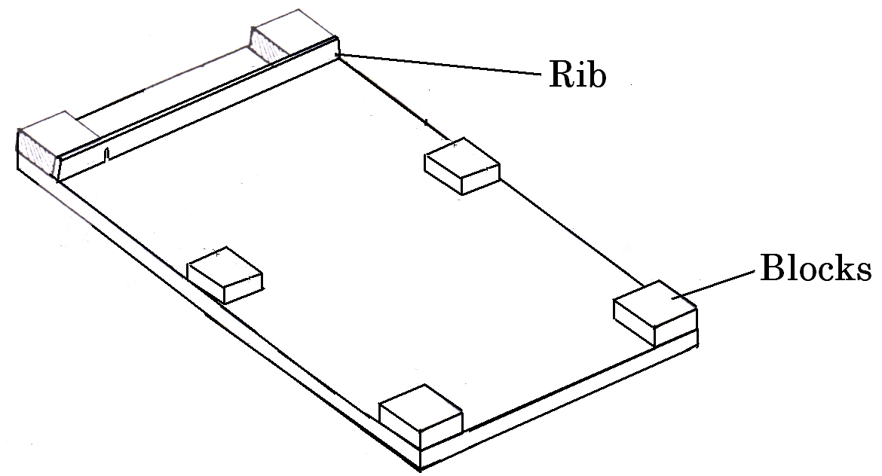
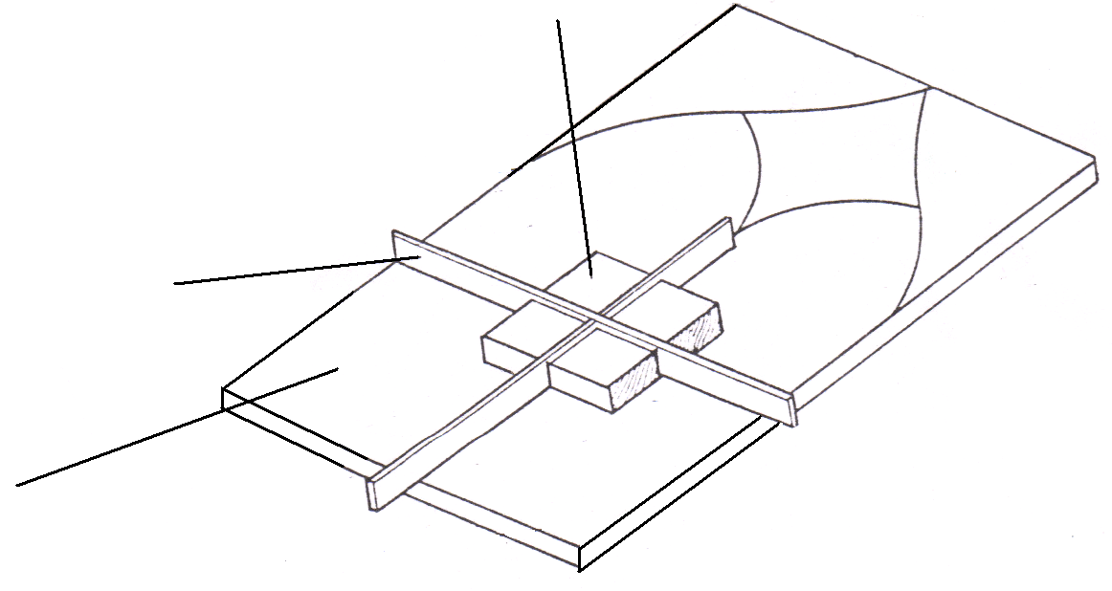
Glazed Bar Doors: Name The Parts
Base boards
with blocks
1_______
2_______
3___________
4_____________

Slide 7
Glazed Bar Doors
Base boards
with blocks
Block
Rib
Base boards with
Tracery pattern
& blocks
Base board

Slide 8
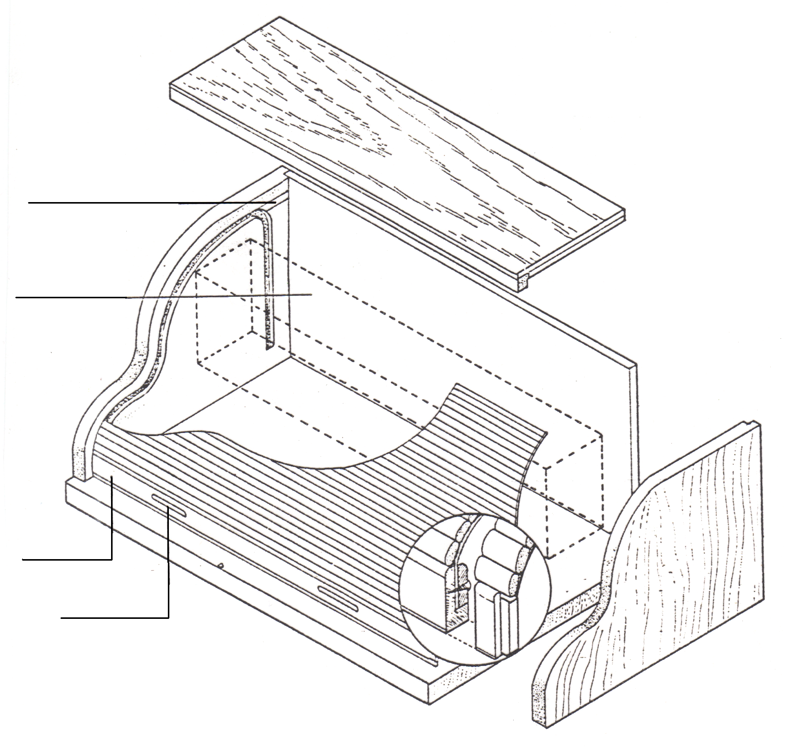
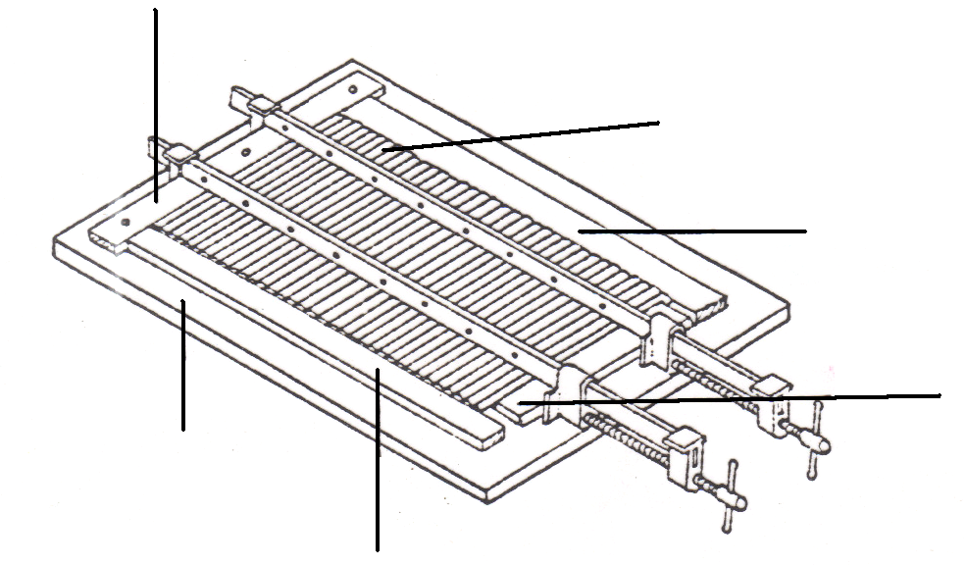
Tambour Doors: Name The Parts
1___________
2__________
5_____
3 _________
4___________
6______________
7 _________
8____________
9______
11__________
10____________

Slide 9
Tambour Doors
Feed in groove
False interior
Slats
Locking rail
Finger Rail
Fixed end stop
Slats
Edging
strips
Baseboard
Cramping
blocks
Edging strip

Slide 10
Tambour Doors
Tambours are pushed & pulled to open & close.
Feed in
groove
False
interior
Locking
rail
Finger
Rail

Slide 11
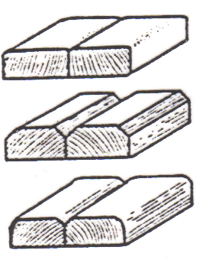
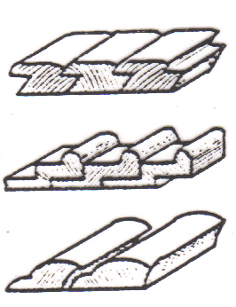
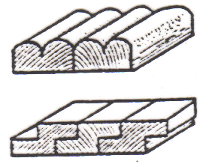
Tambour Doors
A Tambour door is a sliding door
Wooden slats cramped onto a baseboard
A canvas sheet is glued onto the slats.
Fixed end stop
Slats
Edging
strips
Cramping
blocks
Baseboard
Edging strip
Tambour slats

