Slide 1
Stairs Design
WMF Phase 6

Slide 2
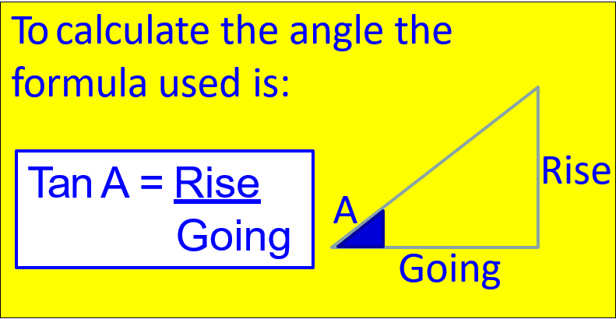
Maths Stair Check
The two key regulations that must be checked out mathematically to make sure that they comply are:
Twice the Rise plus the Going must fall between 550 and 700mm
The Pitch must be less than 42 degrees
Both regulations
(and all other regulations)
must be satisfied for the
stairs to be deemed acceptable
(2R + G = 550 -700)

Slide 3
Sample Calculation 1 Step 1
Two floors are 2700mm apart. Calculate the rise and going of a staircase from the lower floor to the upper floor that meets all building regulations. Check against regulations.
First find the number of steps that divides into the total rise. Start by dividing the total rise by the maximum number of steps: Which is ?
2700 ÷ 16 = 168.75mm
This is within regulations of, but would be difficult to measure precisely, try 15.
2700 ÷ 15 = 180mm
Fifteen steps meets the regulations as does 180mm so now to see if it fits within the formula.
Twice the Rise plus the Going must fall between 550 and 700mm.
2R + G = 550 – 700mm

Slide 4
Sample Calculation 1 Step 2
Twice the Rise plus the Going must fall between 550 and 700mm.
2R + G = 550 – 700mm
Using the optimum going which is?
2(180) + optimum going = 550 – 700mm
2(180) + 250 = 610mm This is acceptable
Therefore, we have 15 steps with a rise of 180mm and going of 250mm. Is this acceptable?
Check Pitch
Tan A = Rise Tan A = 180 Tan A = 0.720 A = Tan ̄¹ 0.720
Going 250 A = 35.75°

Slide 5
Sample Calculation 2 Step 1
Two floors are 2035mm apart. A stairs is to be constructed between the floors with a maximum overall going of 3000mm. Calculate a rise and going that will satisfy all building regulations and allow safe passage between the floors.
Divide the total rise by max. steps (16) to see if that will work out an even number.
2035 ÷ 16 = 127.187mm not a round number so try 15
2035 ÷ 15 = 135.666mm not a round number so try 14
2035 ÷ 14 = 145.357mm not a round number so try 13
2035 ÷ 13 = 156.538mm not a round number so try 12
2035 ÷ 12 = 169.583mm not a round number so try 11
2035 ÷ 11 = 185mm fits regulations max rise 220mm

Slide 6
Sample Calculation 2 Step 2
Check if 11 steps will fit the building regulations that is 11 risers and 10 treads.
Total going 3000mm ÷ 10 treads = 300mm Going 300mm
Check formula 2R + G = ? 185 + 185 + 300 =
670mm within regulations
Check Pitch
Tan A = Rise Tan A = 185 Tan A = 0.6166 A = Tan ̄¹ 0.6166
Going 300 A = 31.66°

Slide 7
Example Question
Two floors are 2660mm apart. A stairs is to be constructed between the floors with a maximum overall going of 3000mm. Calculate a rise and going that will satisfy all building regulations and allow safe passage between the floors.
2660 ÷ 16 = 166.25mm not a round number so try 15
2660 ÷ 15 = 177.33mm not a round number so try 14
2660 ÷ 14 = 190mm fits regulations max rise 220mm
Check overall going for treads. How many?
3000 ÷ 13 = 230.76mm
2(190) + 230 = 610 610mm within regulations Check Pitch
Tan A = Rise Tan A = 190 Tan A = 0.8260 A = Tan ̄¹ 0. 8260
Going 230 A = 39.55°

Slide 8
Stair Maths Using Midpoint. Example 1
Select a suitable going to comply with the 2R + G formula of a private stairs with a total rise of 2340mm. An optimum rise of 180mm is supplied.
Model Answer, correct method should prove whatever figures used.
2340 divided by 180 = 13
(13 risers needed 12 threads formula 2R + G = 550 – 700mm)
180 + 180 = 360mm Mid point = 625mm
625 – 360 = 265 going
(Recheck formula 180 + 180 + 265 = 625mm within regulations )
(Also check the pitch is less than 42°)
Tan A = Rise Tan A = 180 Tan A = 0.6792 A = Tan ̄¹ 0.6792
Going 265 A = 34.18°

Slide 9
Stair Maths Using Midpoint Example 2
Select a suitable going to comply with the 2R + G formula of a private stairs with a total rise of 2450mm. An optimum rise of 175mm is supplied.
Model Answer, correct method should prove whatever figures used.
2450 divided by 175 = 14 (14 risers needed 13 threads formula 2R + G = 550 – 700mm)
175 + 175 = 350mm Mid point 625
625 – 350 = 275 going
(Recheck formula 175 + 175 +275 = 625mm within regulations )
(Also check the pitch is less than 42°)
Tan A = Rise Tan A = 175 Tan A = 0.6363 A = Tan ̄¹ 0.6363
Going 275 A = 32.47°

Slide 10
Grangegorman Visit
Central Quad
Provide the 2 checks on the stairs measured in Grangegorman
Twice the Rise plus the Going must fall between 550 and 700mm.
Central Quad Main Stairs Ground Floor
Rise 187mm Going 247mm
Check Formula
620mm acceptable
Check Pitch is less than 42°
Tan A = Rise Tan A = 187 Tan A = 0.757 A = Tan ̄¹ 0.7570
Going 247 A = 37.12°

Slide 11
Grangegorman Visit
Central Quad
Provide the 2 checks on the stairs measured in Grangegorman
Twice the Rise plus the Going must fall between 550 and 700mm.
Central Quad Main Stairs 2nd level
Rise 180mm Going 250mm
Check Formula
620mm acceptable
Check Pitch is less than 42°
Tan A = Rise Tan A = 180 Tan A = 0.72 A = Tan ̄¹ 0.72
Going 250 A = 35.75°

Slide 12
Grangegorman Visit
Rathdown House
Provide the 2 checks on the stairs measured in Grangegorman
Twice the Rise plus the Going must fall between 550 and 700mm.
Rathdown House Lobby entrance
Rise 150mm Going 425mm
Check Formula
725mm not acceptable
No need to check Pitch

Slide 13
Grangegorman Visit
Rathdown House
Provide the 2 checks on the stairs measured in Grangegorman
Twice the Rise plus the Going must fall between 550 and 700mm.
Rathdown house granite stairs
Rise 156mm Going 298mm
Check Formula
610mm acceptable
Check Pitch is less than 42°
Tan A = Rise Tan A = 156 Tan A = 0.523 A = Tan ̄¹ 0.523
Going 298 A = 27.6°

Slide 14
Grangegorman Visit
East Quad
Provide the 2 checks on the stairs measured in Grangegorman
Twice the Rise plus the Going must fall between 550 and 700mm.
East Quad Main Stairs ground level concrete stairs
Rise 150mm Going 300mm
Check Formula
600mm acceptable
Check Pitch is less than 42°
Tan A = Rise Tan A = 150 Tan A = 0.5 A = Tan ̄¹ 0.5
Going 300 A = 26.56°

Slide 15
Bolton St. Main Building Canteen
Provide the 2 checks on the stairs measured in Bolton St.
Twice the Rise plus the Going must fall between 550 and 700mm.
1st floor level Canteen stairs
Rise 160mm Going 280mm
Check Formula
600mm acceptable
Check Pitch is less than 42°
Tan A = Rise Tan A = 160 Tan A = 0.571 A = Tan ̄¹ 0.571
Going 280 A = 29.72°

Slide 16
Bolton St. Main Building
Provide the 2 checks on the stairs measured in Bolton St.
Twice the Rise plus the Going must fall between 550 and 700mm.
1st floor level Granite stairs
Rise 150mm Going 285mm
Check Formula
585mm acceptable
Check Pitch is less than 42°
Tan A = Rise Tan A = 150 Tan A = 0.526 A = Tan ̄¹ 0.526
Going 285 A = 27.74°

Slide 17
Bolton St. Main Building Spiral Stairs
Provide the 2 checks on the stairs measured in Bolton St.
Twice the Rise plus the Going must fall between 550 and 700mm.
Ground floor level Spiral stairs
Rise 175mm Going 310mm
Check Formula
660mm acceptable
Check Pitch is less than 42°
Tan A = Rise Tan A = 175 Tan A = 0.5645 A = Tan ̄¹ 0.5645
Going 310 A = 29.44°

