Slide 1
Trinket Box Design Ideas Presentation for – Therese Fitzgerald & Bobby Maher
Brian O’Shea TU 732/2
29.11.2021

Slide 2
Welcome
Design Brief:
Trinket Box
Capture essence of Access To Apprenticeship program
Use TU Dublin logo and A.T.A Digital badge logo
Use Walnut! Include features like exposed joints/veneering/banding etc.
Box will be presented to A.T.A partners

Slide 3
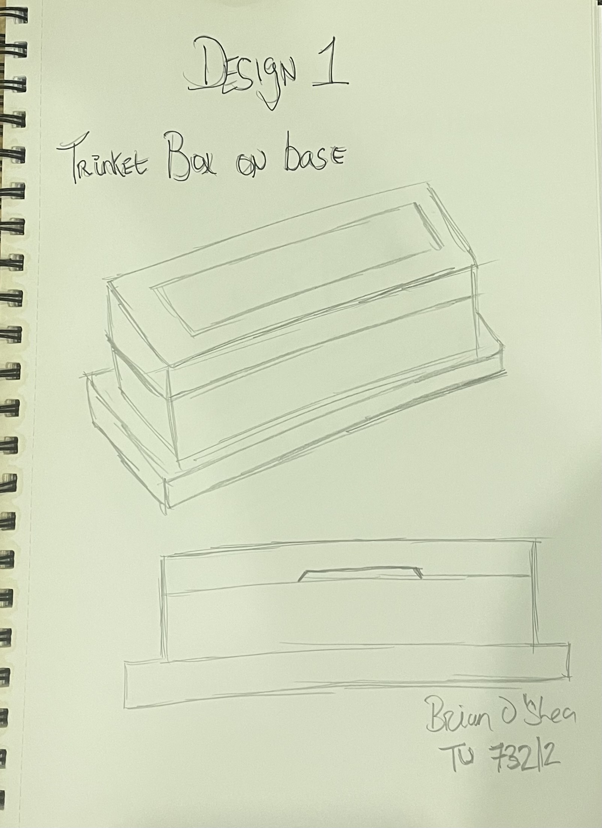
Design ideas/Sketches
What is a trinket box? ‘To store items (precious) to the owner.
Clients will probably place the box on their desk (hopefully!)
Design 1: Starting point/basic design:

Slide 4
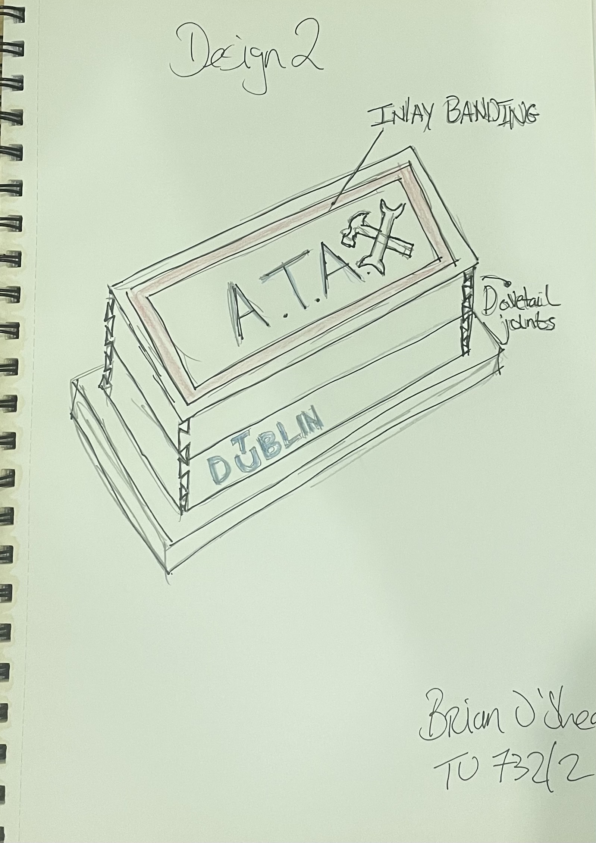
Design 2

Slide 5

Wait a minute……
Let’s think outside the (trinket) box for a moment…………….let’s look again at the digital badge logo:

Slide 6
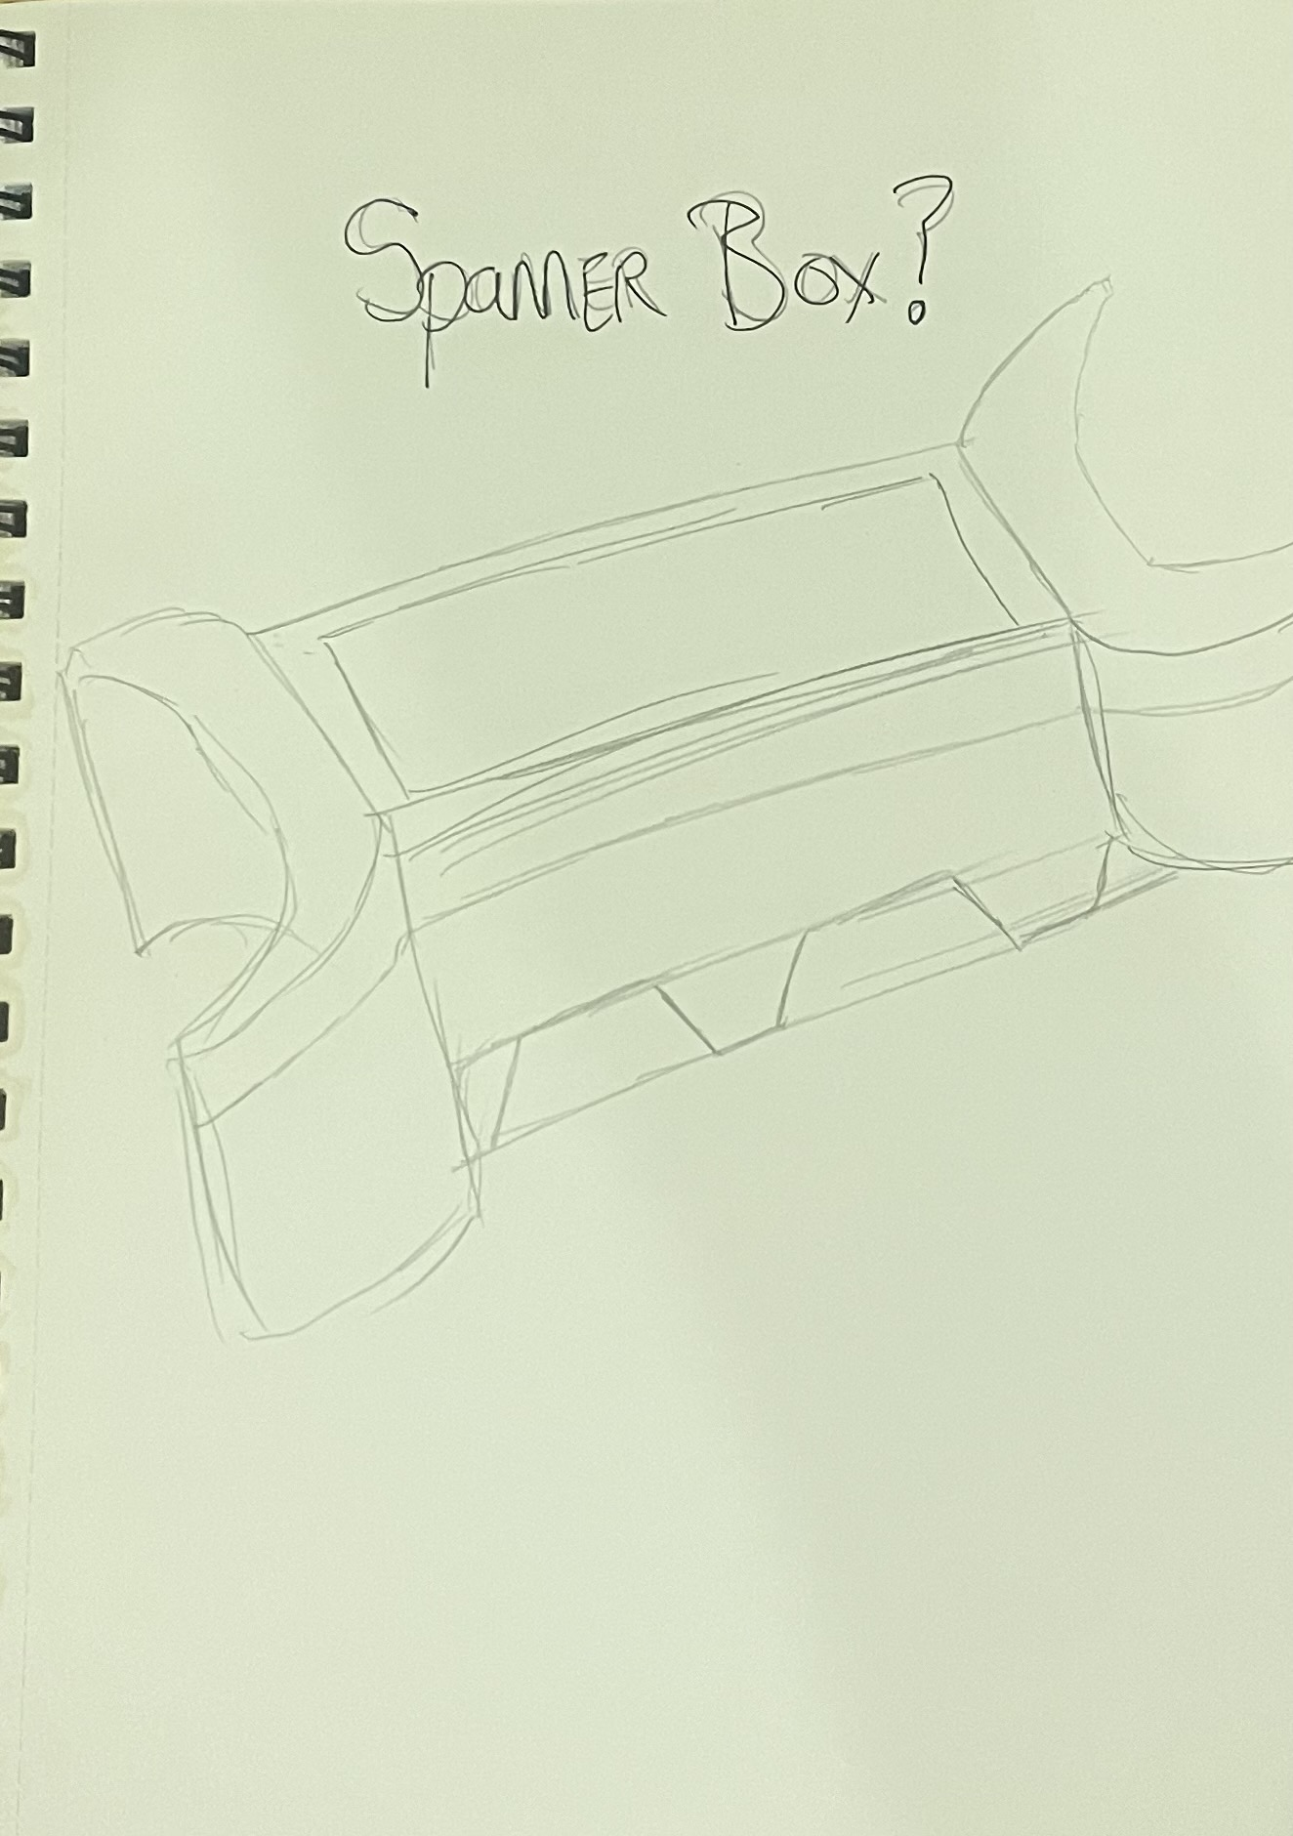
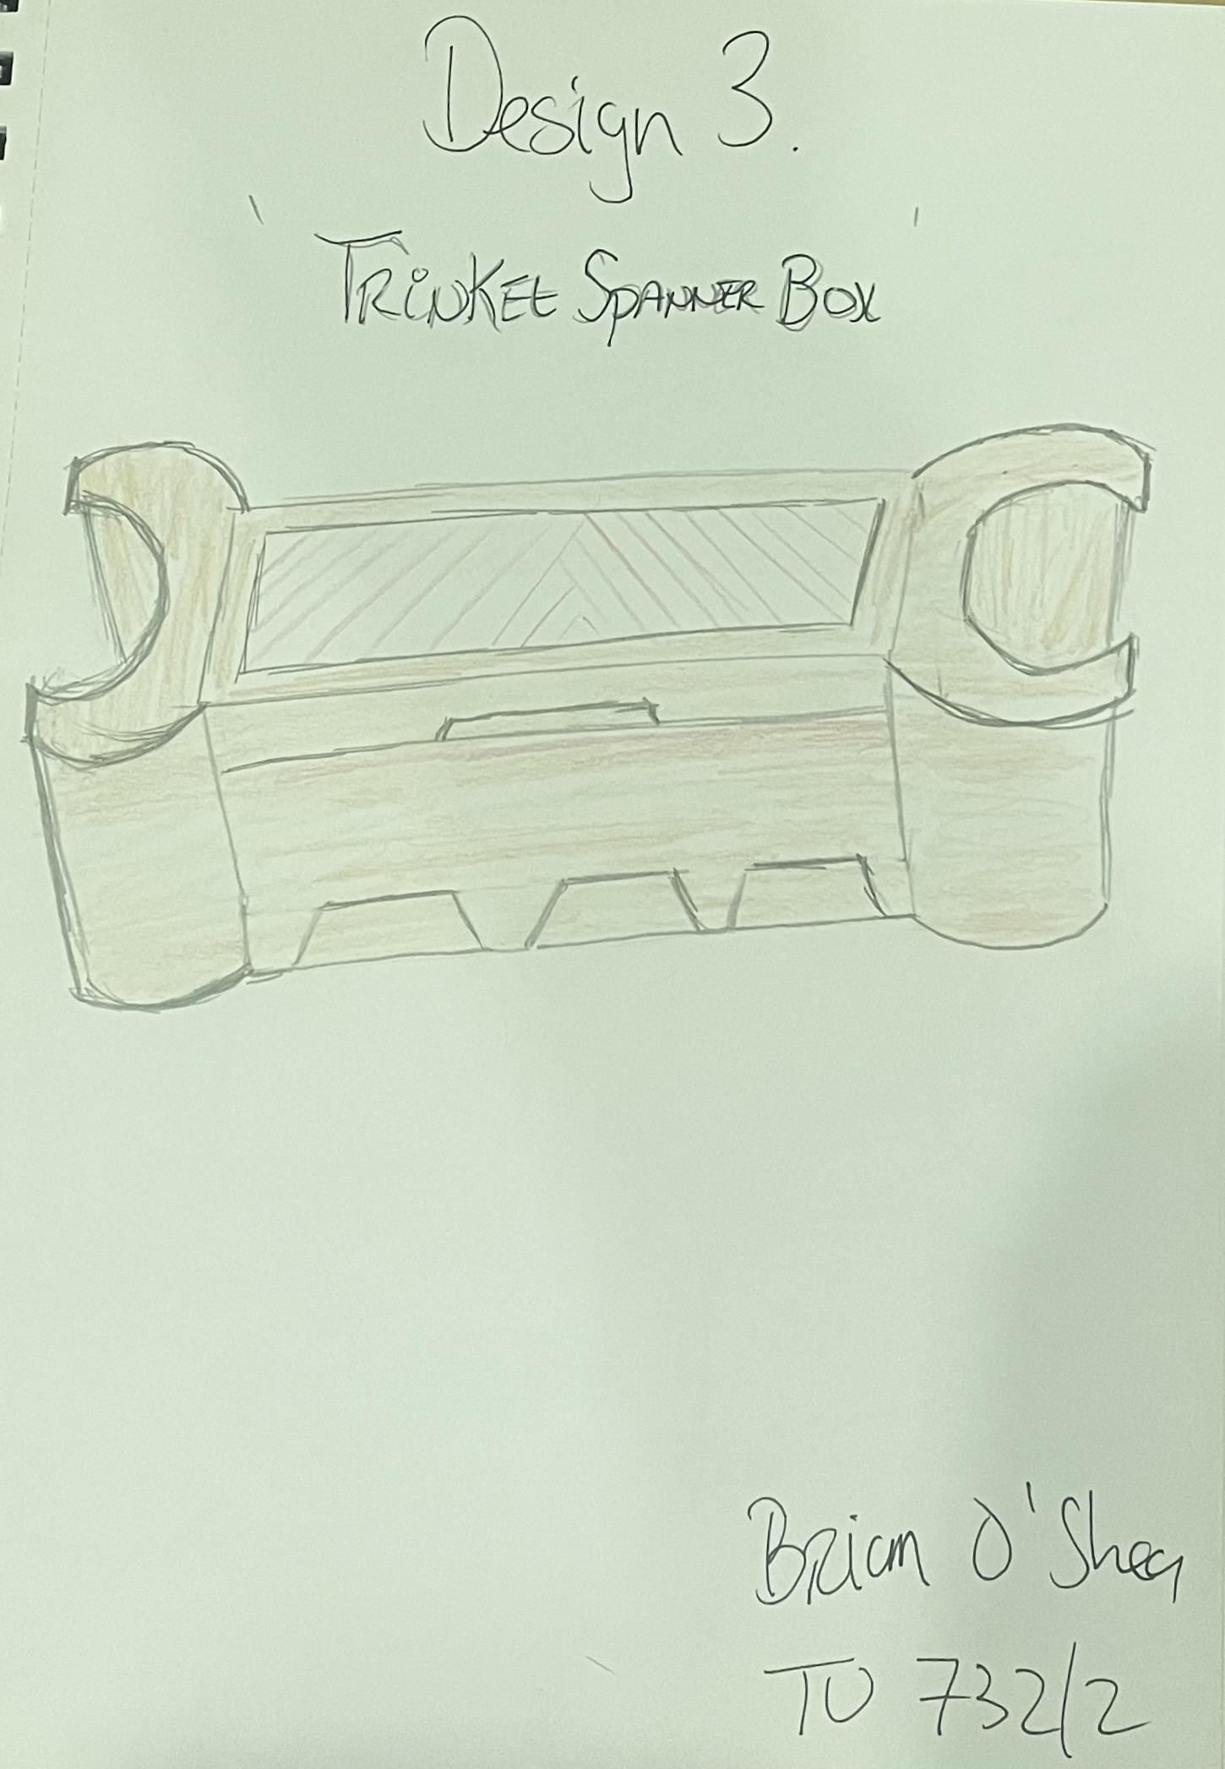
Trinket Spanner Box

Slide 7
Bobby’s wishlist
The spanner trinket box should have:
Exposed joints – dovetails!
Banding and inlays
Walnut….
A connection to the A.T.A programme
Tu Dublin logo & A.T.A digital badge

Slide 8
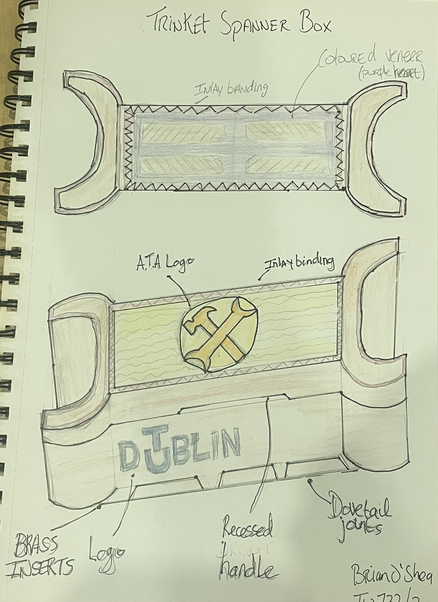
Final Design Idea

Slide 9
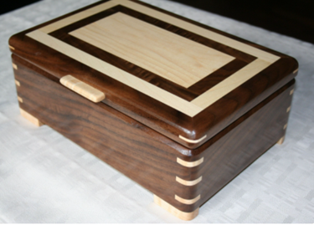
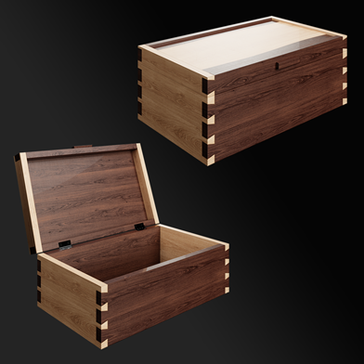
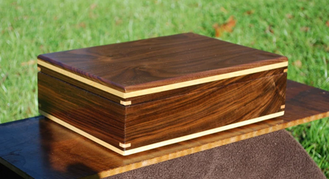
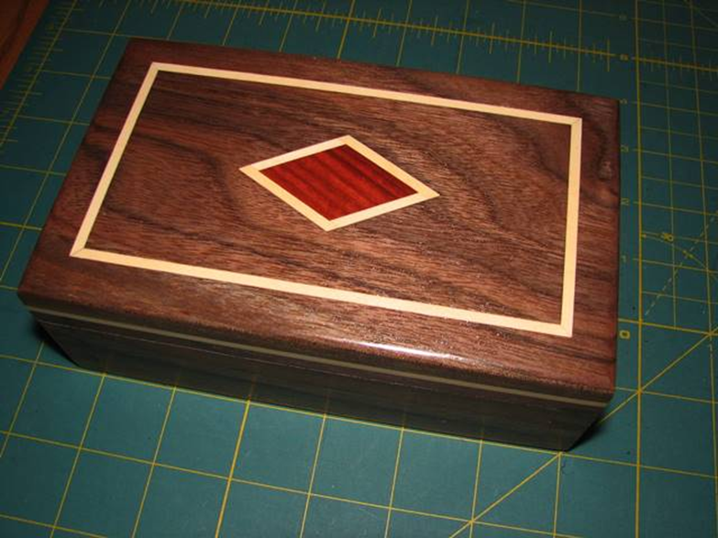
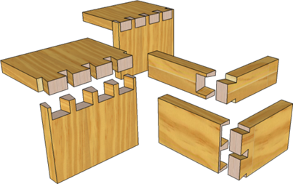
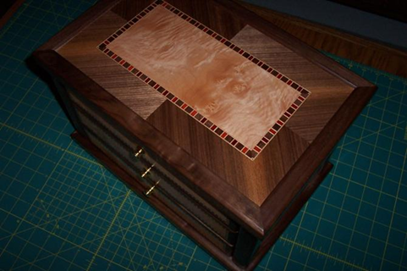
About that walnut….let’s mix and match…

Slide 10
Thanks for listening!
Your feedback is welcome

