Slide 1

Furniture Pests
WMF PH 6

Slide 2
Wood Boring Insects
Wood boring insects cause great damage
Many people bring in infested wood without realising the damage it can cause.
One adult beetle can lay over 50 eggs.
Result: 50 grubs attacking the wood.
After 3 – 5 years they emerge as beetles.
If half are female and they lay 50 eggs each, after another 3 – 5yrs there would be 1250 beetles attacking the wood.
If 600 of them were female and laid eggs there would be 30,000 grubs attacking the wood after a ten year period.
So you should be vigilant and treat wood with insecticides where it might be in danger of attack.

Slide 3
Life Cycle of a Wood Boring Insect
Stage 1
Egg
Stage 2
Larva
Stage 3
Pupa
Stage 4
Adult beetle

Slide 4
Life Cycle of a Wood Boring Insect
4 stages are similar to the Butterfly:
Stage 1: The Egg. The female beetle lays its eggs in cracks & crevices or old exit holes in the wood. After a few weeks the eggs hatch into worms or grubs.
Stage 2: The Larvae The larvae eats its way through the wood causing great damage. Sometimes destroying the wood so that it crumbles. The grub can live in the wood from 3 months to 10 years according to the type of beetle.
Stage 3: The Pupa The lava bores its way to just under the surface and changes into a pupa or chrysalis. During this month it changes into a beetle.
Stage 4: The Mating Beetle.
The adult beetle bores its way out of the wood. It flies off to mate and lays eggs then dies. So begins the cycle again.

Slide 5
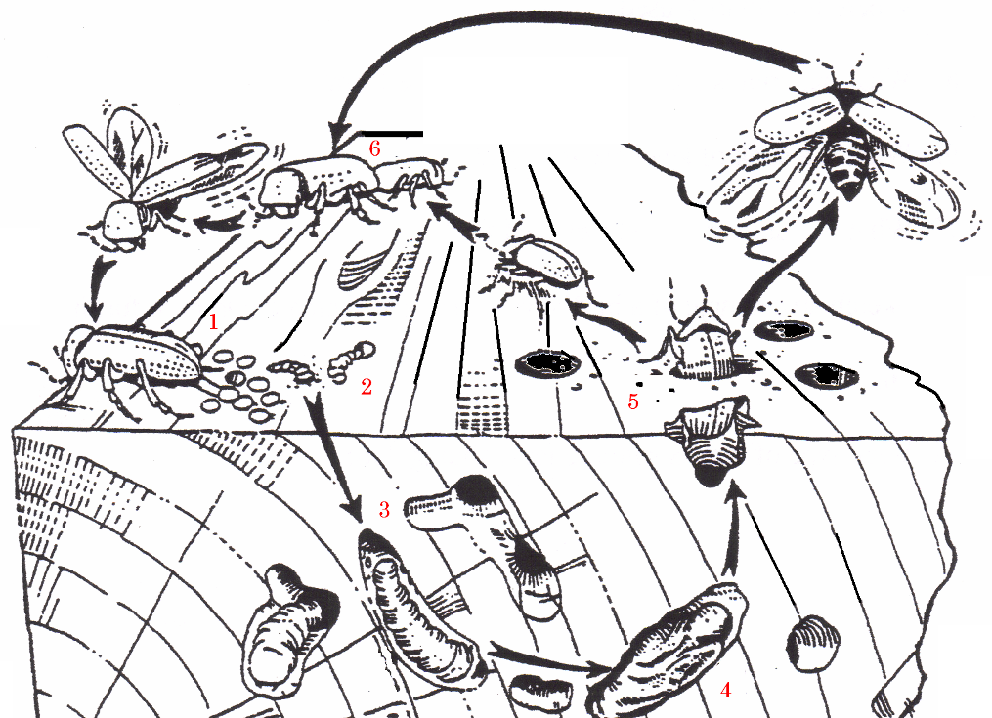
Life cycle
Stage 1. Female lays egg
approx. 20 – 40
Stage 4. Beetles mate & the cycle starts again
Stage 1 to 2.
Eggs hatch into
grubs / Larvae
Stage 2.
Larvae bore their
way through the
wood
Stage 3 to 4.
Chrysalis changes
into adult beetle
Stage 2 to 3.
Larvae / Grub bore near surface then form chrysalis / pupa

Slide 6
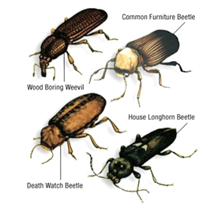
Types of Wood Boring Insects
Common Furniture Beetle
Death Watch Beetle
Wood Boring Weevil
Powder Post Beetle
House Longhorn Beetle
Commonly called woodworm
They feed on the cellulose & starch contained in all timber
The most common is the Furniture Beetle. It is responsible for 80% of damage.
Image obtained from Acorn Property Preservation

Slide 7
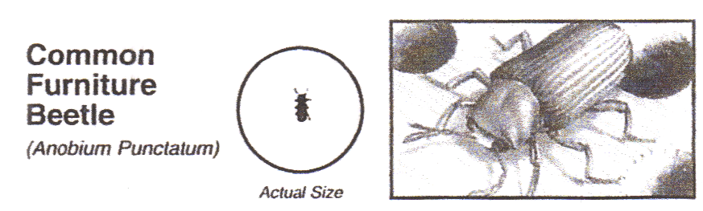
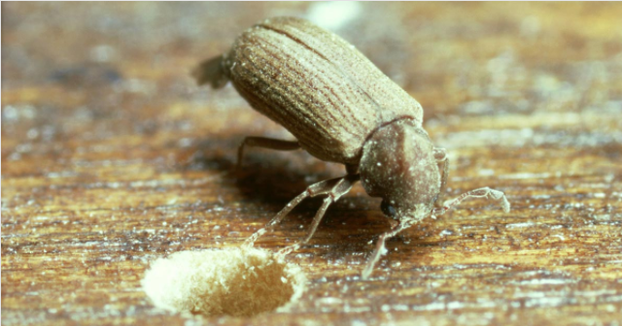
Types of Wood Boring Insects
Image from
Peter Cox
Attacks seasoned softwood & hardwoods
Flight season: April - August
Lifecycle: 3 – 4 years
Adult Common Furniture Beetle will only lay her eggs in open cracks or crevices and on the surface of untreated wood surfaces like drawer bottoms or plywood backs of cabinets, open joints.
They also often lay eggs in old exit holes.
It is responsible for 80% of damage.

Slide 8
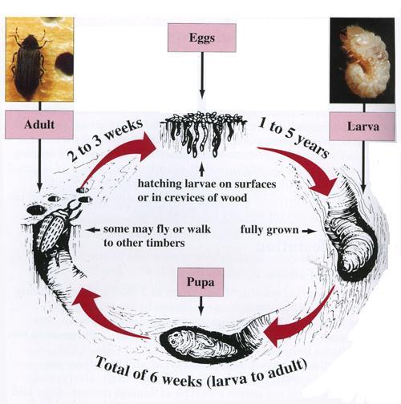
Life cycle of the Common
Furniture Beetle
Life Cycle
Eggs are laid on the timber.
Eggs hatch into larvae and they feed on the wood.
After a period of time 1 – 5 years the larvae pupates its way out of the timber and flies away.
Mating takes place, new eggs are laid, and the life cycle repeats.

Slide 9
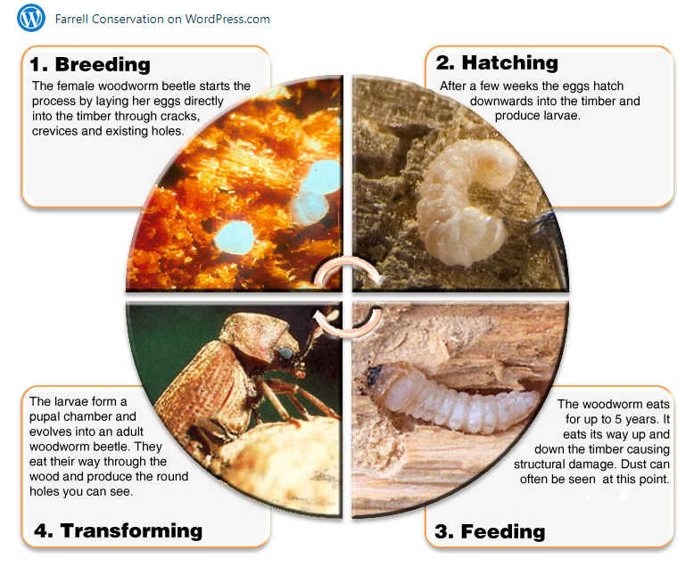
Life cycle of the common
Furniture
Beetle

Slide 10
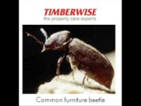
Life cycle of the common
Furniture
Beetle
Timberwise 4.26m

Slide 11
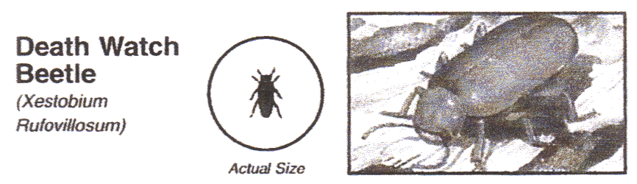
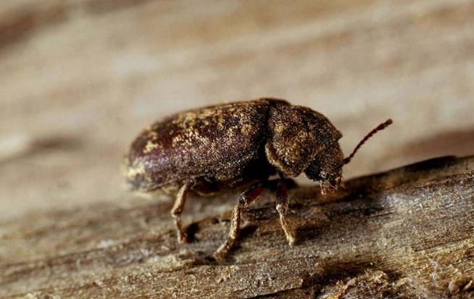
Types of Wood Boring Insects
Image from
Woodland Trust
Decaying hardwood mainly oak and softwood in contact with infested hardwood
Flight season: April – June
Lifecycle: 5 – 12 years
Responsible for the most damage in old buildings and churches commonly attacks oak and elm attacks decaying timber. The Death watch beetle was often heard by people on vigil with their loved ones in church. The beetle makes a tapping sound when it strikes its head on the surface of the timber.

Slide 12
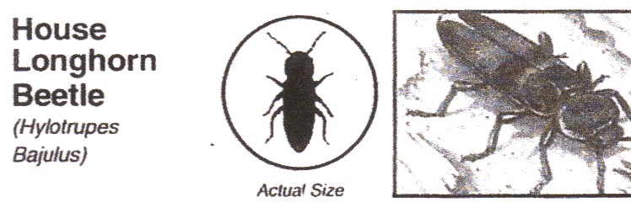
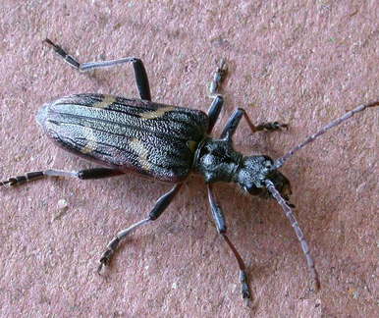
Types of Wood Boring Insects
Image from
Wise Property Care
Attacks seasoned softwood can cause huge structural damage.
Flight season: July - September
Lifecycle: 3 – 11 years
The females lay small clutches of eggs in a fan shape within shrinkage cracks in the timber surface. Only attack the sapwood of softwoods such as Pine, Spruce and Fir. Larvae bore long straight tunnels for up to 11years before emerging as adult through a 6-9mm oval hole. Beetles

Slide 13
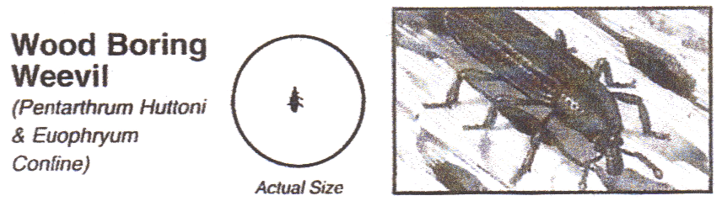
Types of Wood Boring Insects
Image from Museum Pests
Attacks decaying hardwood & softwood or plywood.
Flight season : Anytime
Lifecycle: 7 – 9 months very short lifespan
Wood-boring weevils feed on damp or decaying wood, but will also continue to eat dry wood that has previously attacked by fungus. They will also eat wood products such as cardboard and paper that have been infested with fungus.

Slide 14
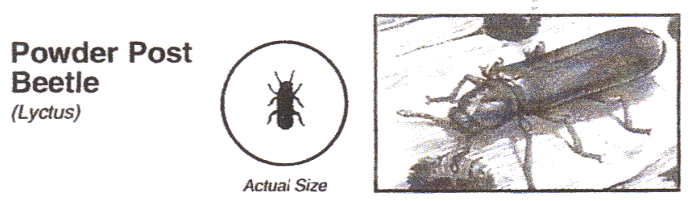
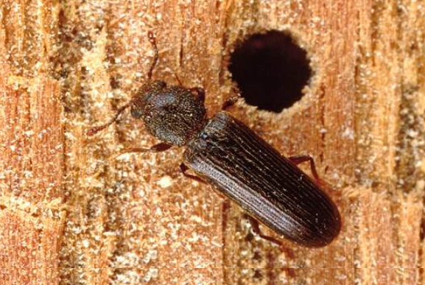
Types of Wood Boring Insects
Image obtained from
Pest World
Attacks the new sapwood of softwood.
Flight season: June to August
Lifecycle: 10 months or less one of the shortest lifespans
Collective name given to about 70 species of wood boring insects in the same family. The larvae of these beetles reduces wood to a fine powder if given enough time to feed. The female often lay their eggs in wood with high starch content like Oak, Ash, Mahogany, and Walnut. Infestations can occur in many types of wood furnishings including: panelling, flooring, window/door frames, and various types of wooden furniture.

Slide 15
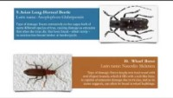
11 types of Woodworm
The Natural History Museum
Identification of 11 types 3.45m

Slide 16
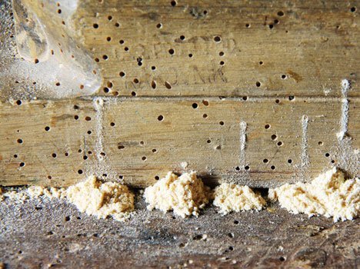
What is Fras?
Fras is the dust left behind by the larvae.
Fresh fras is usually a sign of recent activity.
So is this a sign that the timber is free from insects?

Slide 17
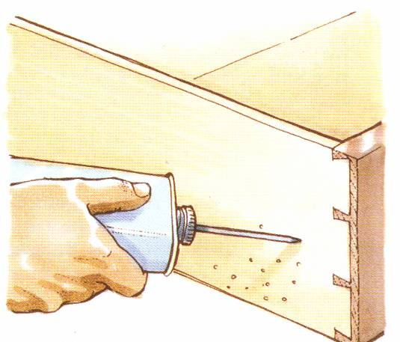
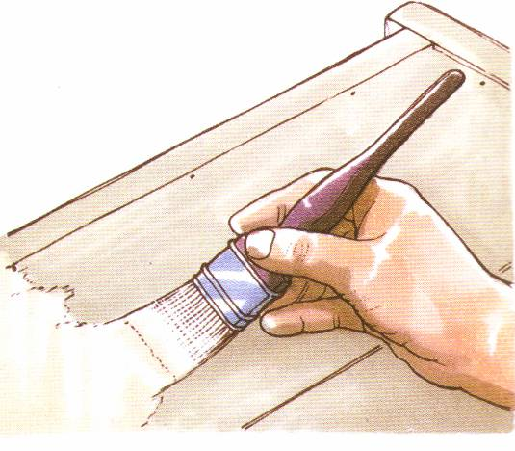
Treatment of Woodworm Infested Furniture.
Wear goggles & Mask.
Inject the chemical fluid into the flight holes.
Clean excess fluid off polished surfaces.
Brush fluid onto unfinished surfaces.
Leave to dry overnight.
Treat again.

Slide 18
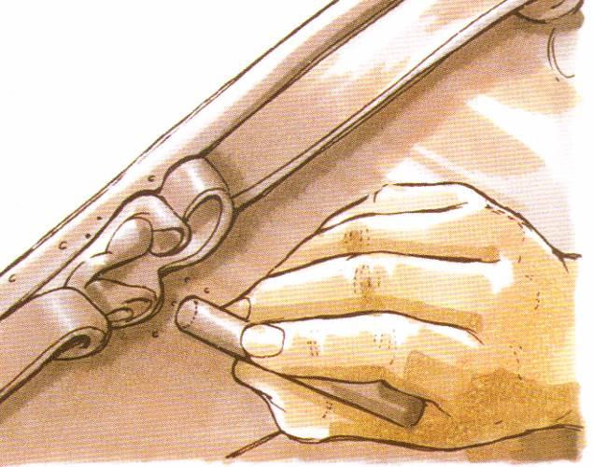
Treatment of Woodworm Infested Furniture.
Use coloured wax sticks to fill flight
holes/exit holes in a polished
Surface.
Prevention
Treating the timber with suitable preservative prior to installation.
Treating timber in-situ is less effective (Brushing or Spraying)

Slide 19
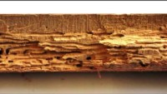
Woodworm Treatment
Protum services Ireland 2.10m

Slide 20
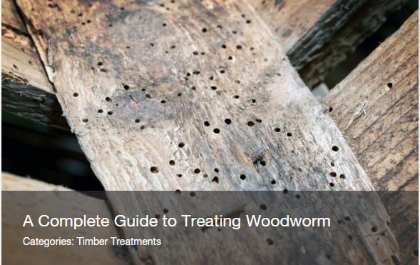
Treating Woodworm
Use trusted sites to gather information on treating woodworm.
Permagard
Timberwise
Preservation Expert

Slide 21
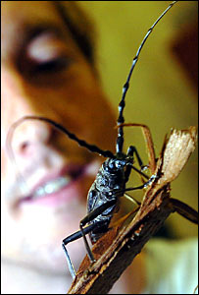
Carpenter finds 'extinct' beetle
The Giant Capricorn Beetle was found on an oak timber at a workshop in Llanelli by carpenter Ben Perrott. At first, he thought the 6cm long creature was a toy until it started to move.
Experts examined the bug, which has 10cm long antennae, and identified it as the rare beetle which was thought to be extinct in the UK since the 1700s.
Mr Perrott said he spotted the bug as he walked through the workshop of furniture restorers Foothold Group who make furniture out of recycled material.

Slide 22
Mr Perrott and his colleagues captured the bug before contacting an expert about their find. "I wasn't too worried about it because it was beetle but I wouldn't have liked it if it had been a spider," he confessed.
"We slid a piece of paper under it and put it under a glass bowl." Entomologist Ian Morgan told the Western Mail newspaper: "I realised it was something special as soon as I saw it "It is very rare and is the largest long-horned beetle in Europe.
"This type of long-horn beetle was supposed to have been extinct in the UK since 1700.
"This is the first time in centuries that it has been seen here in Wales.".

Slide 23
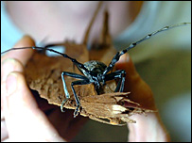
"This type of long-horn beetle was supposed to have been extinct in the UK since 1700.
"This is the first time in centuries that it has been seen here in Wales.".
He said the beetle was male and hoped more beetles will be found because the larvae takes more than two years to grow. Workers at the furniture plant have set up a tank for the beetle to live in and plan to donate its remains to the National Museum of Wales when it dies.
More on the story.

Slide 24
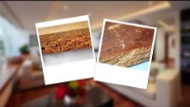
Furniture Pests
How to get rid of Woodworm with Chemicals?
How to Get Rid
of Borer and
Protect Wood
from
Borer Damage
(2.35mins)
https://youtu.be/JYM2IEWBtYE?si=9ImAoOZrDv58UzP- https://youtu.be/QFxjZooAyGw?si=MnlpJSCnifZiDQuF

Slide 25

Furniture Pests
How to get rid of Woodworm?
Get rid of
woodworm
for good
(no pesticides)
(6.52)
https://youtu.be/QFxjZooAyGw?si=MnlpJSCnifZiDQuF

Slide 26

Revision Questions
Scan the QR Code and answer the questions

