Slide 1

James Whyte
Principles of Furniture and Joinery Design.

Slide 2

Artefact Presentation 29/11/2021
Clients: Access to Apprenticeship
Bobby Maher
Therese Fitzgerald

Slide 3
Key points from previous meeting
Gift to members for their support and interest in helping develop young people.
Trinket Box/ functional, to be on display
Craft element to be shown off as a visual representation of the work being done in the programme.
Exposed joints.
Logo
Overall dimensions around 120 x 200 x 300mms

Slide 4

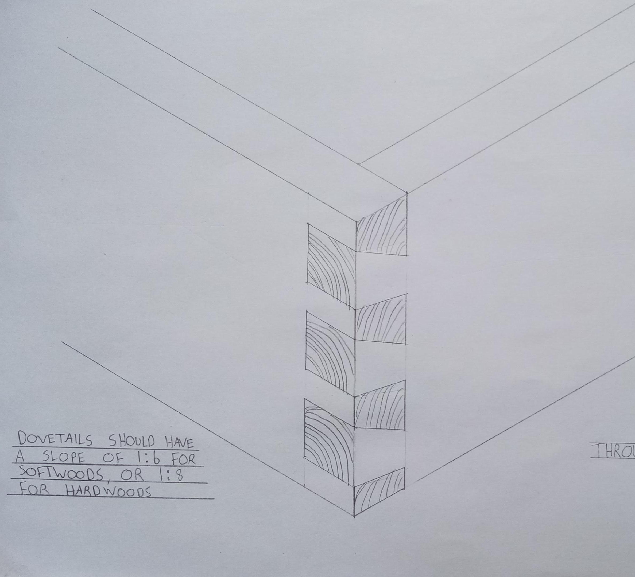
Ideas
Through Dovetail.
Exposed joint
Shows craft

Slide 5
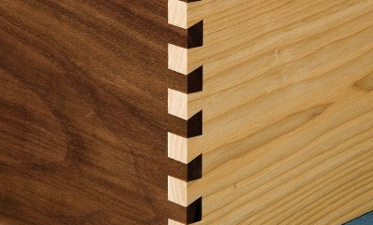
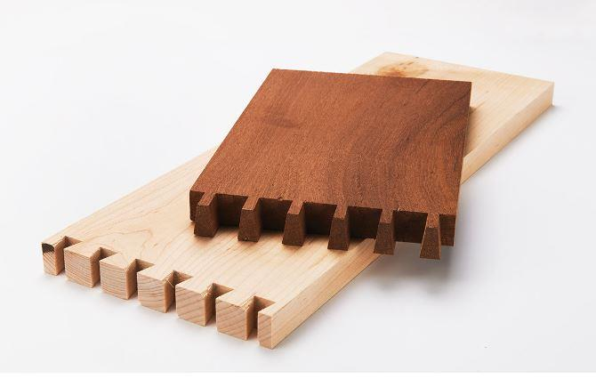
Wood choice
Walnut and Maple
Can see joints clearly
Nice contrast in colour

Slide 6
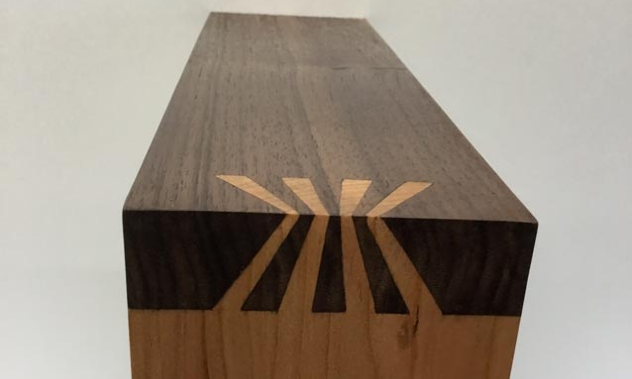
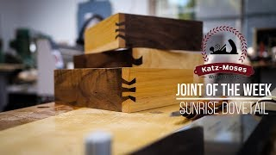
Feature Joint
Symbolism of a sunrise
New dawn, brighter future
Encapsulates the ethos of the Apprenticeship program

Slide 7
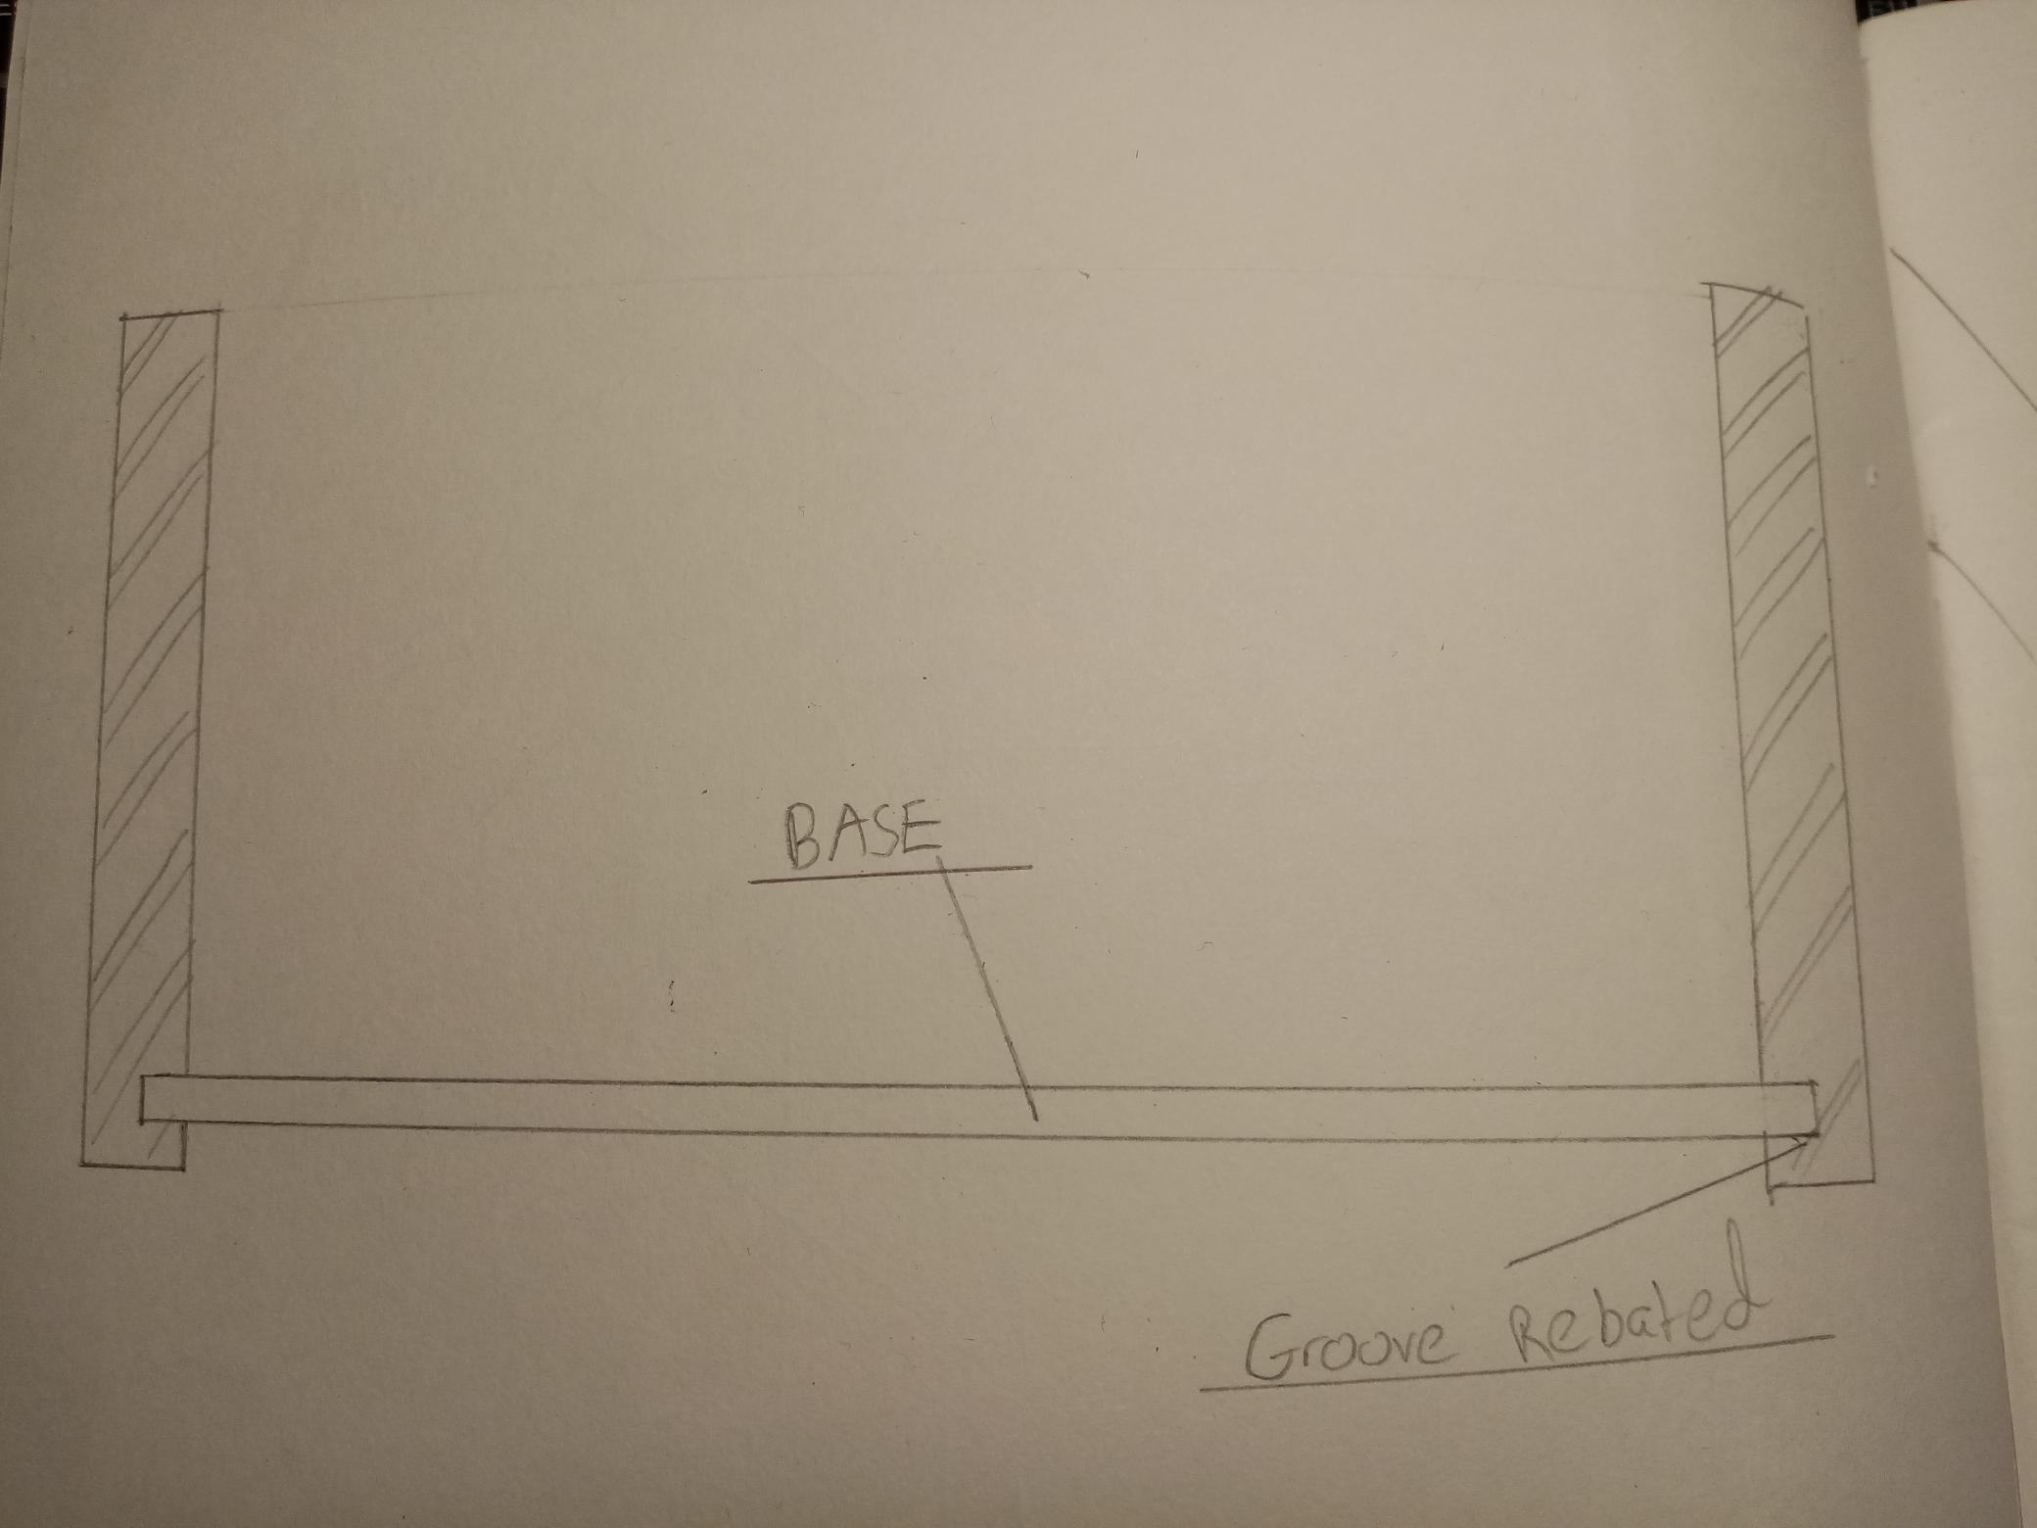
Base
Plywood base
Grooves rebated on all four pieces
Can be Veneered

Slide 8
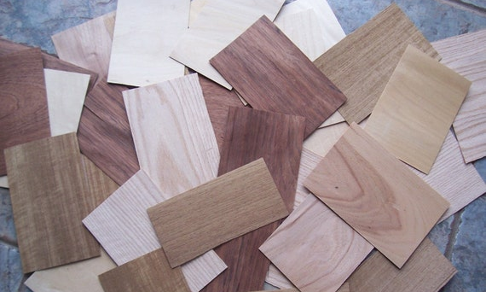
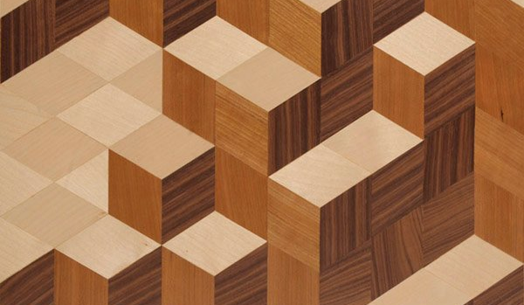
Veneer pattern
Combining different colours of veneer gives a nice design pattern.
The cubes represent building blocks, obstacles, problem solving.
Will add a feature to inside of box

Slide 9
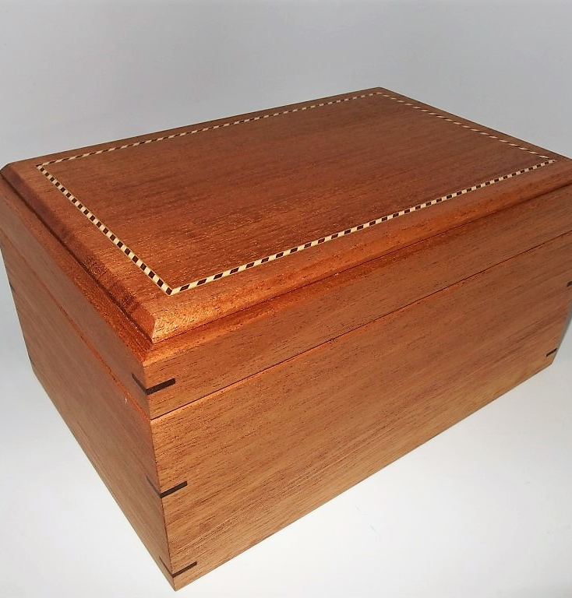
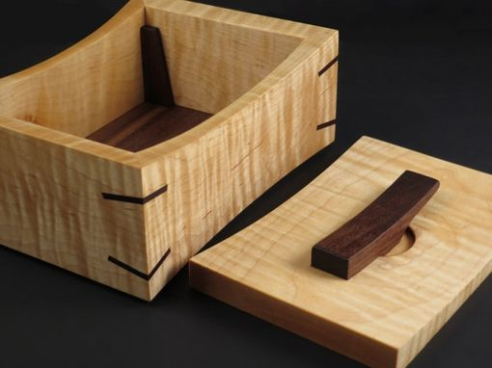
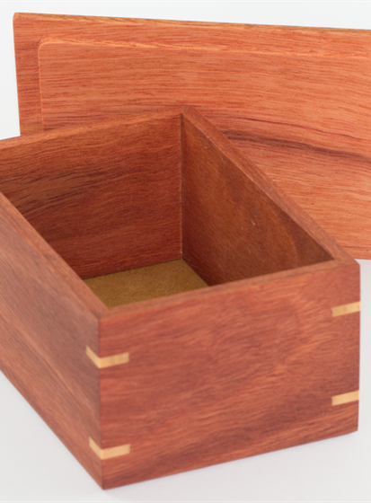
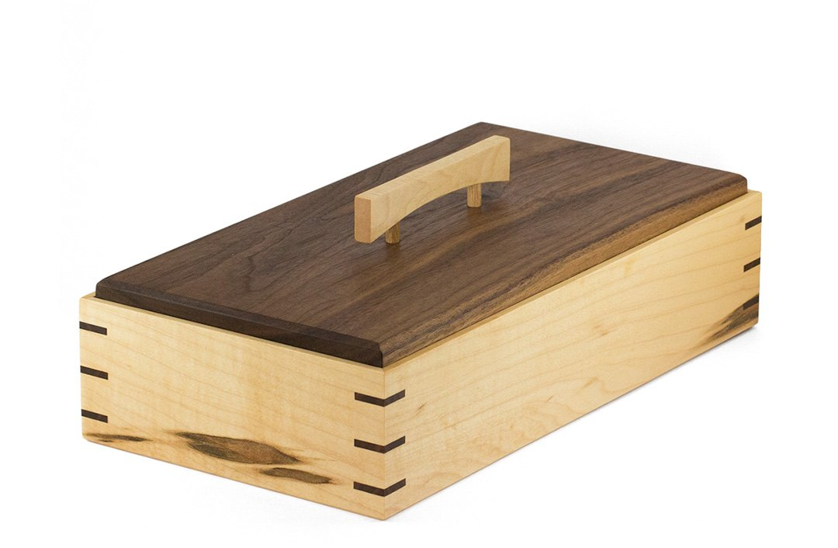
Lid
Profiled edge, Chamfer or a molding.
No hinges.
Rebated underneath so fits into box snug.
Has a handle on top to lift lid on and off box.
Contrasting colours between lid and handle

Slide 10
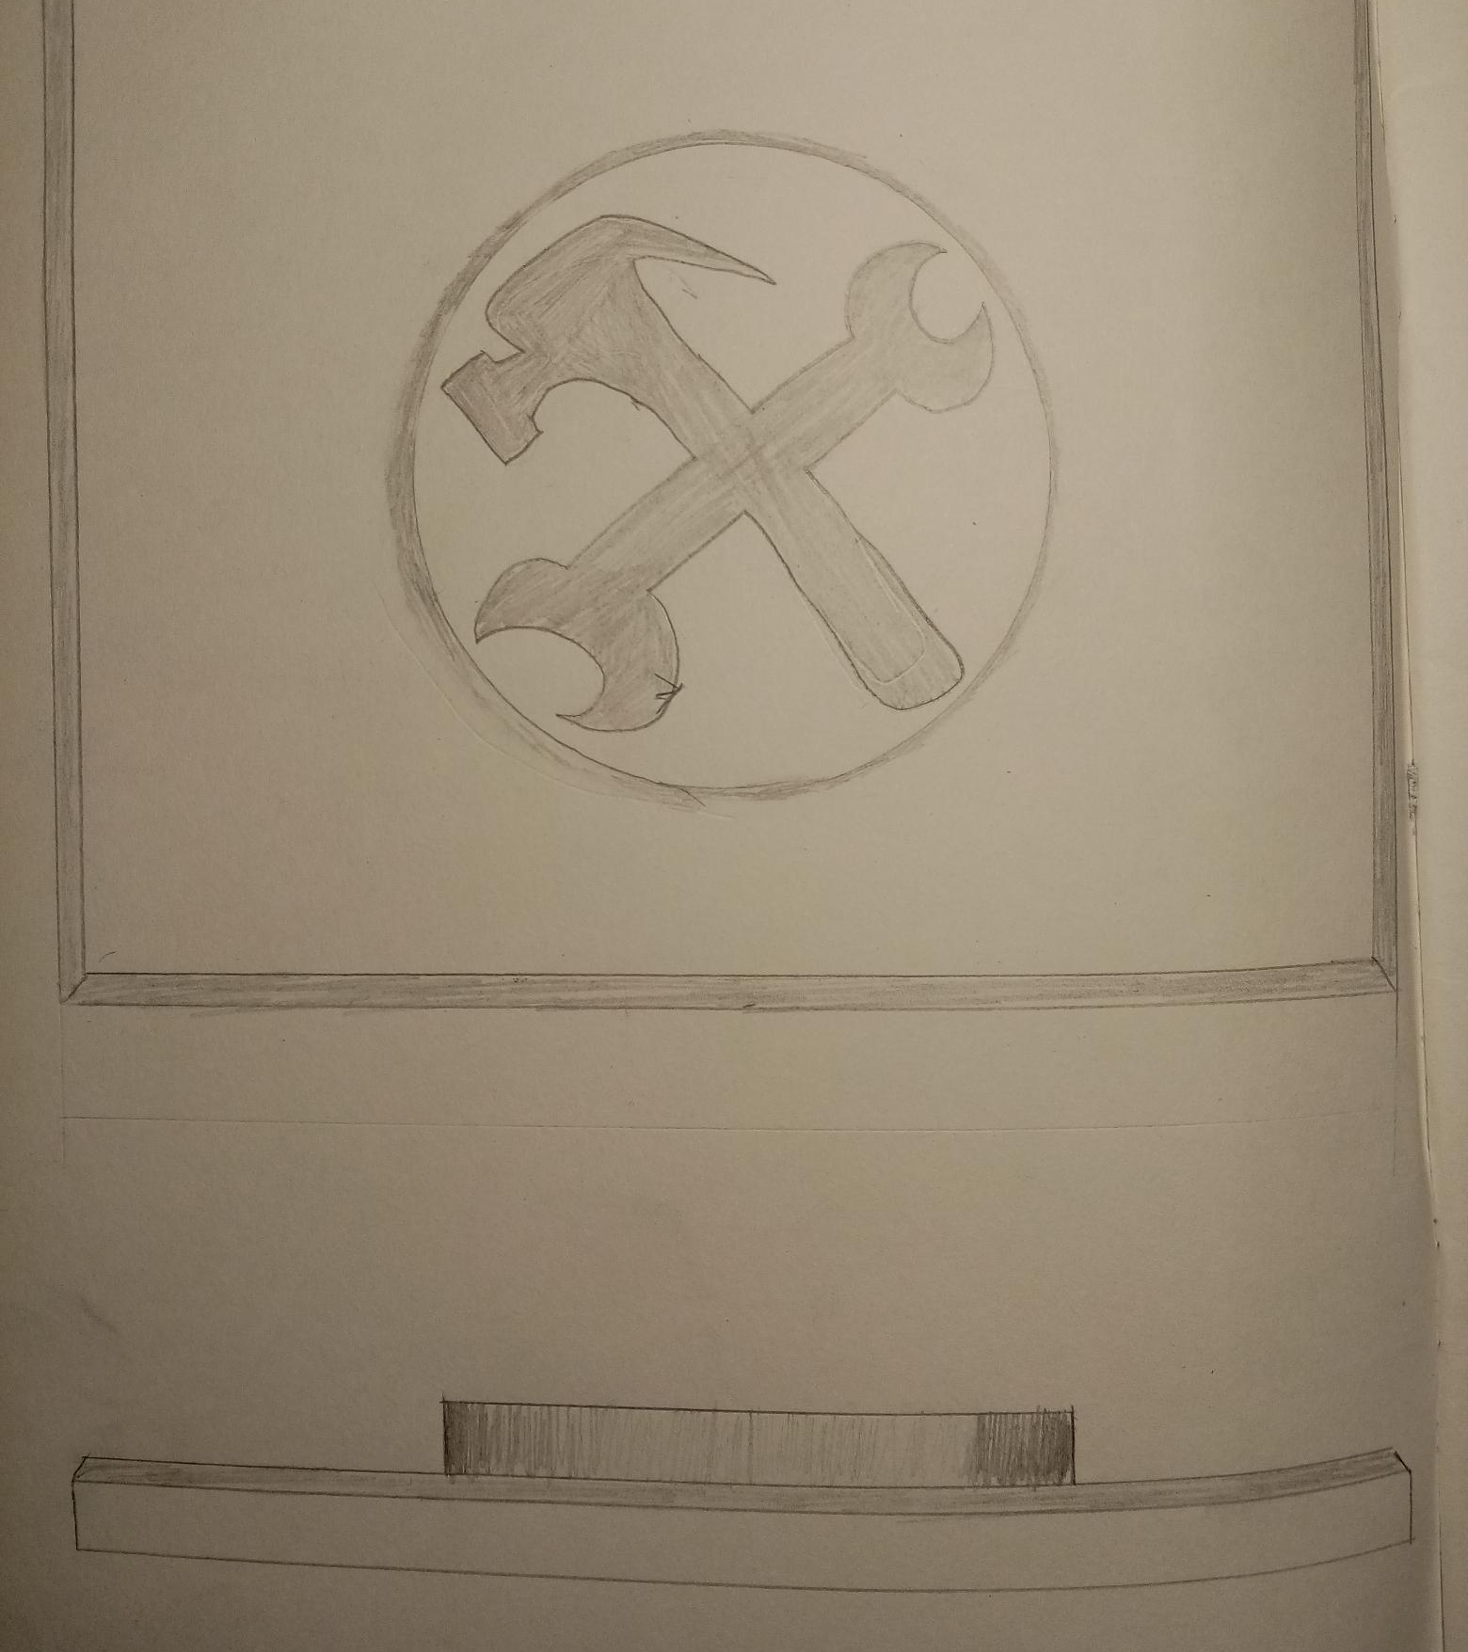
Handle
Lid piece will be darker colour and handle in the brighter wood.
Hammer and wrench will be chip carved out of a circular piece of wood that will be attached to lid.
Shows Access to Apprenticeship logo.
The carving of the symbol shows visual representation of crafts and skills that go into the Apprenticeship program.
Looks like a physical badge.

Slide 11
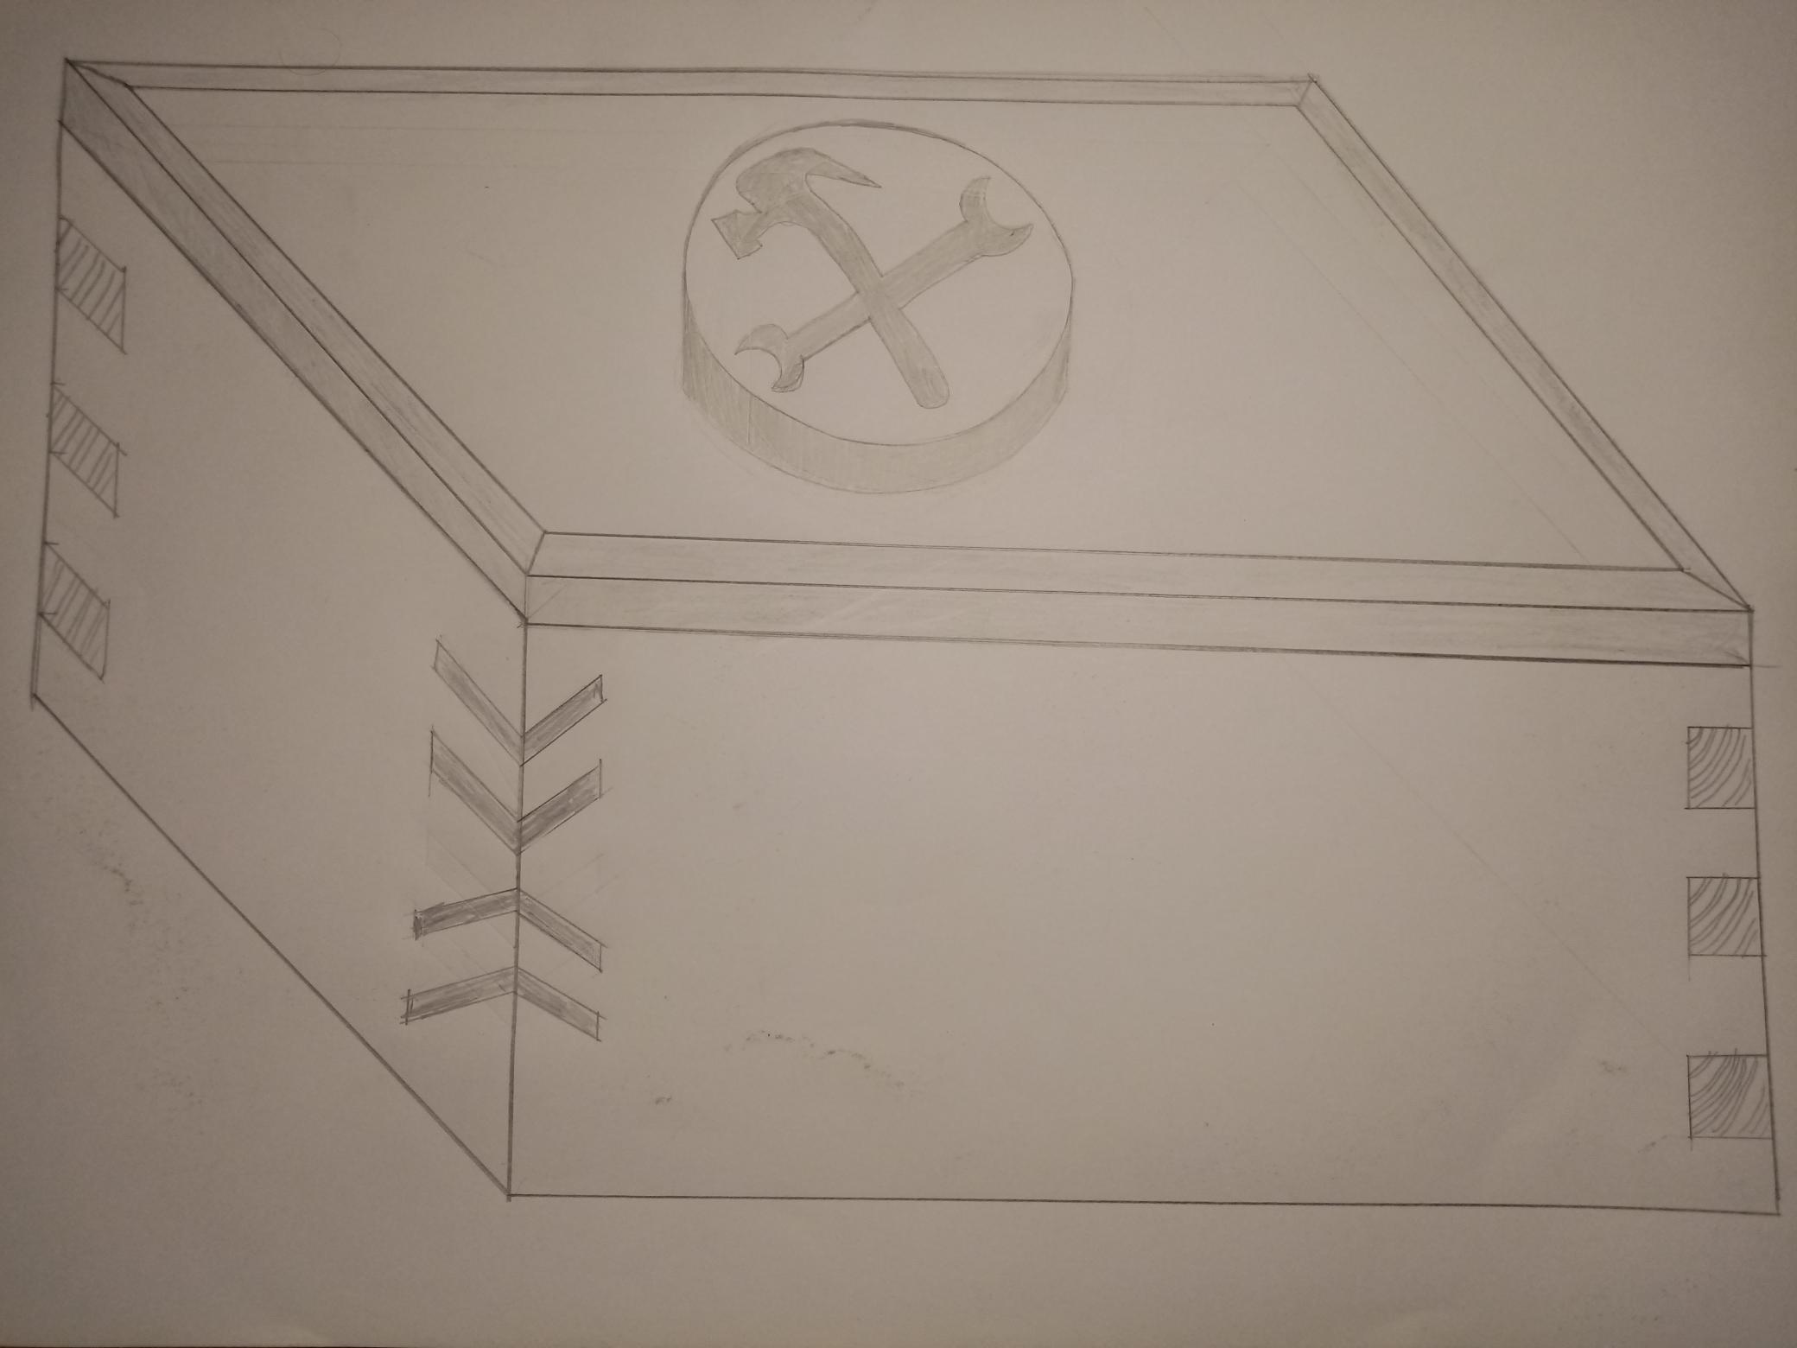
Thanks
Space on front for the 120mm x 50mm plaque

