Slide 1
Design Presentation to access to apprenticeship clients
By Neil Schorman

Slide 2
Introduction
Design and present an artefact to Therese Fitzgerald and Bobby Maher of TU Dublin Access to Apprenticeship. This artefact will be gifted to the Advisory Board members of the ATA programme.
This artefact should:
  Make the ATA partner feel valued.
  ‘Capture the essence of the programme.’
  Have an apprenticeship theme.
  Display the ATA logo.
  Be a box to be used on a desk.

Slide 3
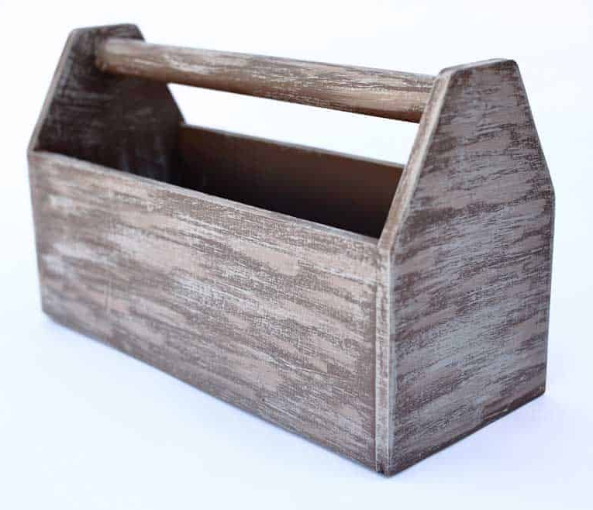
Design inspiration
My first thought when trying to capture the essence of the programme was an old fashioned toolbox.
No matter what trade background you are from a toolbox is always a welcome and familiar sight.
Image courtesy of thediyplan.com

Slide 4
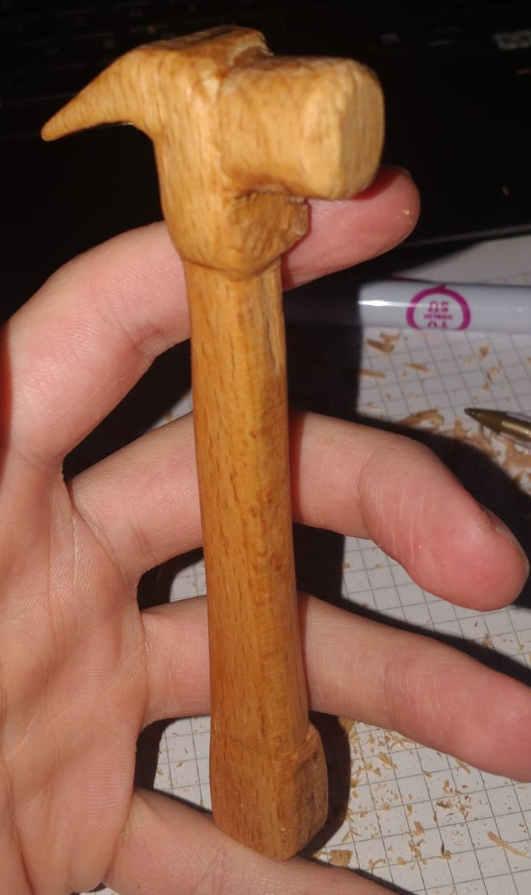
Access to Apprenticeship Logo
When trying to incorporate the ATA digital badge logo I decided it would be nice to make a tangible version of the logo out of timber. For this I will carve a hammer and a wrench from timber and incorporate them into my design.

Slide 5
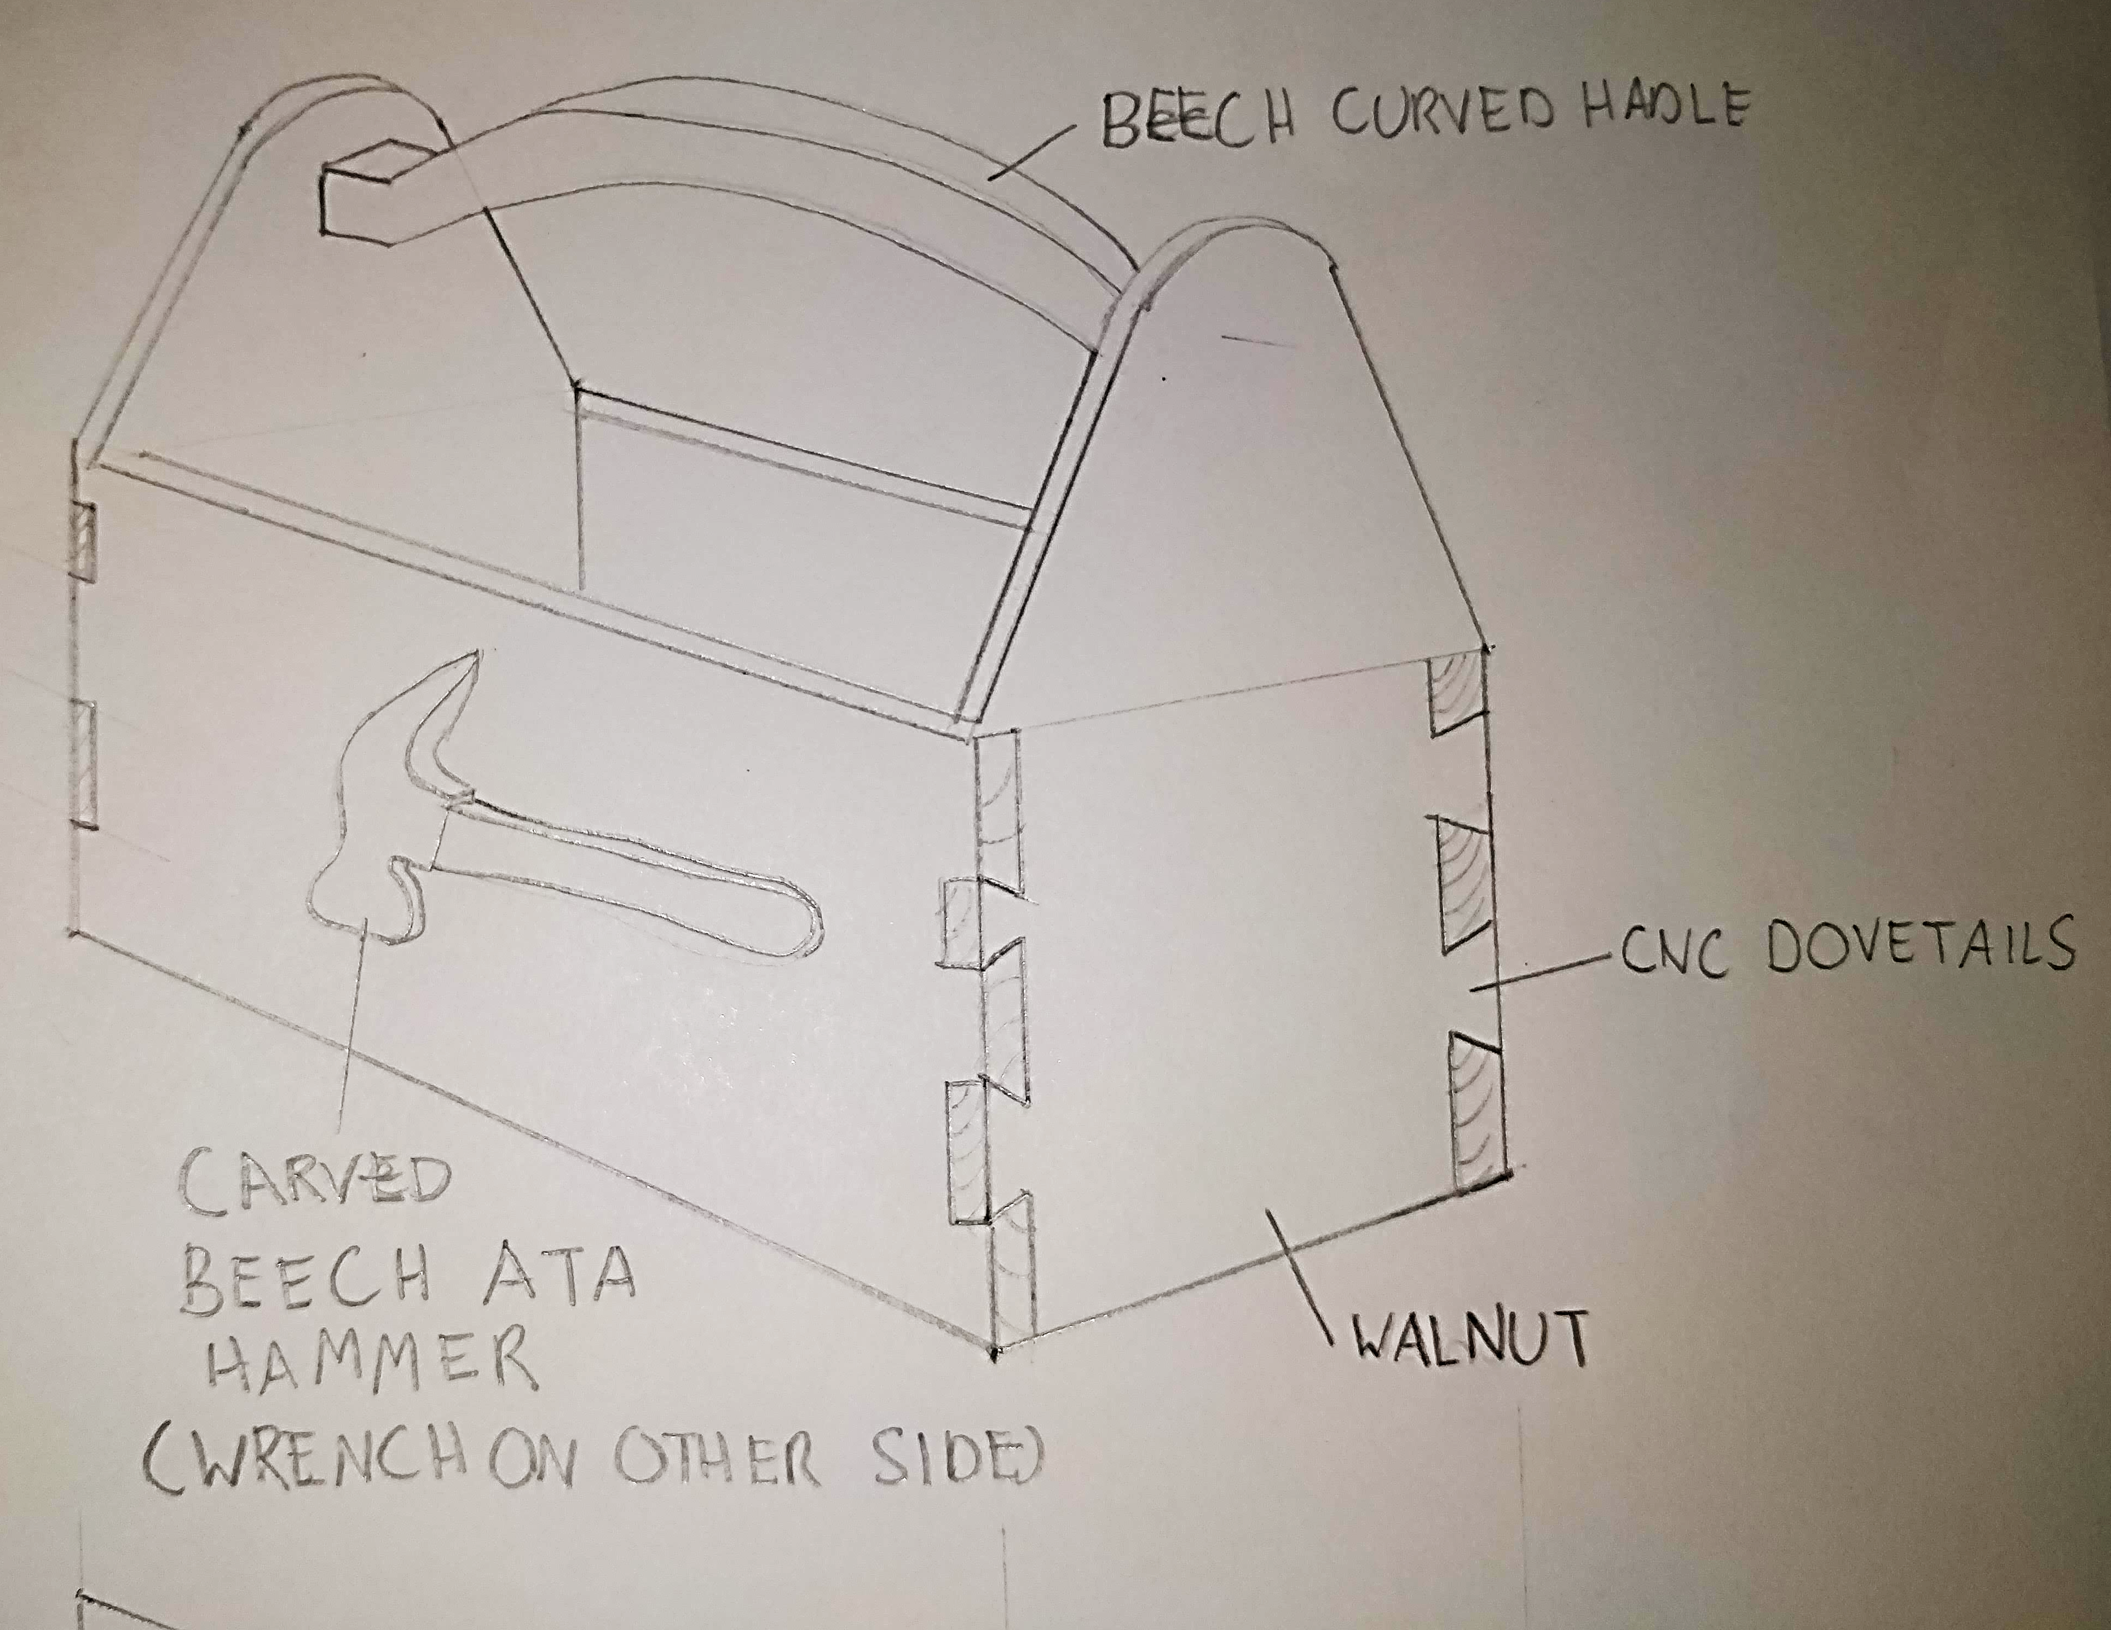
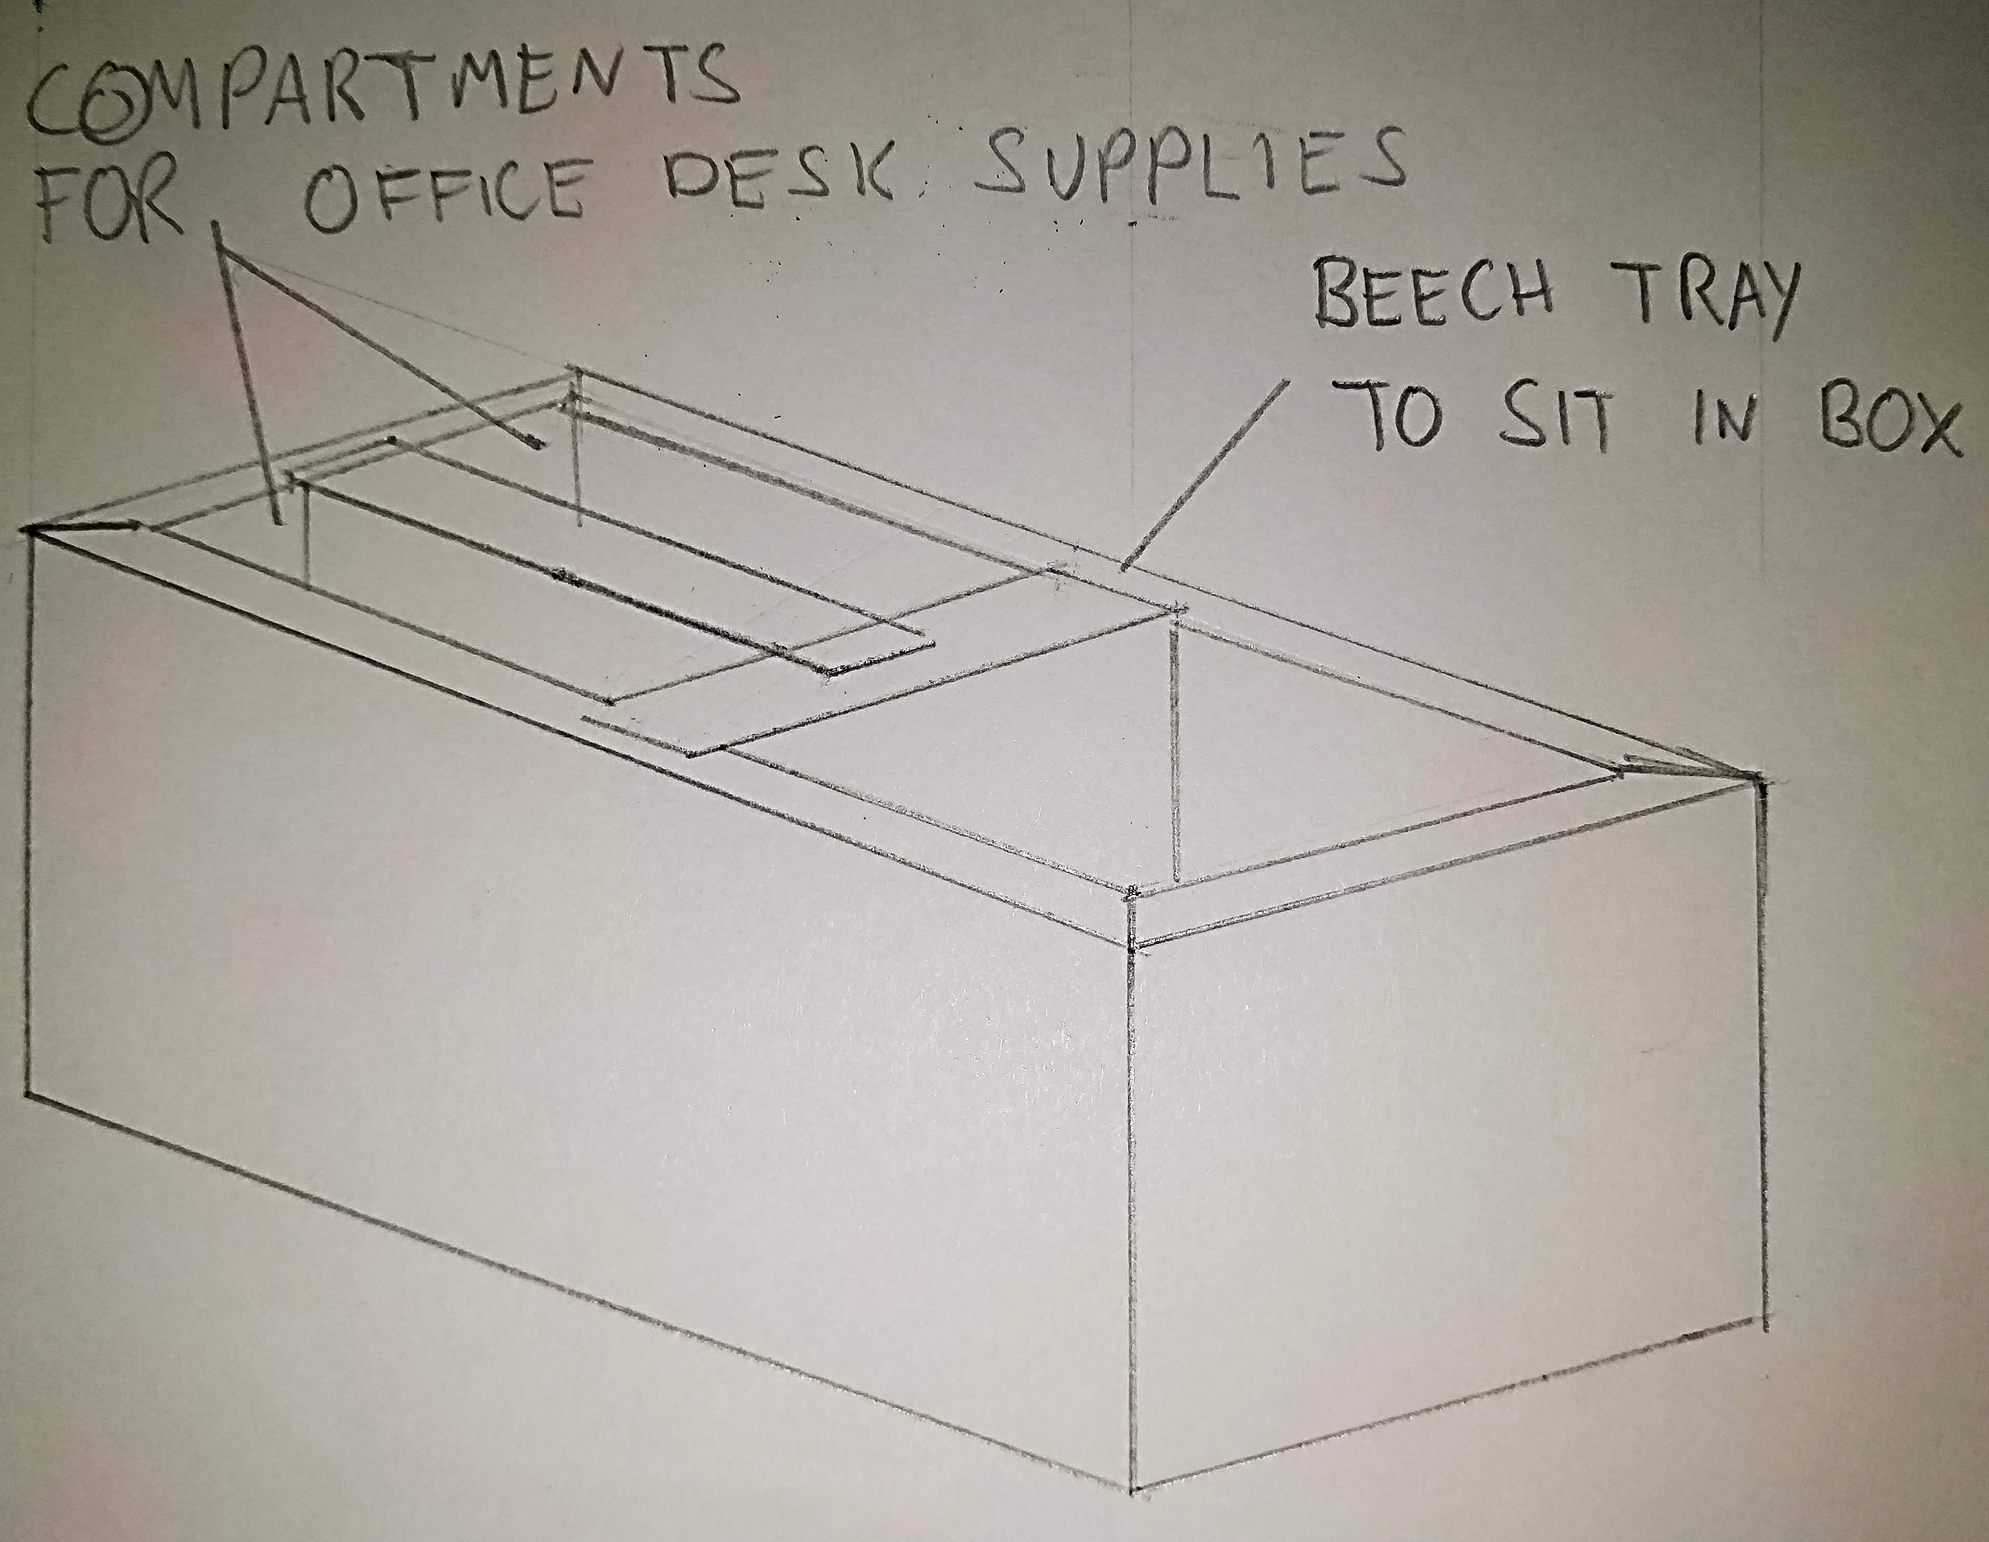
Final design
Final design incorporates toolbox design, physical ATA logo and storage for desk supplies.

Slide 6
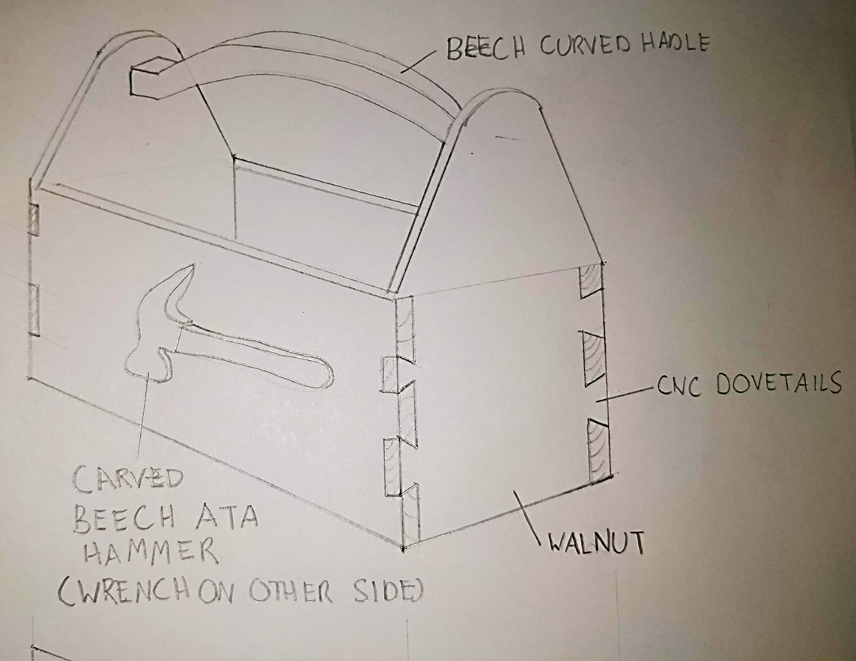
Thank you for your time.
Presented by Neil Schorman

