Slide 1
Restoring a
Writing Bureau
Step by step.

Slide 2
Assessment
Check over the item and assess the damage.
Structural repairs should be carried out first.
Veneers, replacement parts etc.
Finish.

Slide 3
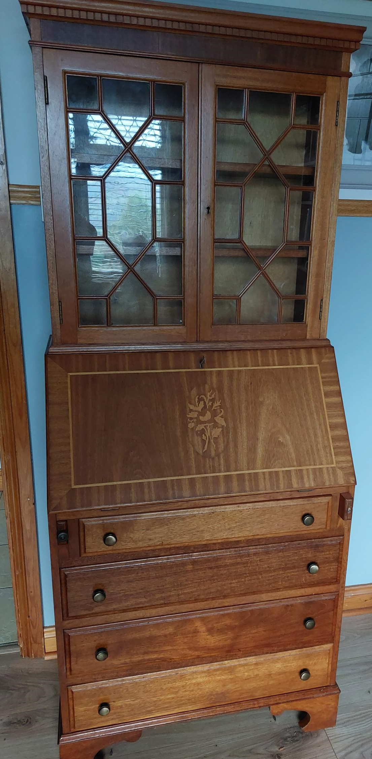
Assessment
The Bureau was made in 1992, 31 years old.
Made from a mix of solid mahogany and mahogany veneered plywood and chipboard.
Mainly surface wear and tear.
Some surface damage.

Slide 4
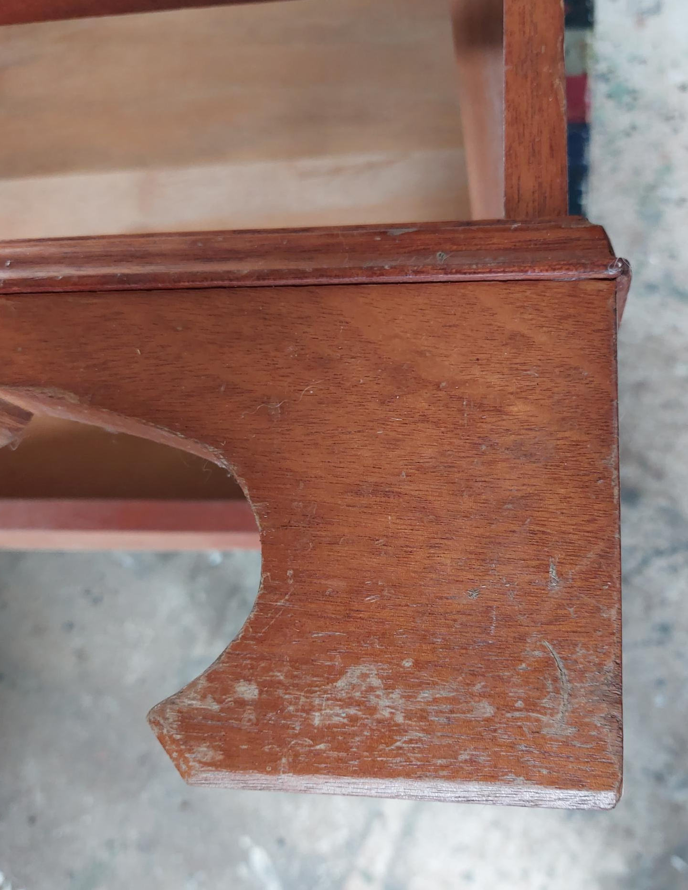
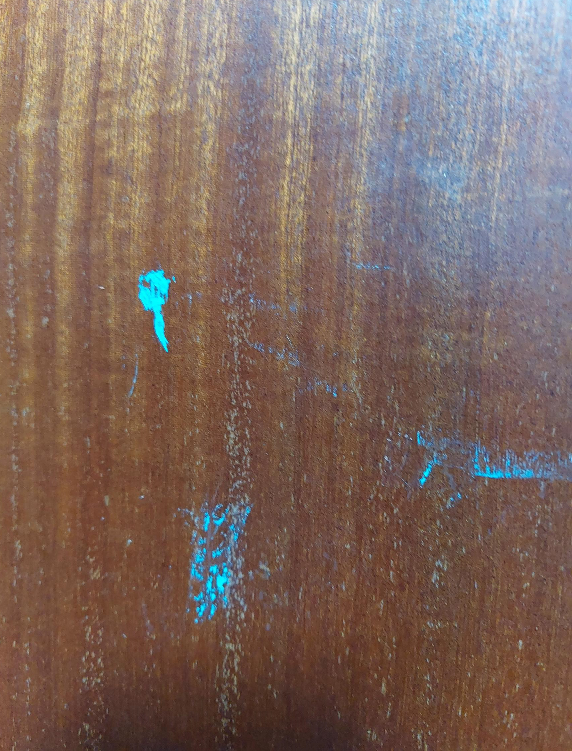
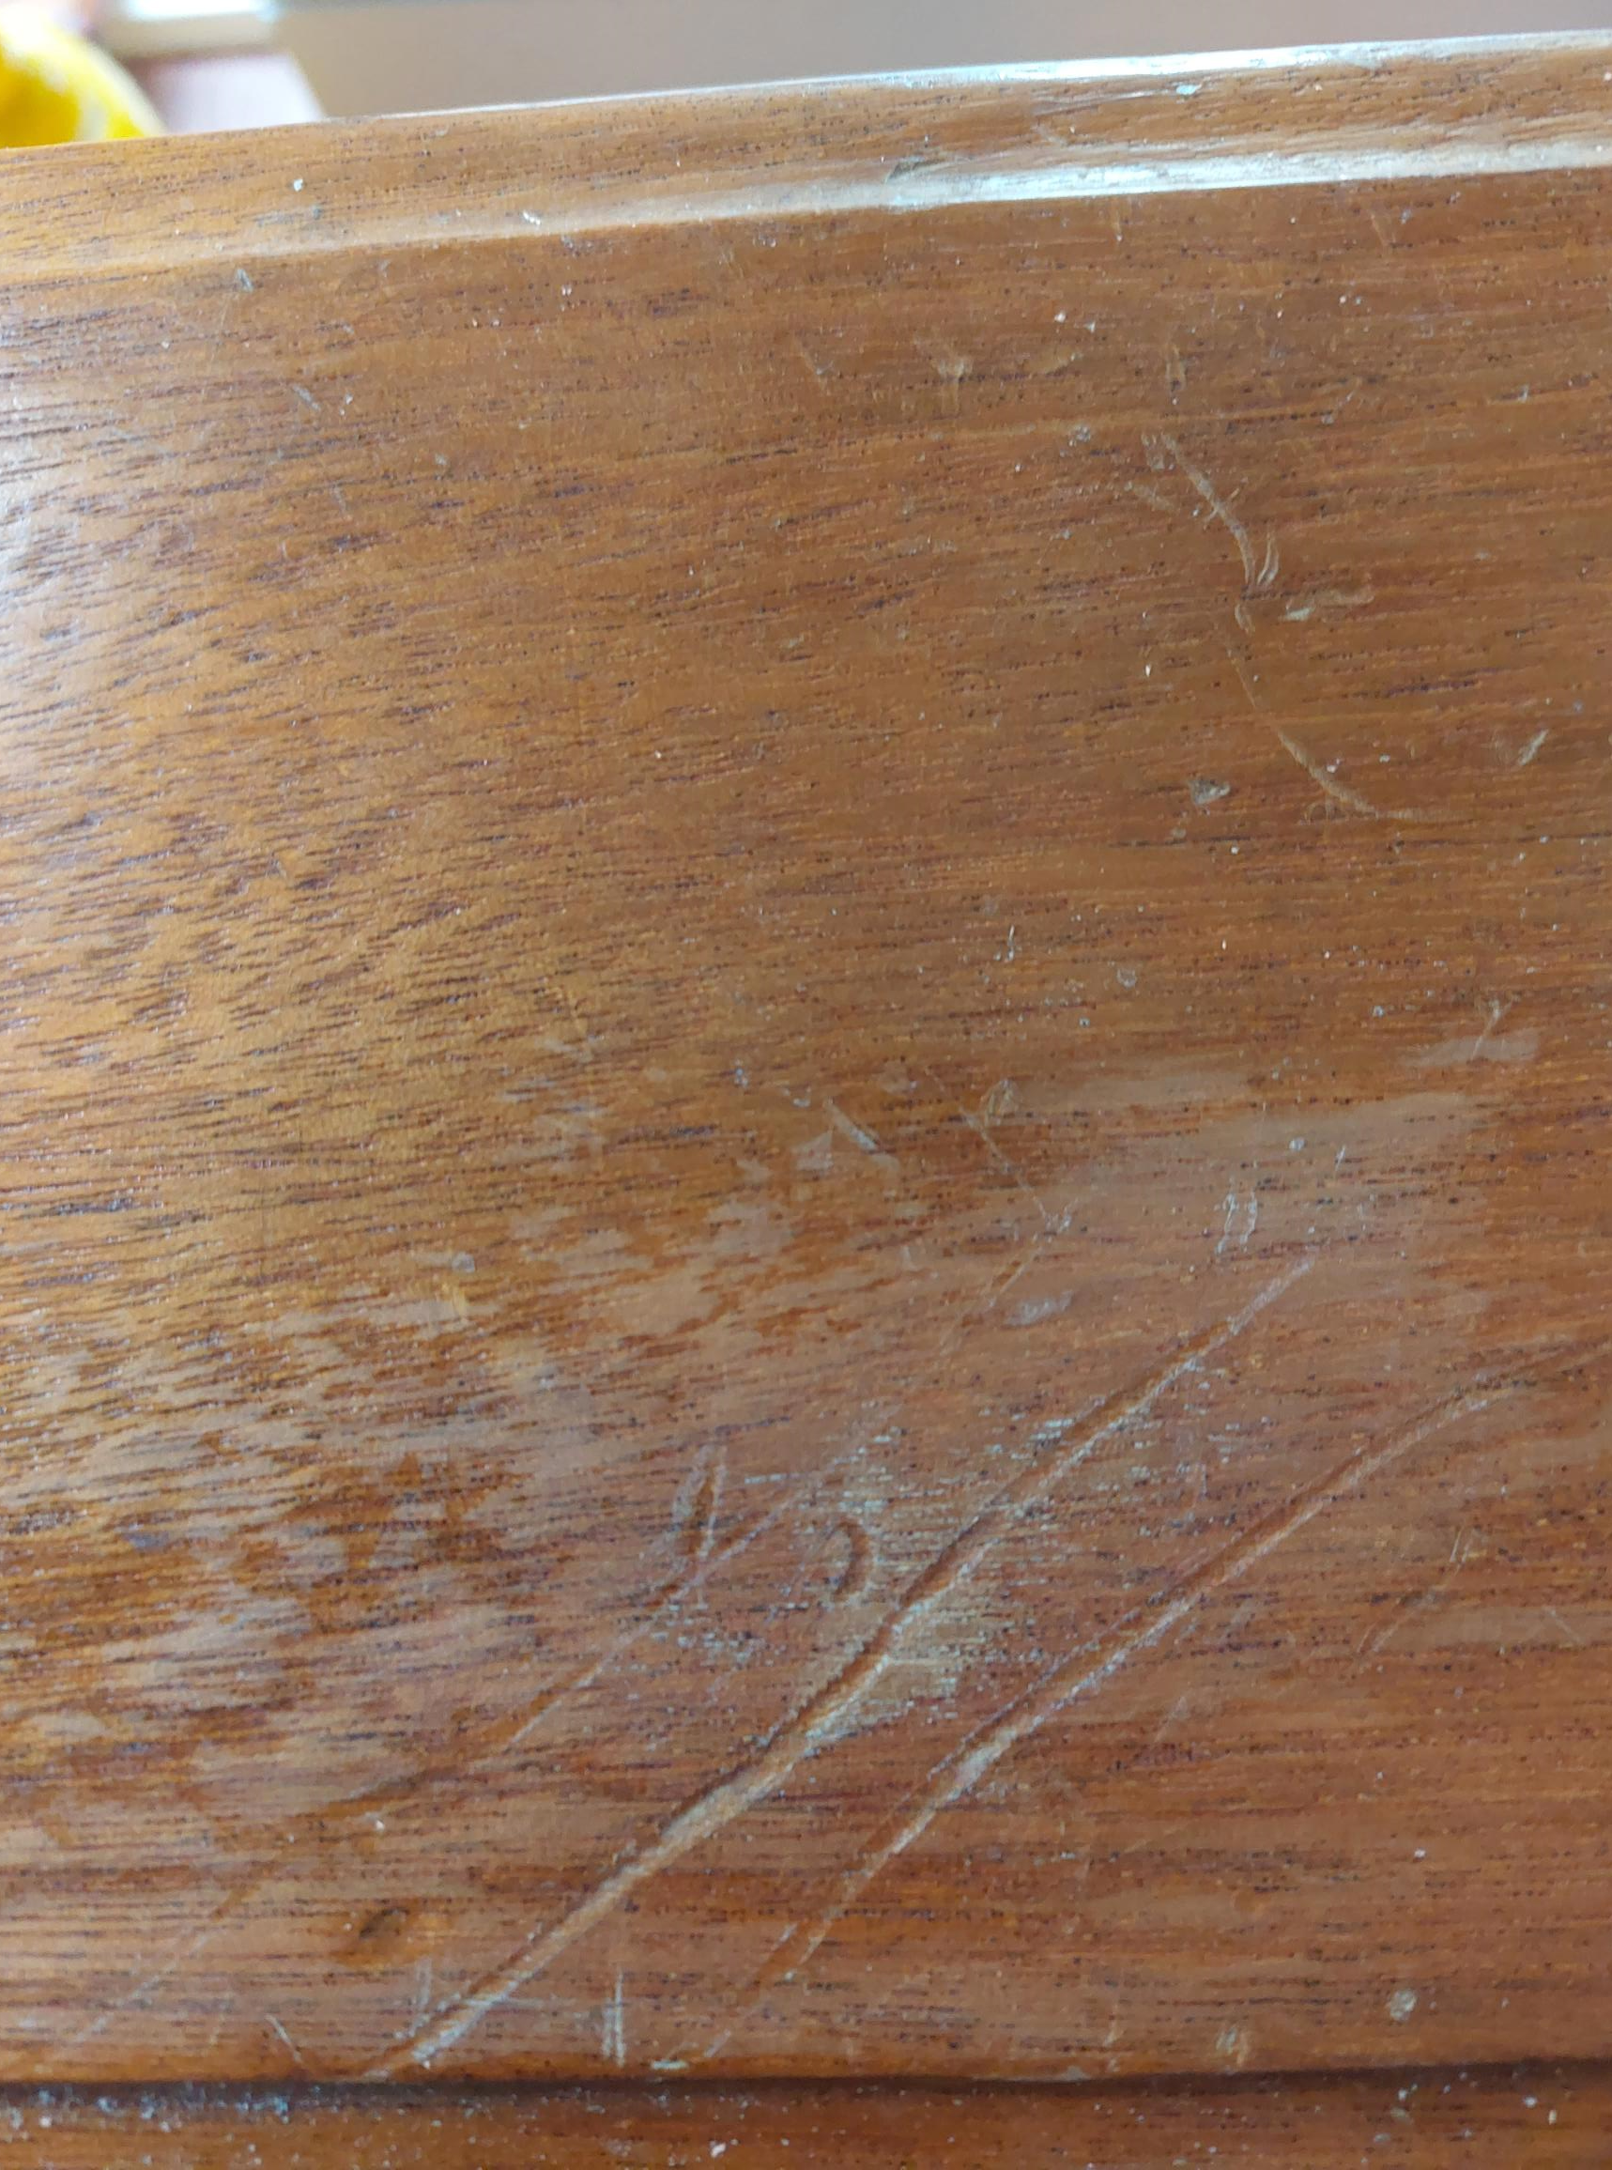
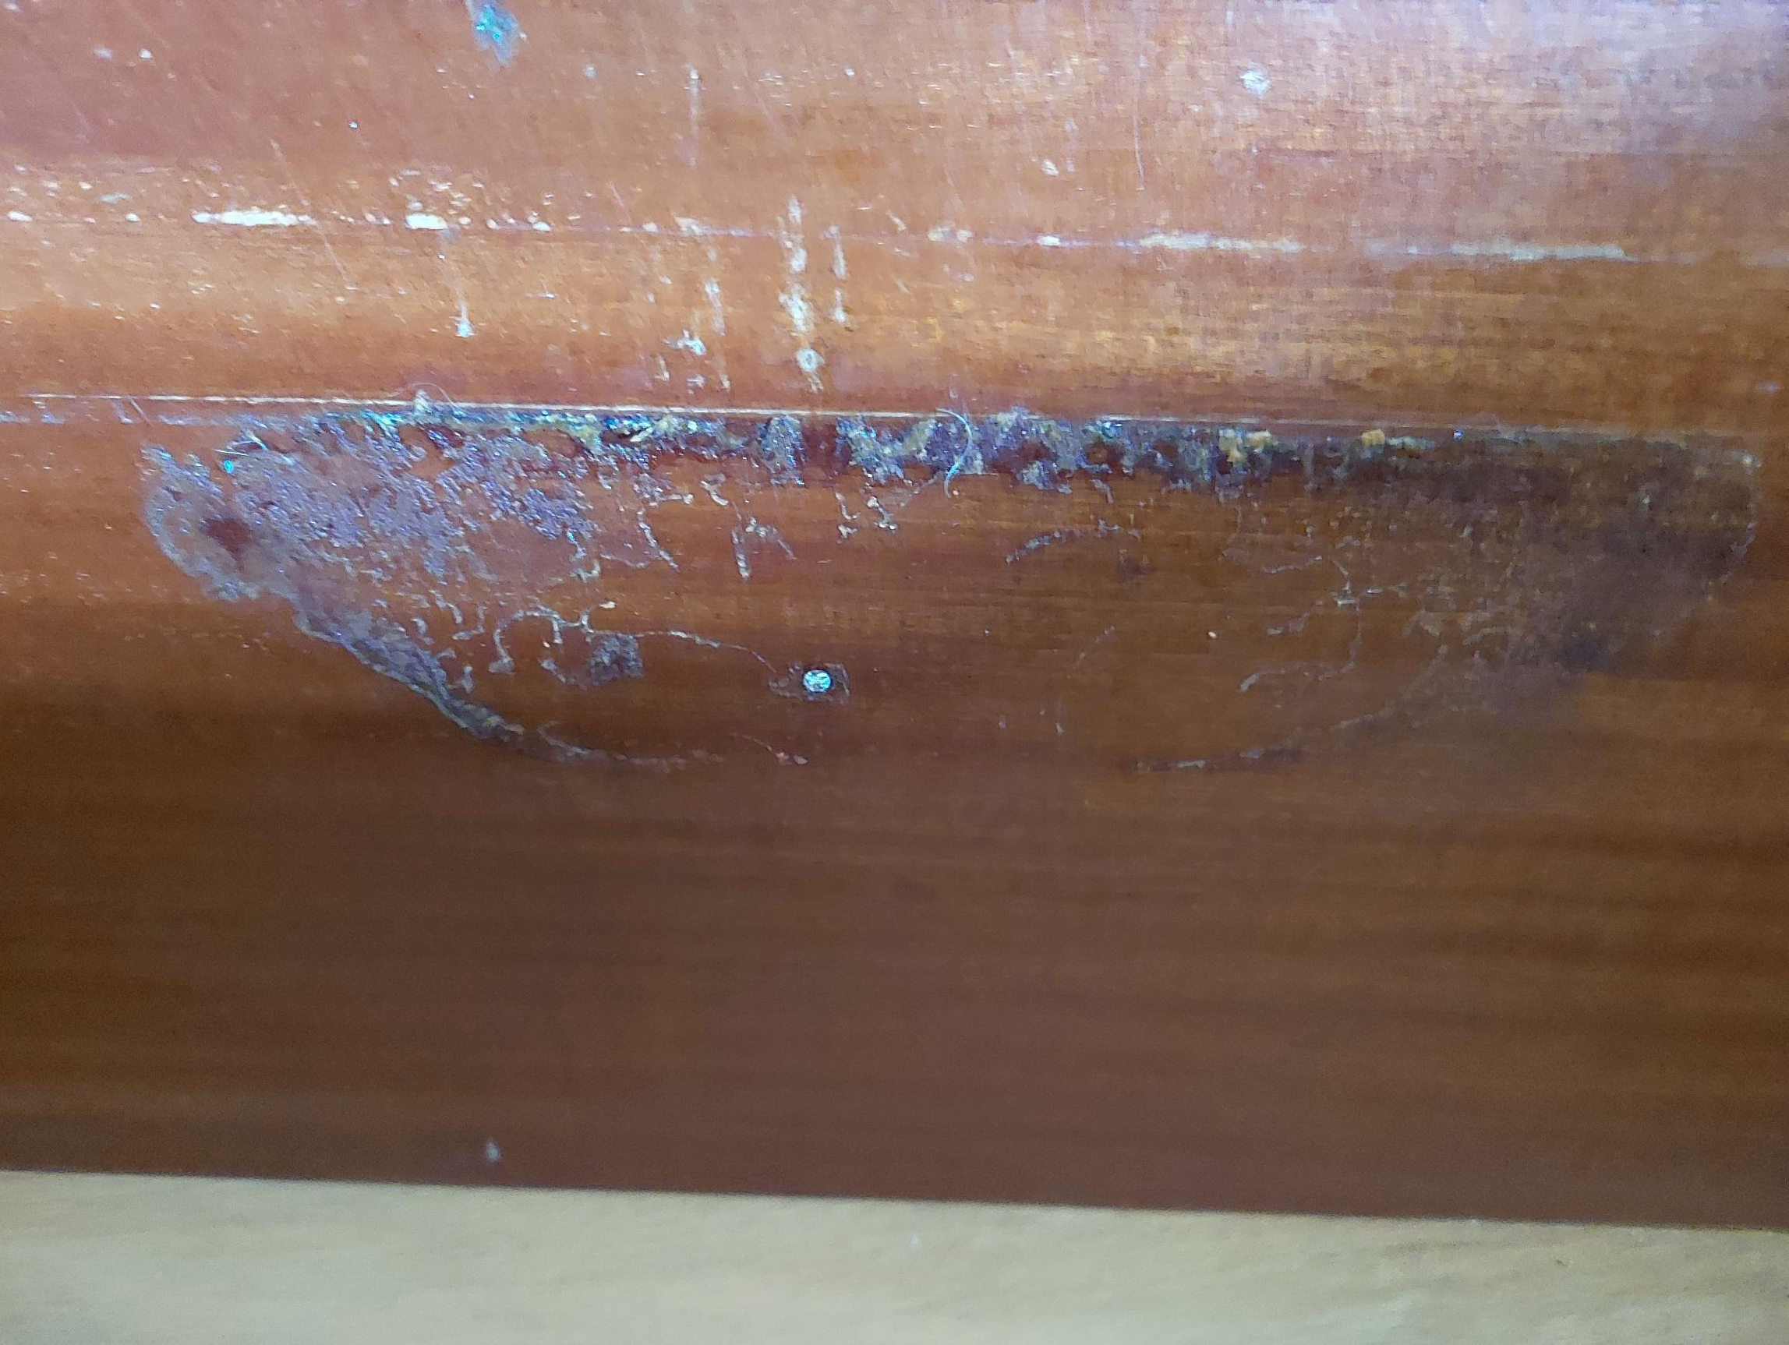
Assessment
Superficial scratches, dents and staining.

Slide 5
Inspection and Treatment
The bureau has been in use in the family home so no signs of mould or evidence of fresh woodworm holes.
As adult beetles cannot bore into wood they often lay their eggs in old exit holes and loose joints, always check inside, back and underneath.
There were a number of areas where the surface had been damage, emulsion paint, residue from stickers, a sticky substance, some minor scratches and dents.

Slide 6
Dismantling of Sections
Carefully remove the different sections to make working on the parts easier.
Remove Pigeonhole section.
Remove all drawers.
Separate top and bottom.
Remove writing flap.

Slide 7
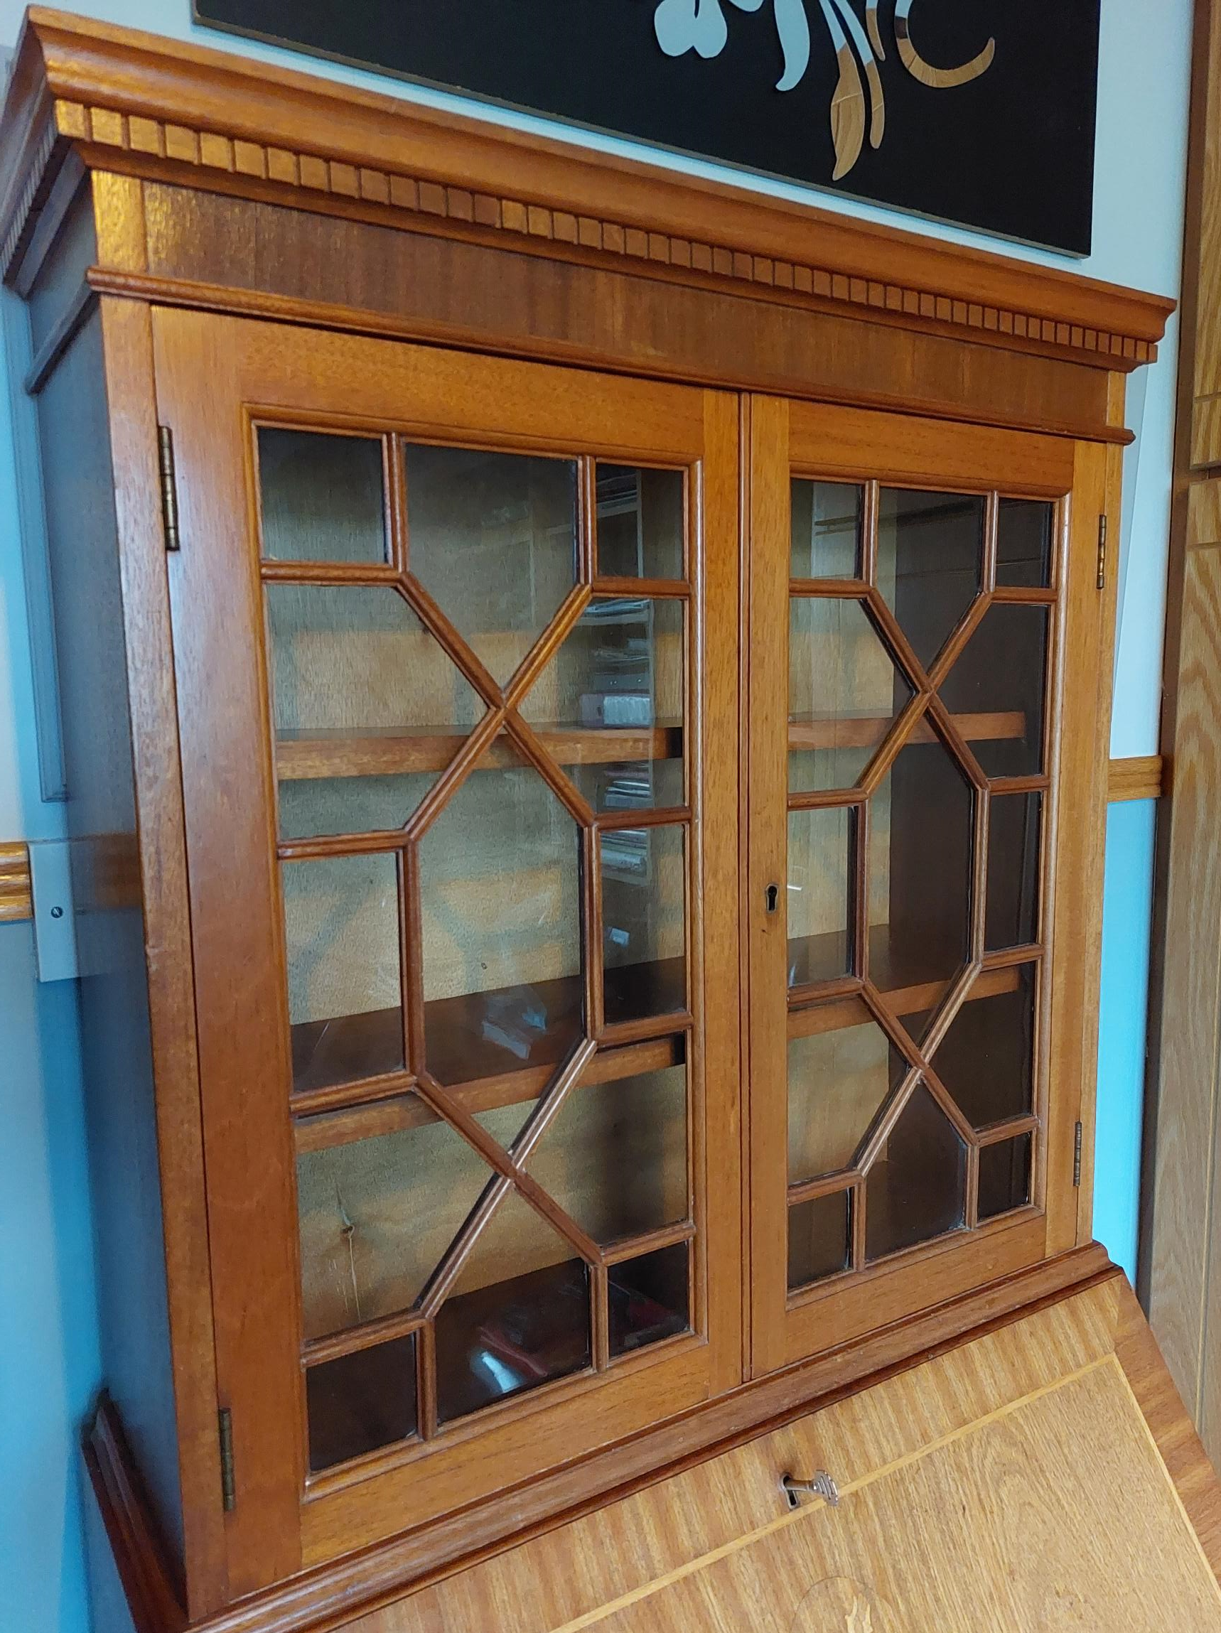
Dismantling of Sections

Slide 8
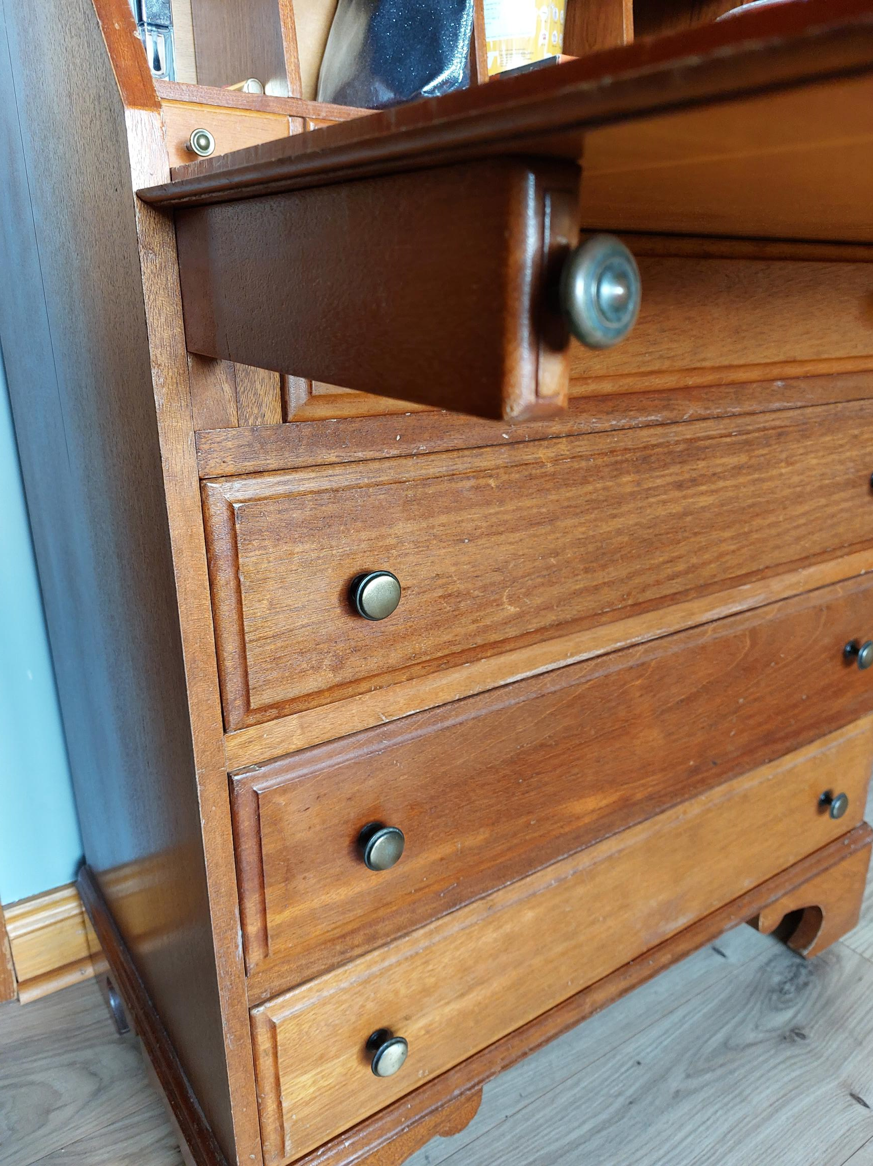
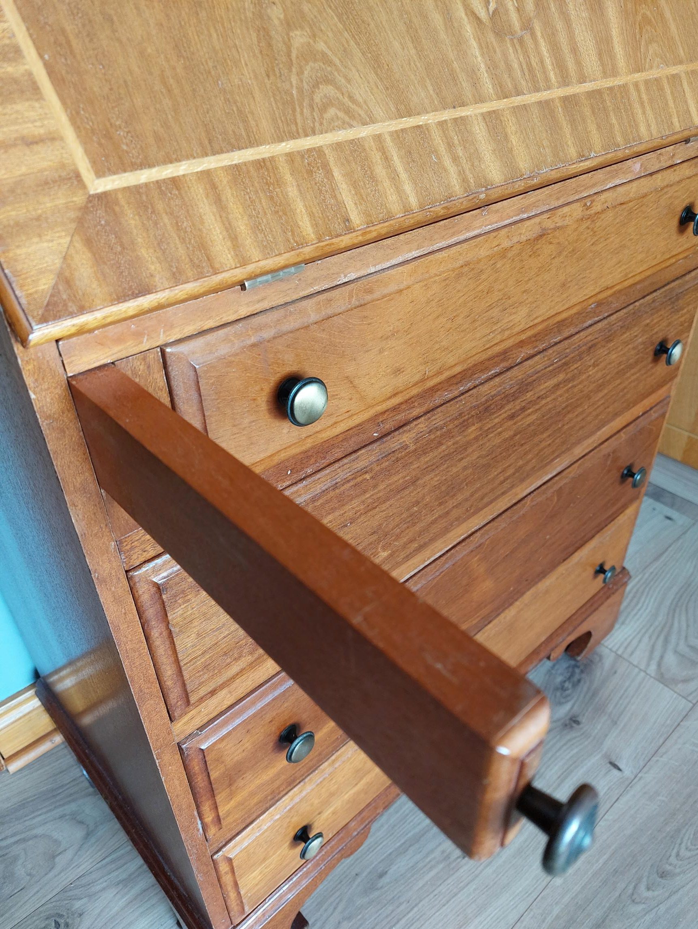
The Writing Flap

Slide 9
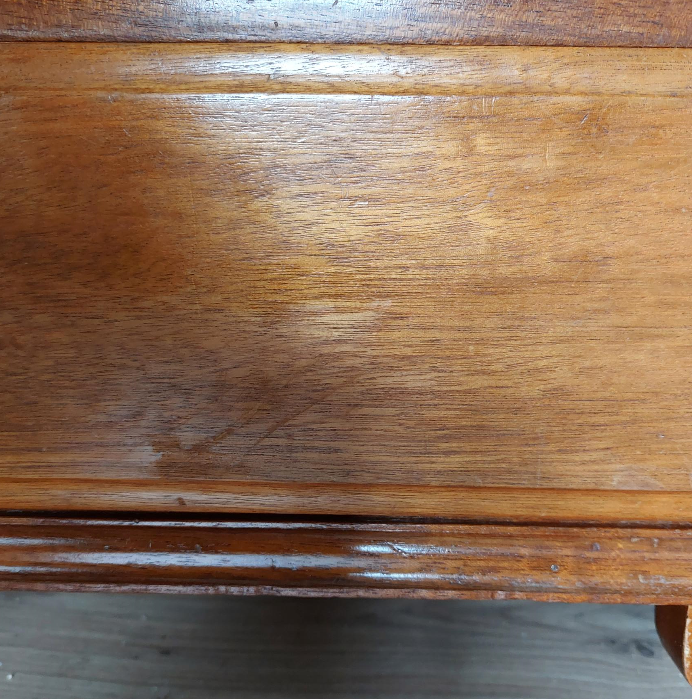
Dents and Scratches
Bottom drawer had some dents and scratches how would this be treated?

Slide 10
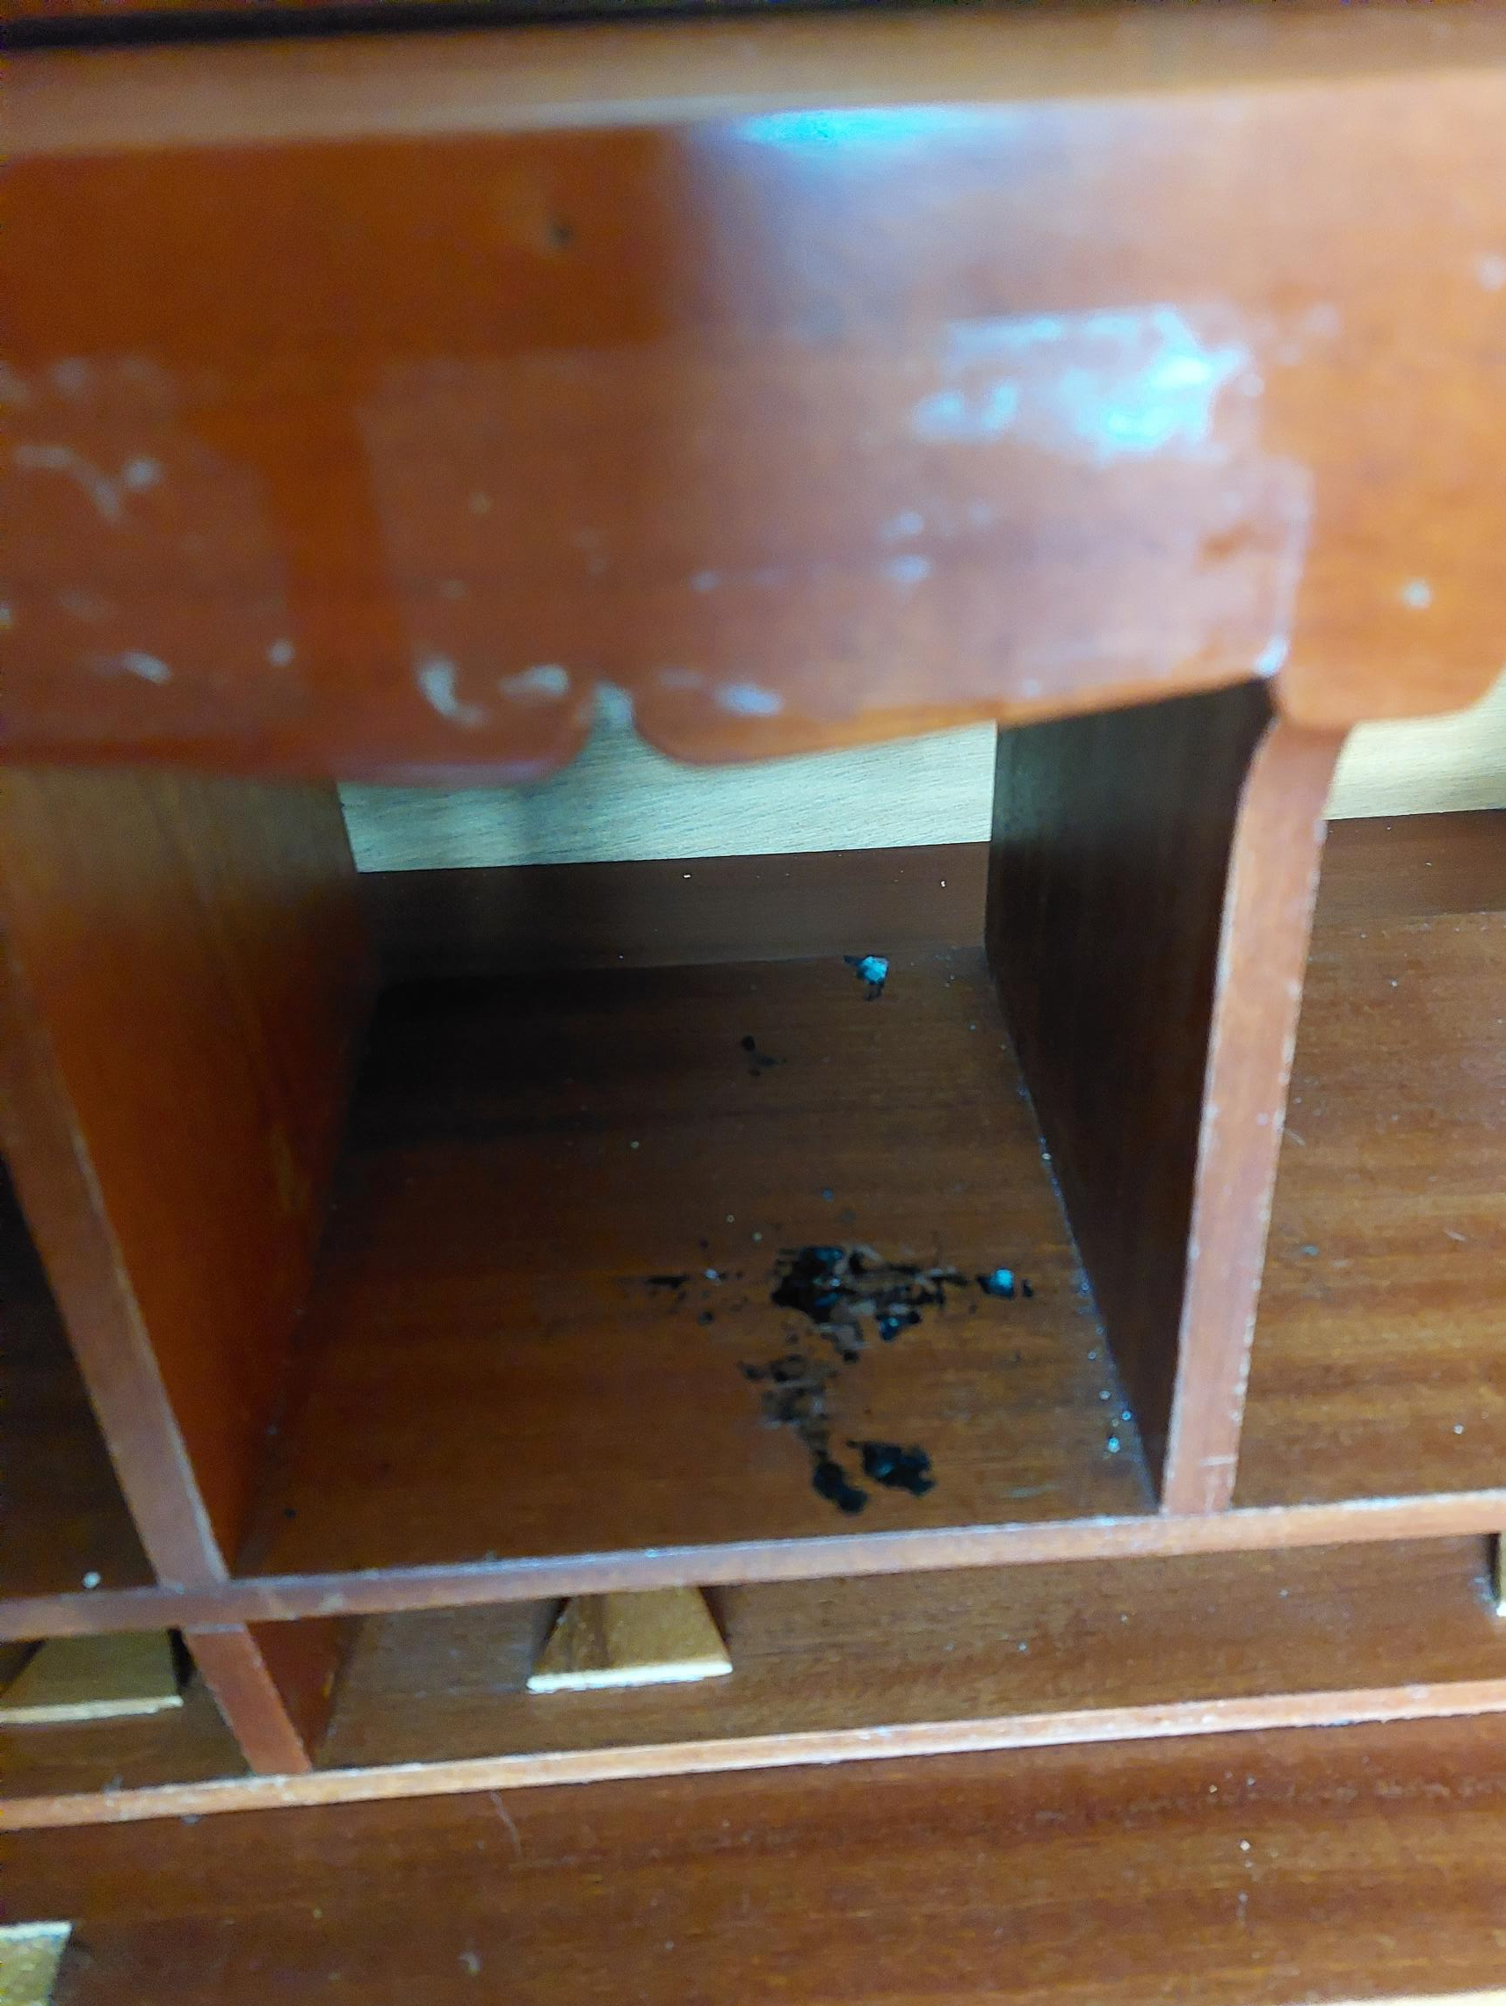
Pigeon Hole Section
Remove sticker residue.
Treatment of ink staining.
Any ideas on how to carry out these repairs without resorting back to sanding off patina?

Slide 11
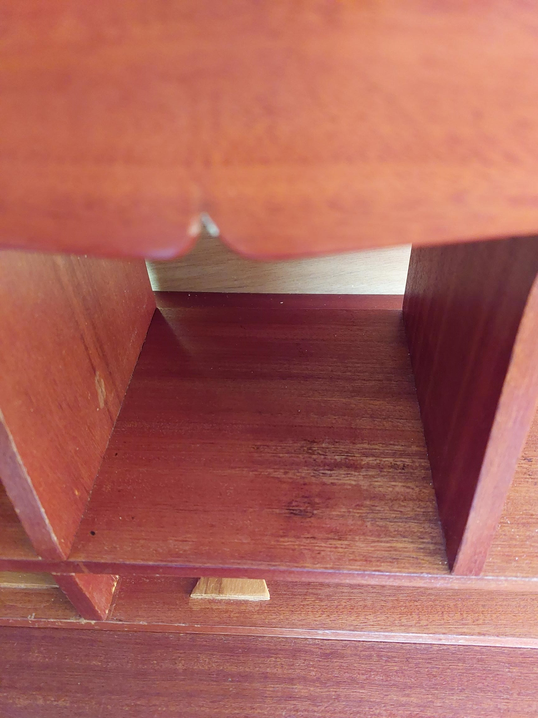
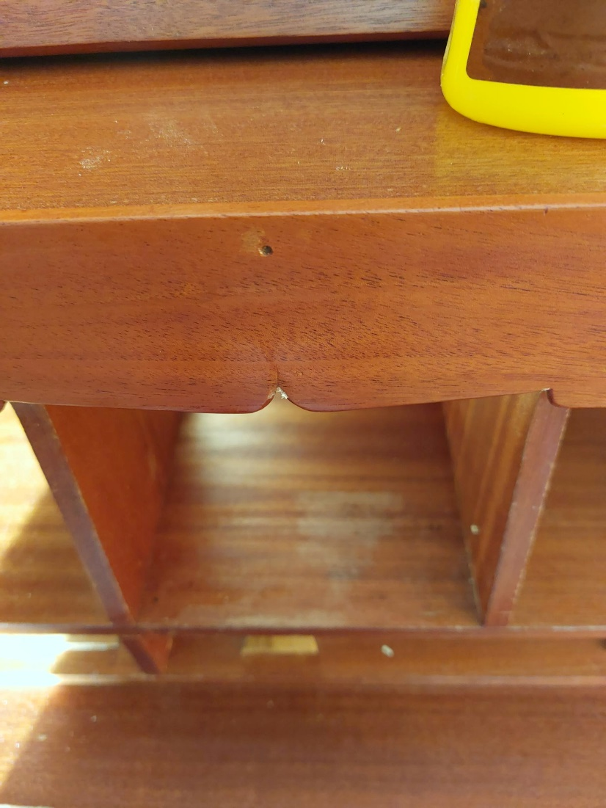
Pigeon Hole Section

Slide 12
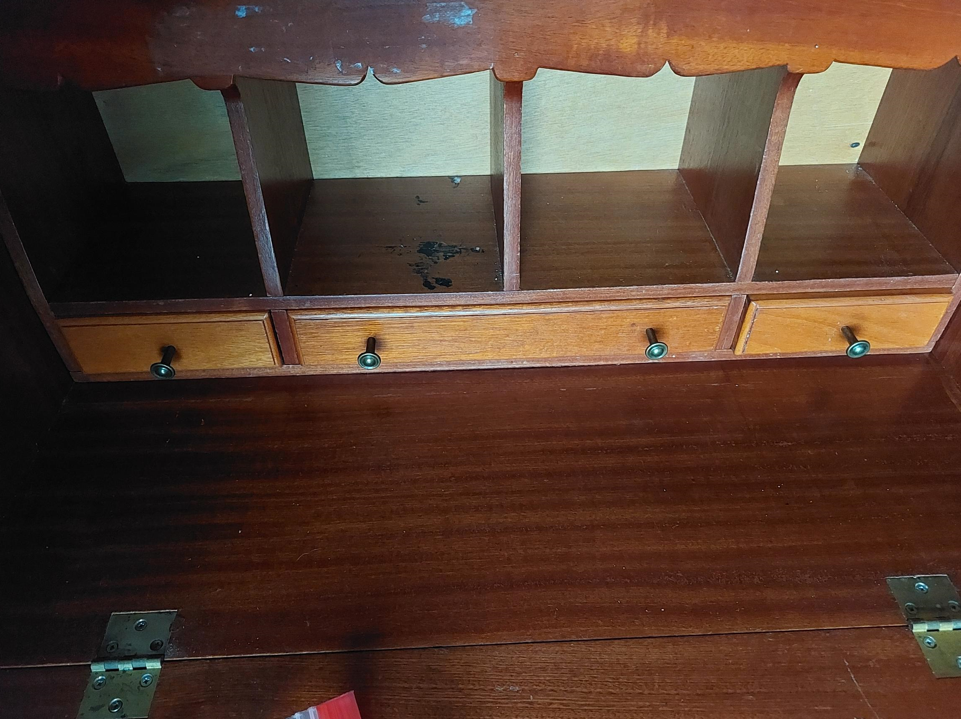
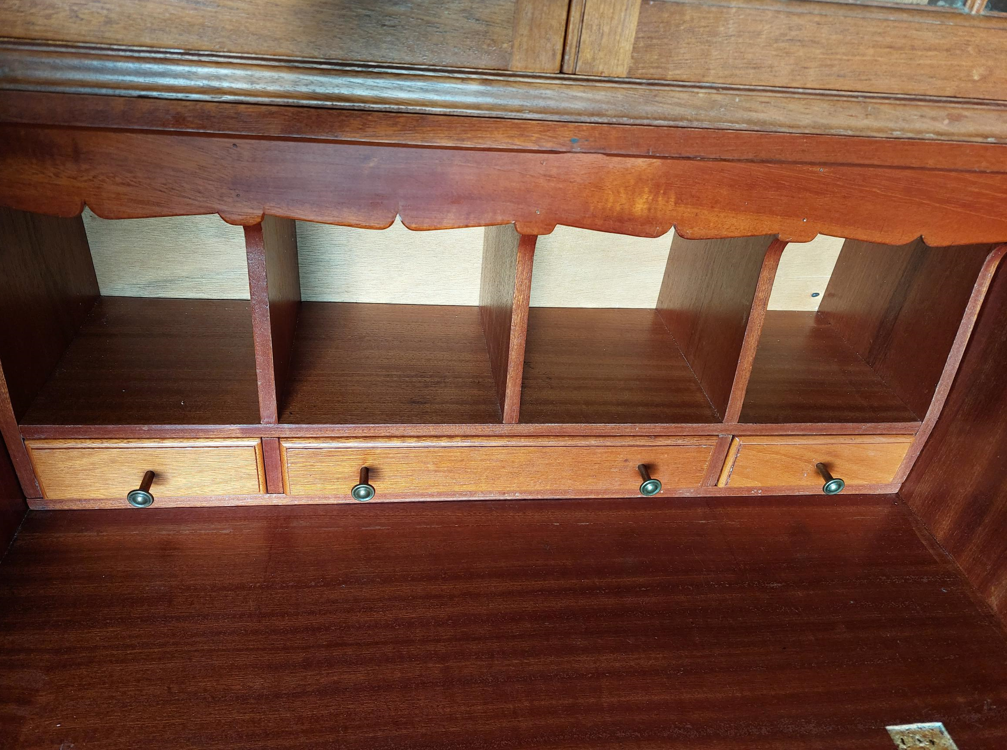
Pigeon Hole Section Before and After

Slide 13
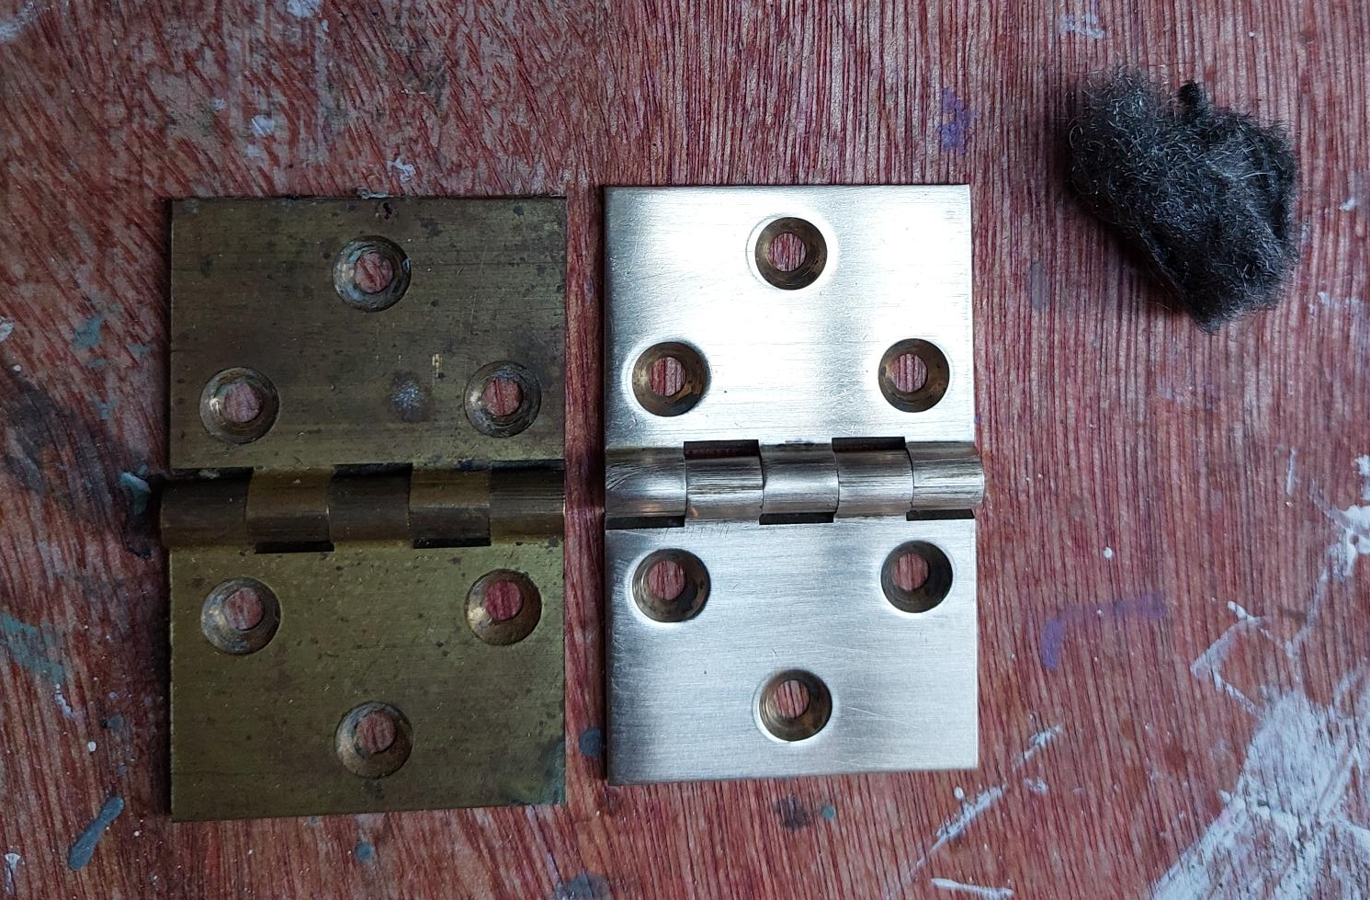
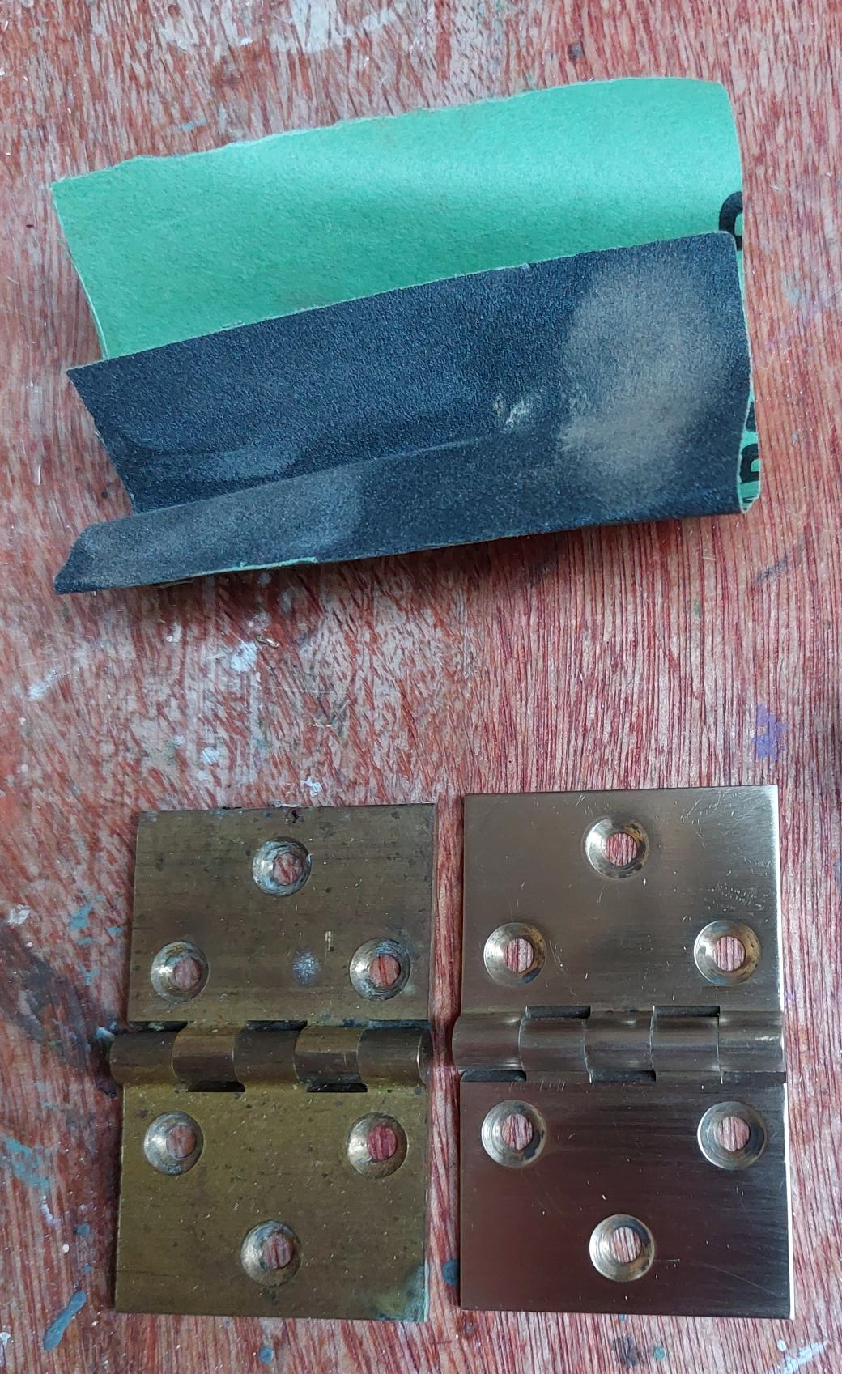
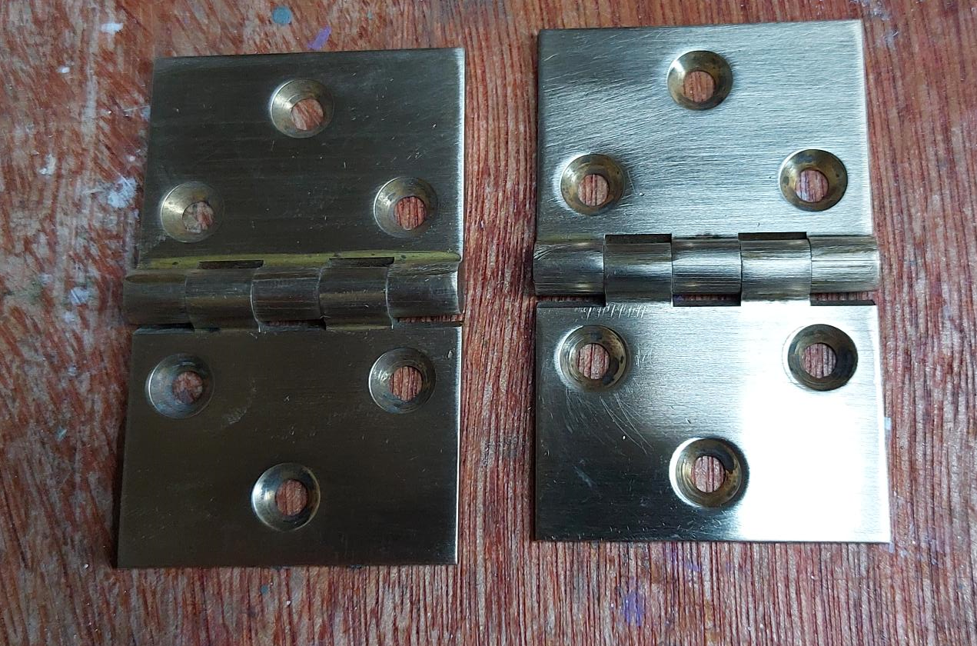
Restoring Brassware
Polish with fine
steel wool
Before and after
Sand with fine sandpaper

Slide 14
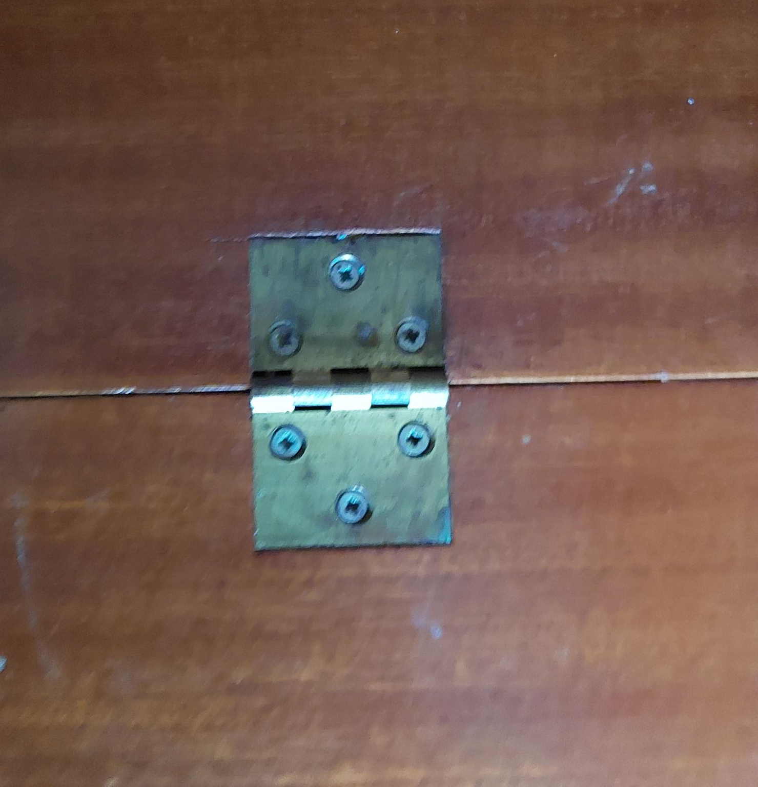
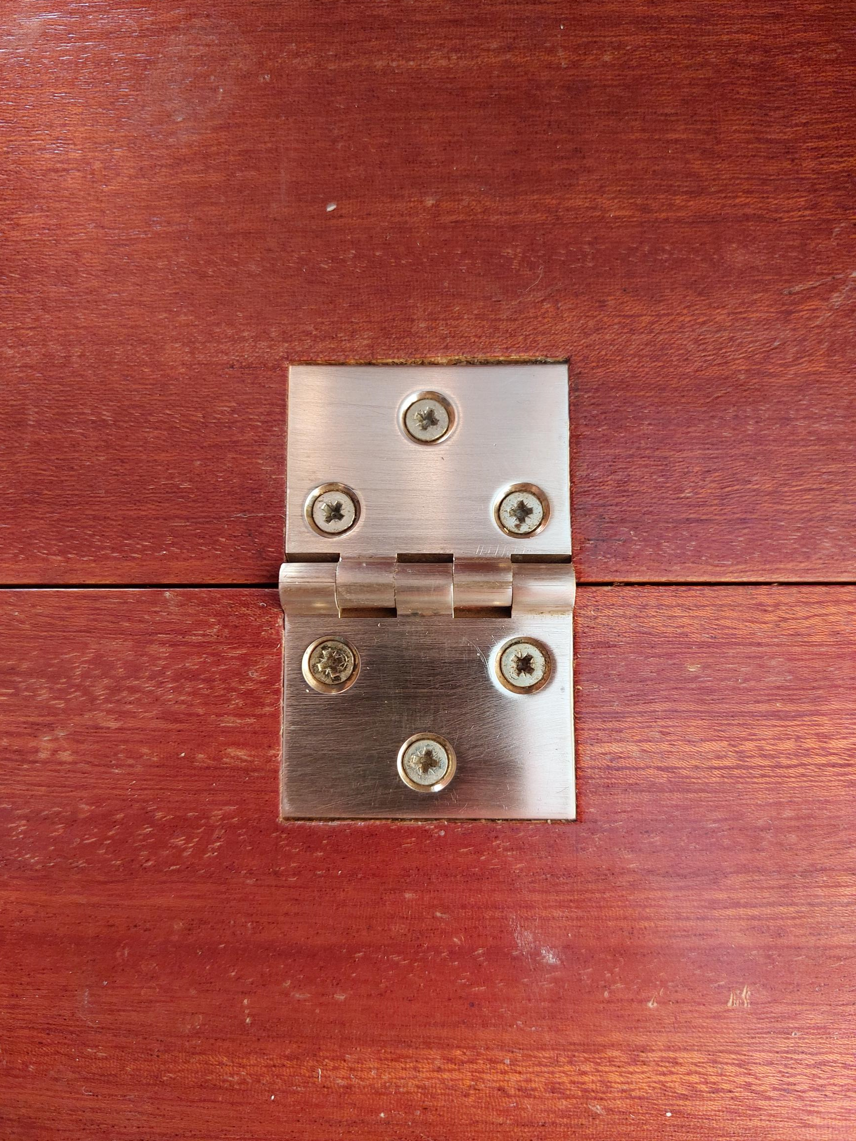

Slide 15
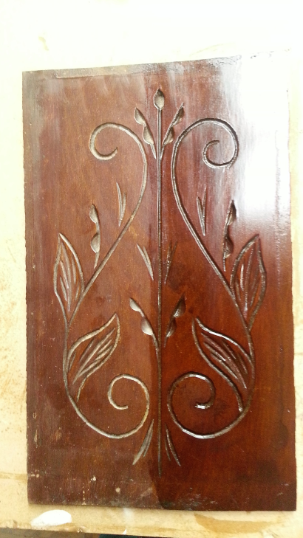
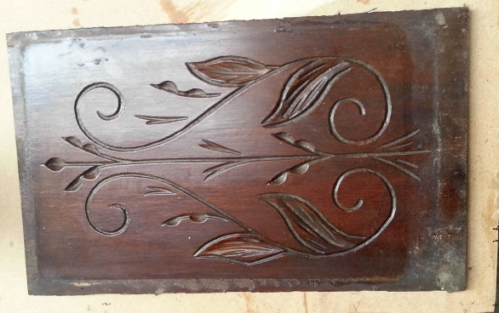
French Polished Surfaces
The patina builds up from years of dust and polishing causing the surface to appear darker than it is.
Reviver used is
1/3 French Polish
1/3 linseed Oil
1/3 Methylated Spirits
Carved panel before and after applying
a reviver coat

Slide 16
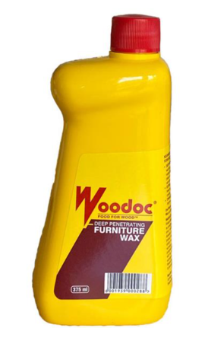
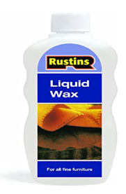
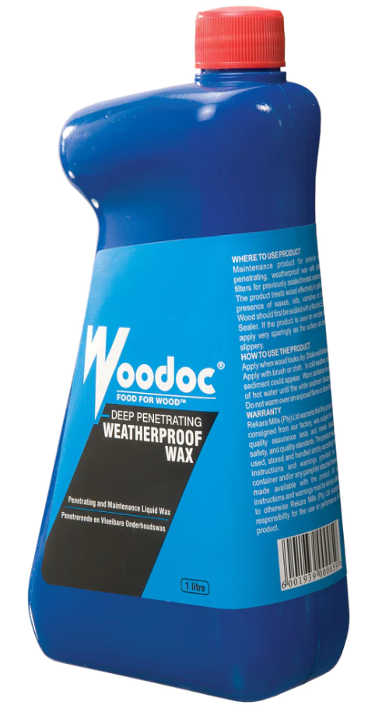
Different Finished Surfaces
If you want to revive the finish without stripping back or sanding and refinishing you can use any penetrating liquid wax. Click on image.

