Slide 1
Ergonomics
Of
Furniture Design
Standard Sizes

Slide 2
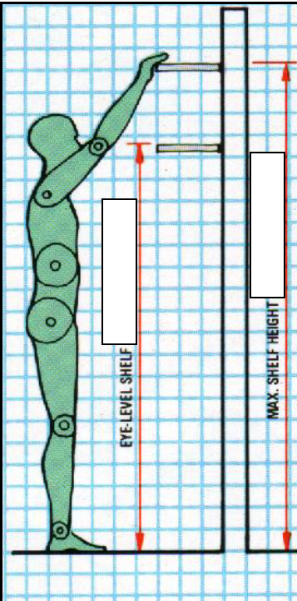
Kitchen
Max Shelf
1.8 – 2.0M
Eye Level Shelf
1.5 – 1.7M
Images taken from Collin’s Complete Woodworkers Manual

Slide 3
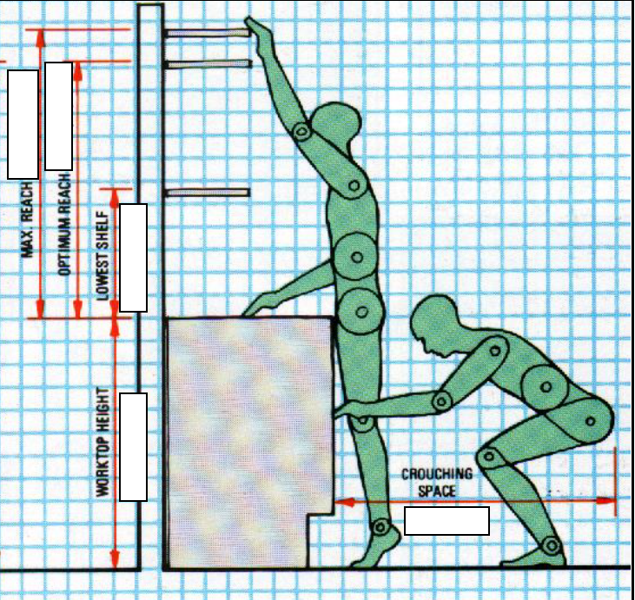
Kitchen
Max Reach
1.05m
Optimum Reach
900mm
Lowest Shelf
450mm
Worktop Height
900mm
Crouching space
1000mm

Slide 4
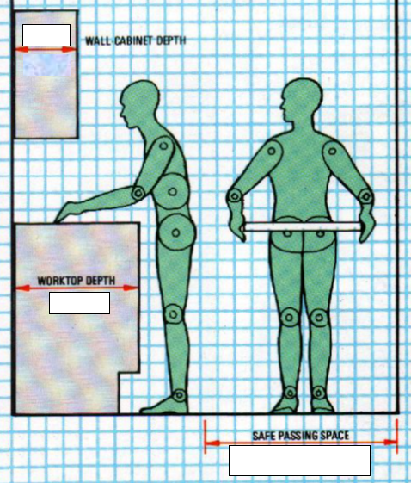
Kitchen
Max Depth Wall Cabinet 300mm
Worktop Depth
600mm
Safe Passing Space
900mm

Slide 5
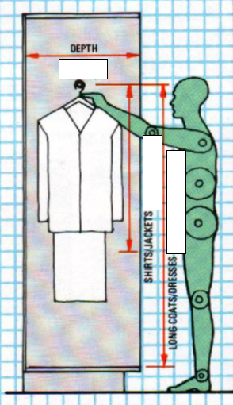
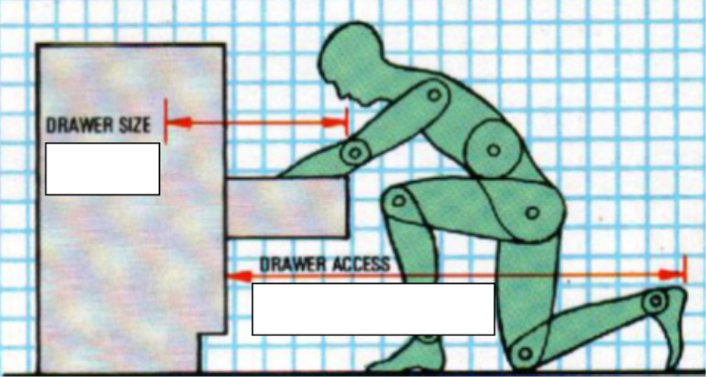
Wardrobe & Drawer unit
Wardrobe Depth
600mm
Min. Wardrobe Depth
500mm
Short hang
850mm
Long hang
1.45 – 1.6M
Drawer Size
425 – 500mm
Drawer
Access
1.25M

Slide 6
Occasional Table
Table Height 300 - 600mm

Slide 7
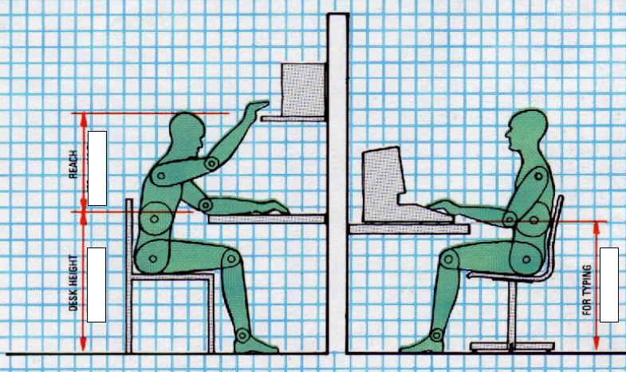
Work Station
Desk Height
700mm
Keyboard Height
650mm
Max reach above desk in sitting position
475mmmm

Slide 8
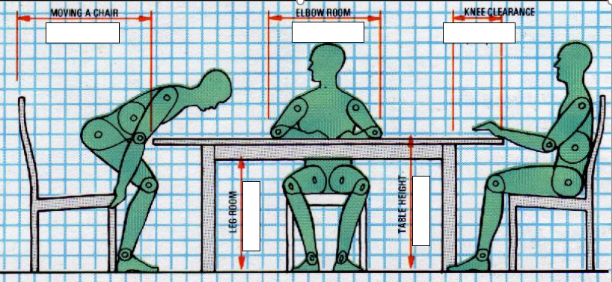
Dining Table
More on Chairs:
Chairs seat height
Seat depth
Arm rests
Seat width
Back height

Slide 9
Dining Table
Space required
to move a chair
700mm
Elbow Room
600mm
Knee clearance
250mm
Leg room 600mm
Table Height 750mm
More on Chairs:
Chairs seat height 450mm max
Seat depth 400 – 460mm
Arm rests 200mm above seat
Seat width 450mm (carver 500mm)
Back height 800 – 900mm high

