Slide 1

Wood Manufacturing & finishing
WMF PH 6
CW1 Topic ????????

Slide 2
Decay
Decay in timber is caused by 2 main factors.
What are they?
Attack by wood destroying fungi.
Attack by wood boring insects.

Slide 3
Topic ????
History of?

Slide 4

Heading from Report
Fig. 1 shows
As can be seen in Fig. 1
A blah blah blah like that shown in Fig. 1 is ……
Include some bullet points to help you remember.
Fig. 1 ???????????

Slide 5
Next Heading
Repeat as before

Slide 6
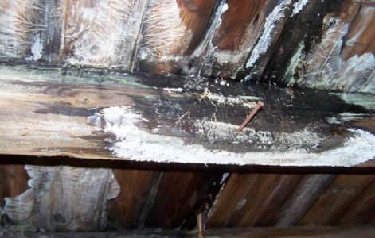
Another Heading
More images of sketches include an image that you can talk about.
Image courtesy of Aquacraftltd.

Slide 7
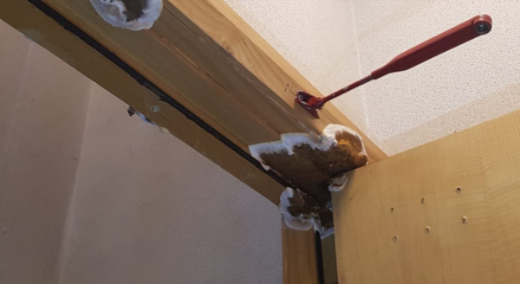
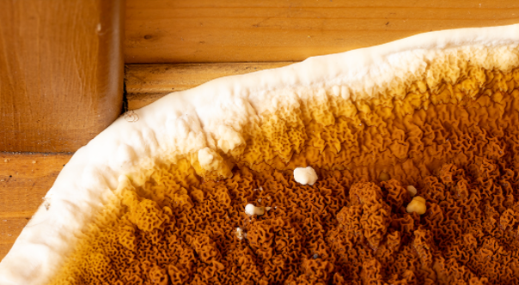
Compare images or image to sketch/drawing
Dry Rot on internal door jamb. Dry Rot Fruiting Body.

Slide 8
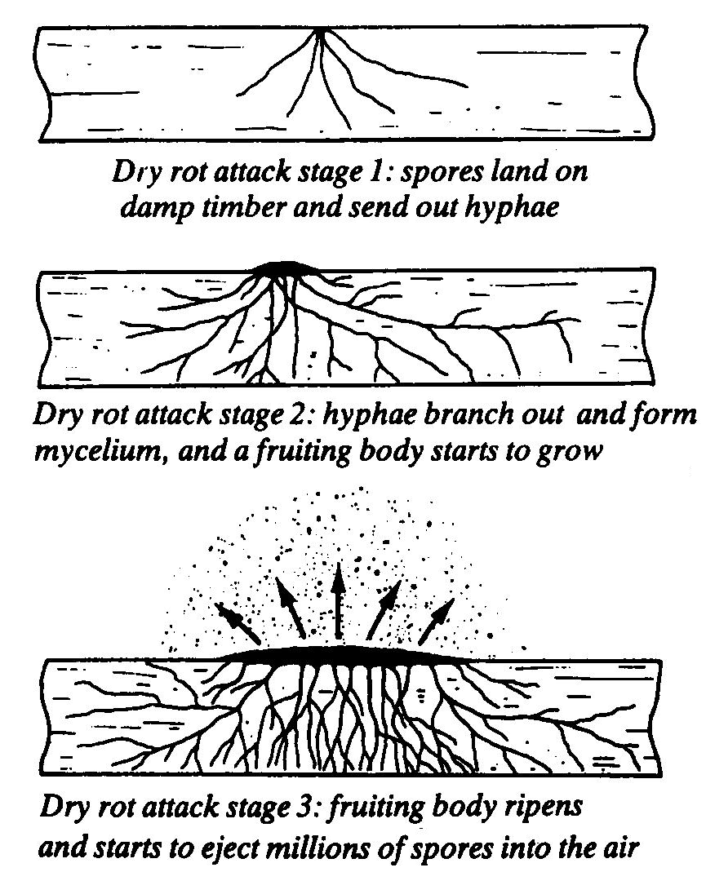
Dry Rot
Dry rot needs certain conditions before they can thrive on the wood.
These conditions are:
Moisture - a moisture content
above 20%.
Little or no ventilation.
Warm humid atmosphere.
Note mycelium can travel through a meter thick wall and can carry moisture to nearby sound timber. This then increases the moisture content to above 20% so spores can germinate.

Slide 9
Dry Rot
Prevention
Always keep timber dry.
Ensure good ventilation.
Use well seasoned timber.
Use preservative treated timbers in vulnerable positions.

Slide 10
Dry Rot
Eradication
Remove damp source.
Provide ventilation.
All affected timber removed (+ 500mm) and burned.
All affected timber and waste removed from site.
All replacement timbers treated.
Surrounding brickwork and walls must be surface heated and treated to kill off any mycelium and spores.
PJ Barret Timber Decay Specialists

Slide 11
Include a link to a website if you want to show and talk about something
Wood Rot Identification and Elimination

Slide 12
Thank You and Any Questions Page
The last page should include something that you want to draw out questions about or a word cloud etc. to help you remember.

