Slide 1

Timber Decay
WMF PH 6

Slide 2
Decay
Decay in timber is caused by 2 main factors.
What are they?
Attack by wood destroying fungi.
Attack by wood boring insects.

Slide 3
Fungal Attack
Fungal attack can cause damage by feeding on the cells of the wood.
As a result, the wood softens and eventually it decays.
Fungi need certain conditions before they can live on the wood.
These conditions are:
Moisture - a moisture content above 20%.
Food supply - the wood is the food source.
Oxygen - particularly still air.
Warmth.

Slide 4
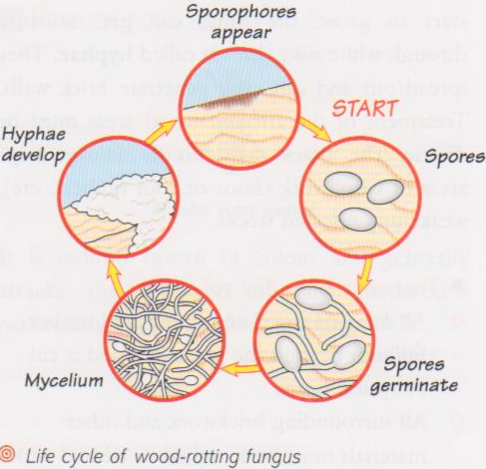
Fungal Attack
A fungus is formed when spores germinate and send out hyphae.
The hyphae penetrate the wood in order to feed and get moisture.
When there are a large number of hyphae together this is called a mycelium(like white cotton wool).
Fruiting bodies called sporophores are formed.
These produce tiny spores which are blown by the wind and carried to other wood.
They germinate and grow into more fungi. (Cycle continues)

Slide 5
Fungal Attack
There are many kinds of wood-rotting fungi, but they can be classified under two headings:
Wet rot (white rot)
Dry rot (brown rot).

Slide 6
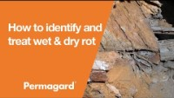
How to Identify and Treat Wet and Dry Rot.
Permagard Products 1.54m

Slide 7
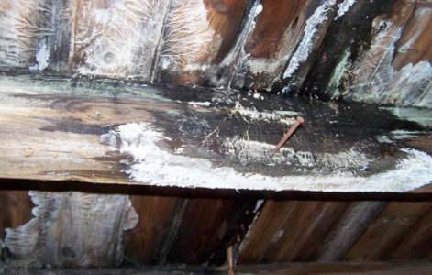
Wet Rot (Coniophora puteana)
Wet rot usually occurs outdoors, and it rots fence posts, window frames, logs, doors etc.
The affected wood becomes very moist and slimy. A white residue is sometimes present.
Internally there is a damp musty smell.
Timber can be soft and spongy.
Darkened timber.
Paint or varnish flakes off.
Image courtesy of Aquacraftltd.

Slide 8
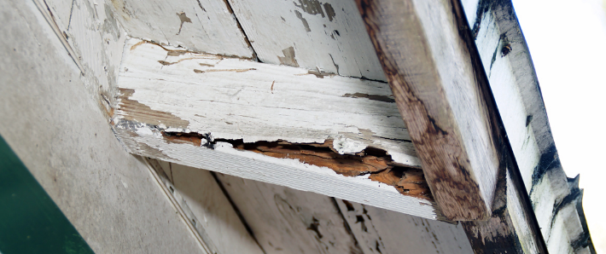
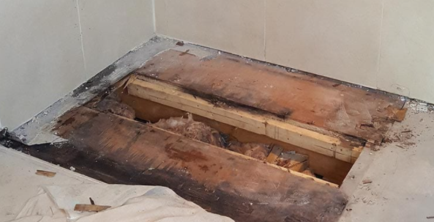
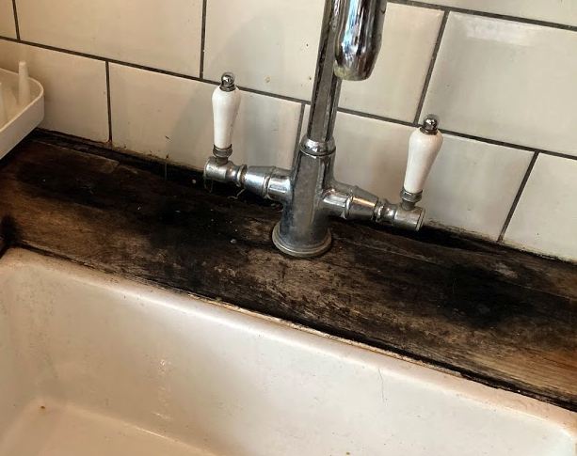
Wet Rot (Coniophora puteana)
Wet rot soffit
Wet rot around taps and sink
Wet rot under shower
Image courtesy of Room H20

Slide 9
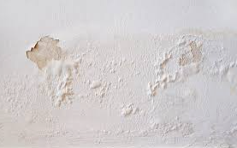
Wet Rot
Wet rot usually affects very wet timber and can cause decay in surrounding material like plaster, grout and sealants, wallpaper and carpet.
What situations can cause wet rot?
Leaking gutters and pipes.
Condensation.
Leaking plumbing, baths or showers.
Penetrating damp.

Slide 10
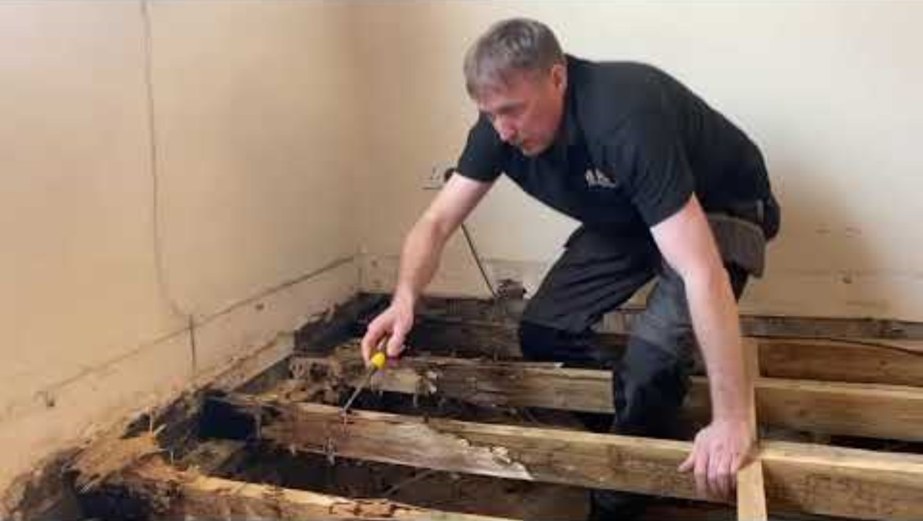
Wet Rot In Joists 4.48m

Slide 11
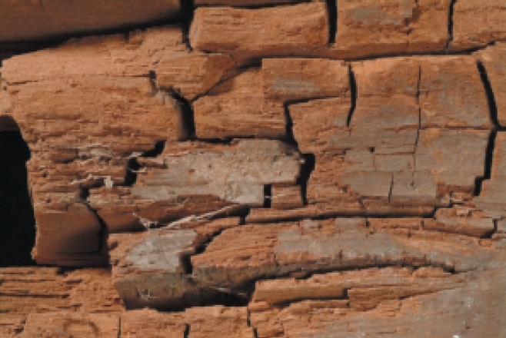
Dry Rot (Serpula lacrymans)
The most common type of fungal attack.
Most difficult fungus to eradicate from timber.
Dry rot attacks the cellulose found mainly in sapwood.
The timber
  Loses strength and weight.
  Develops cracks with & across the grain.
  Becomes so dry and powdery that it can crumble in your hand.

Slide 12
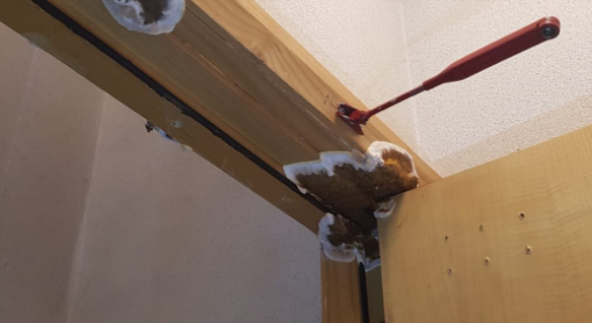
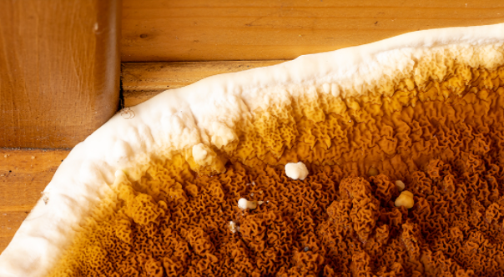
Dry Rot (Serpula lacrymans)
Dry Rot on internal door jamb. Dry Rot Fruiting Body.

Slide 13
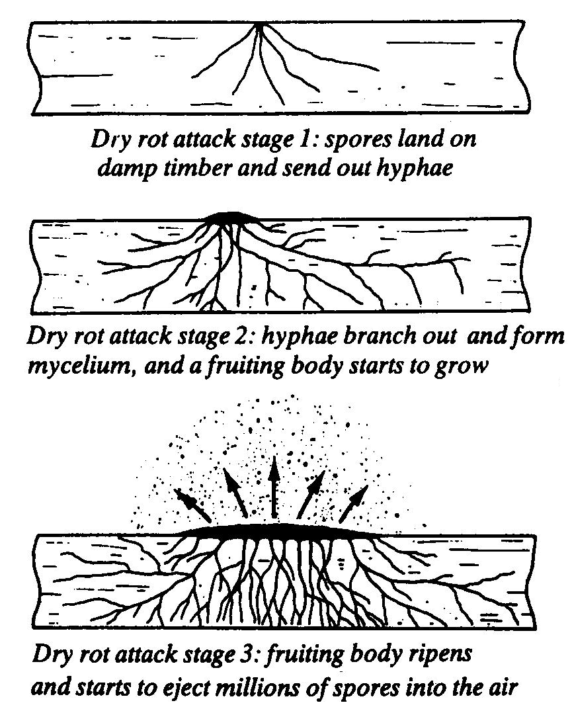
Dry Rot
Dry rot needs certain conditions before they can thrive on the wood.
These conditions are:
Moisture - a moisture content
above 20%.
Little or no ventilation.
Warm humid atmosphere.
Note mycelium can travel through a meter thick wall and can carry moisture to nearby sound timber. This then increases the moisture content to above 20% so spores can germinate.

Slide 14
Dry Rot
Prevention
Always keep timber dry.
Ensure good ventilation.
Use well seasoned timber.
Use preservative treated timbers in vulnerable positions.

Slide 15
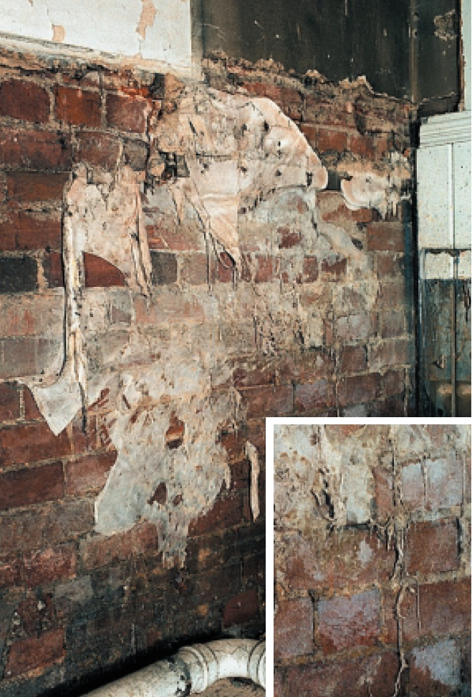
Dry Rot

Slide 16
Dry Rot
Eradication
Remove damp source.
Provide ventilation.
All affected timber removed (+ 1M) and burned.
All affected timber and waste removed from site.
All replacement timbers treated.
Surrounding brickwork and walls must be surface heated and treated to kill off any mycelium and spores.
PJ Barret Timber Decay Specialists

Slide 17
How to Identify Wet Rot or Dry Rot
Wood Rot Identification and Elimination

Slide 18
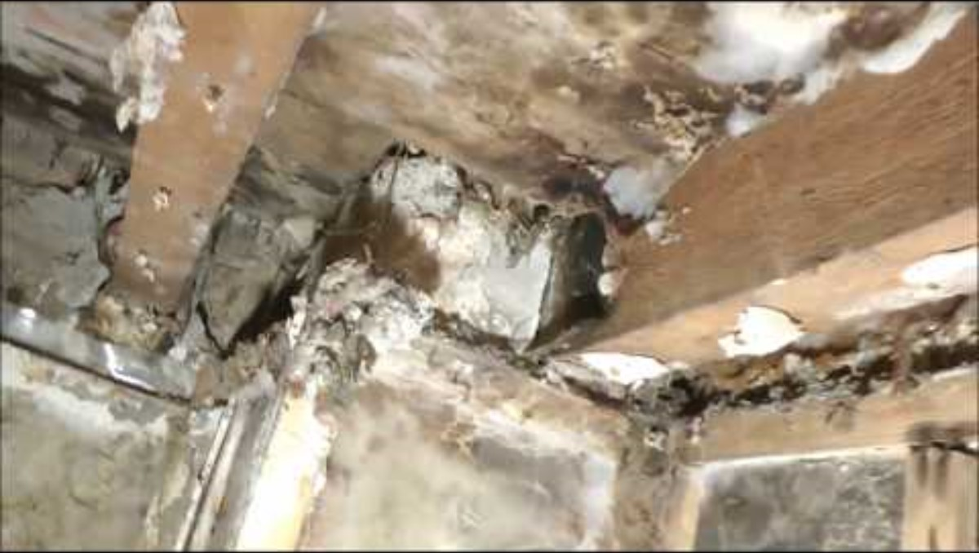
Dry Rot Out Break 4.48m

Slide 19
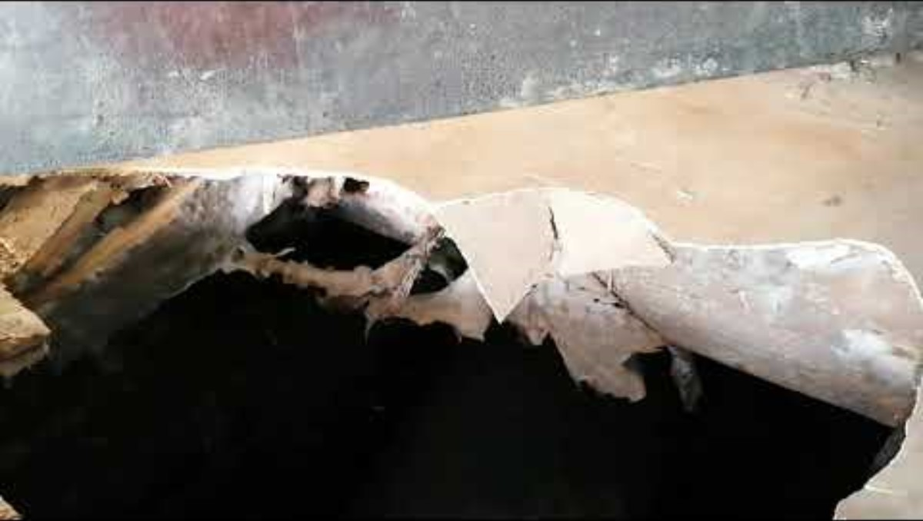
Dry Rot what does it look like? 4.21m

Slide 20

Revision Questions
Scan the QR Code and answer the questions

