Slide 1

Timber Preservation
WMF PH 6

Slide 2
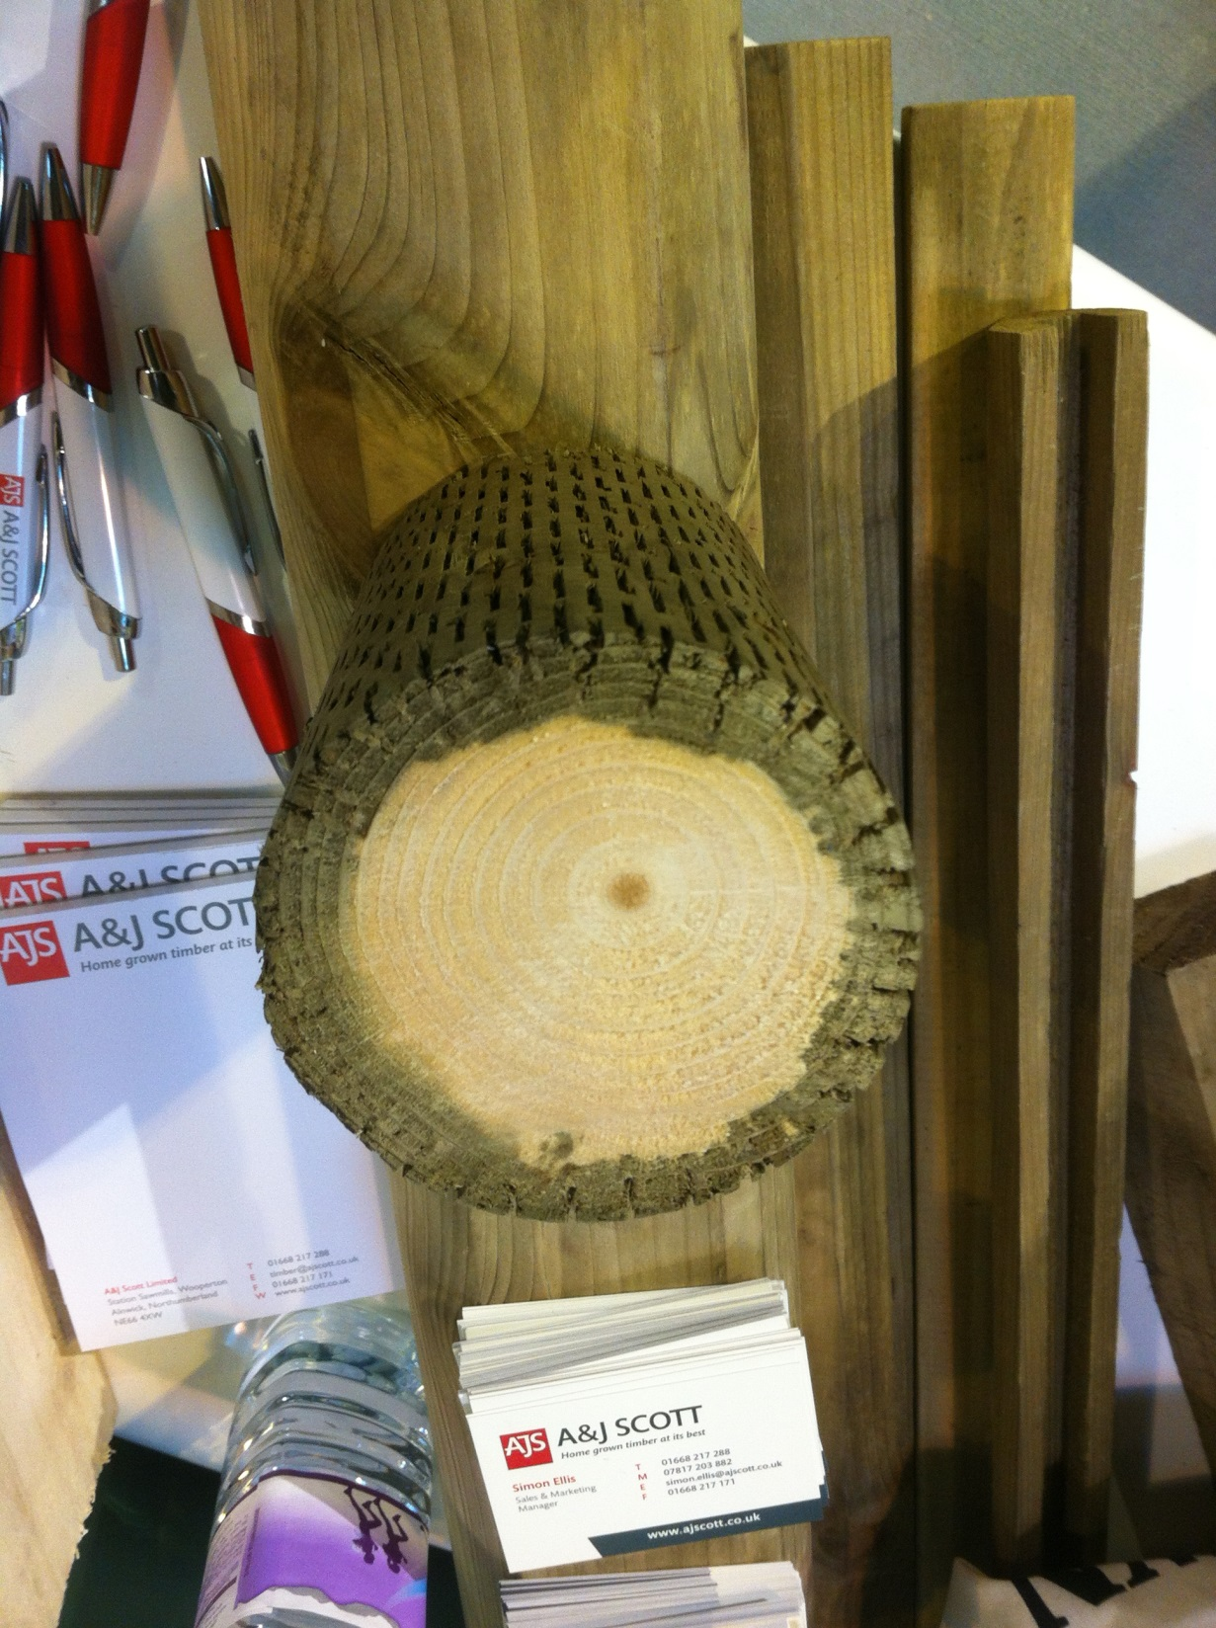
Preservation of Timber
All timbers, especially the sapwood, contain food on which fungi and insects live. The idea behind timber preservation is to poison the food supply by applying a toxic liquid to the timber.
Photo taken by Niall Delaney Timber Expo Birmingham.

Slide 3
Preservation Requirements
  The ideal requirements of a timber preservative are as follows:
    It must be toxic to the fungi and insects, but safe to animals and humans.
    It should be permanent and not liable to be bleached out by sunshine or leached out by rain.
    It should be economical and easy to obtain.
    It should not corrode or affect metal in any way.
    It should be easy to handle and apply.
    It should, as far as possible, be odourless.
    It should not affect the subsequent finishing of the timber, for example, painting or polishing.
    It should be non-flammable.
(Note: Although these are the ideal requirements of a preservative, bear in
mind that most preservatives will not embody all these points.)

Slide 4
Preservation Types
There are three main types of timber preservative available:
Can you name them?
  Tar oils
  Water-soluble preservatives
  Organic solvent preservatives

Slide 5
Preservation Tar Oils
Tar oils
These are derived from coal and are dark brown or black in colour. They are fairly permanent, cheap, effective and easy to apply. However, they should not be used internally, as they are flammable and possess a strong lingering odour.
They should never be used near foodstuffs as the odour will contaminate the food. The timber, once treated, will not accept any further finish; that is, it cannot be painted. Its main uses are for the treatment of external timber such as fences, sheds, telegraph poles etc.
Creosote has been replaced with crecote, Creosote sub.
Creosote ban in Ireland Independent News Nov. 2022

Slide 6
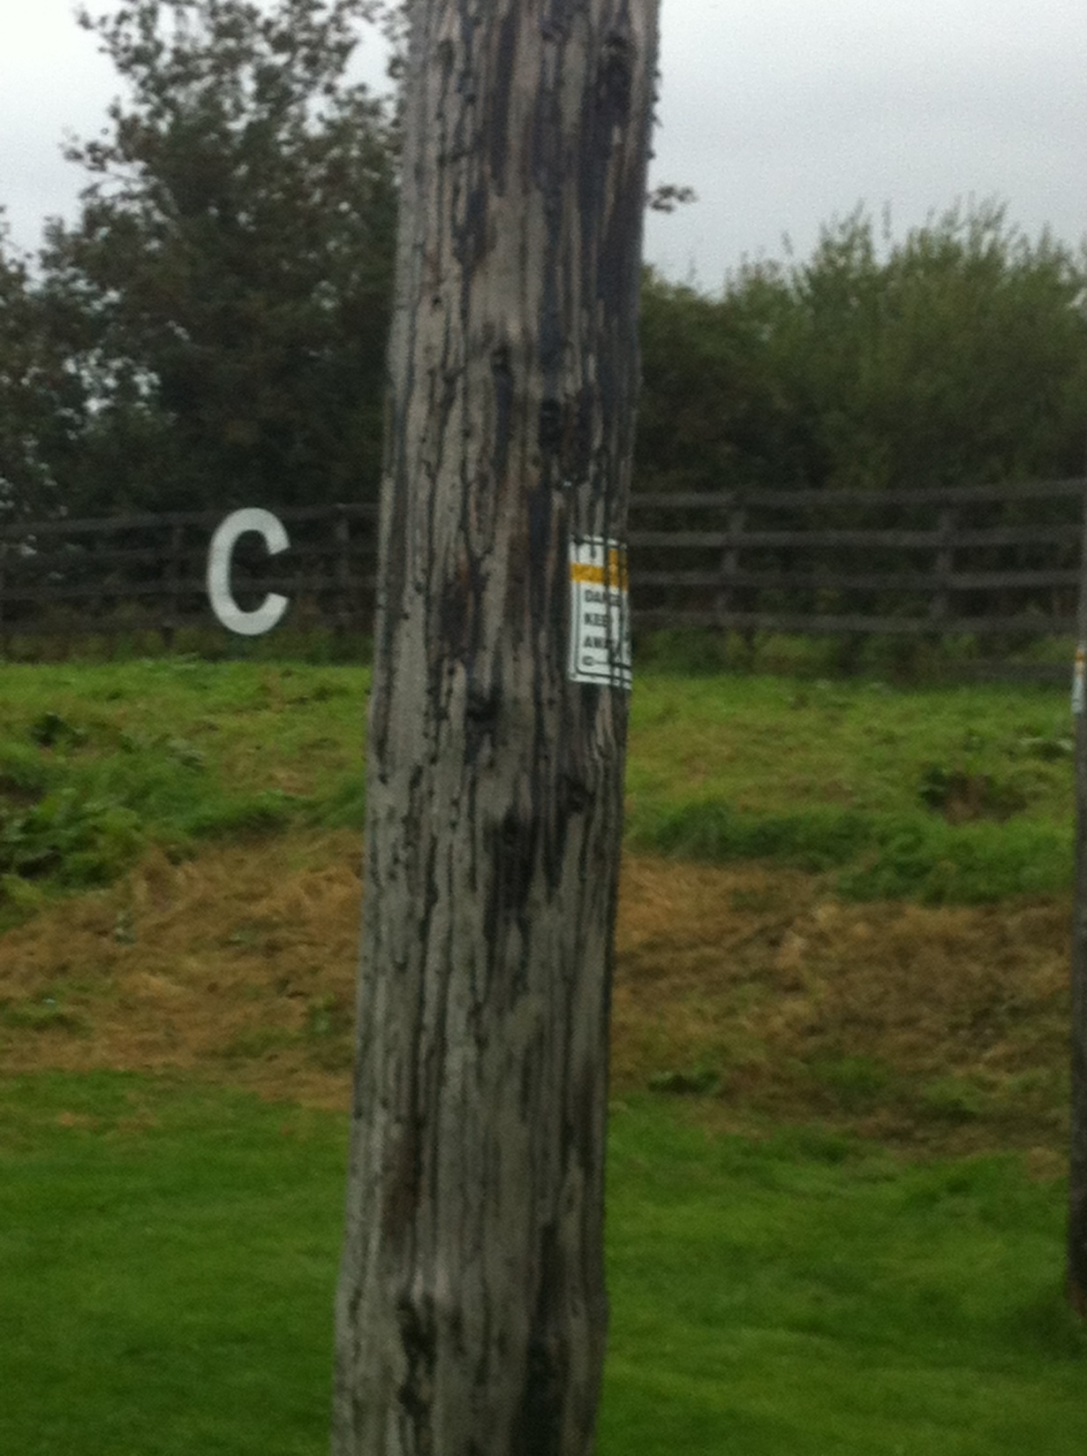
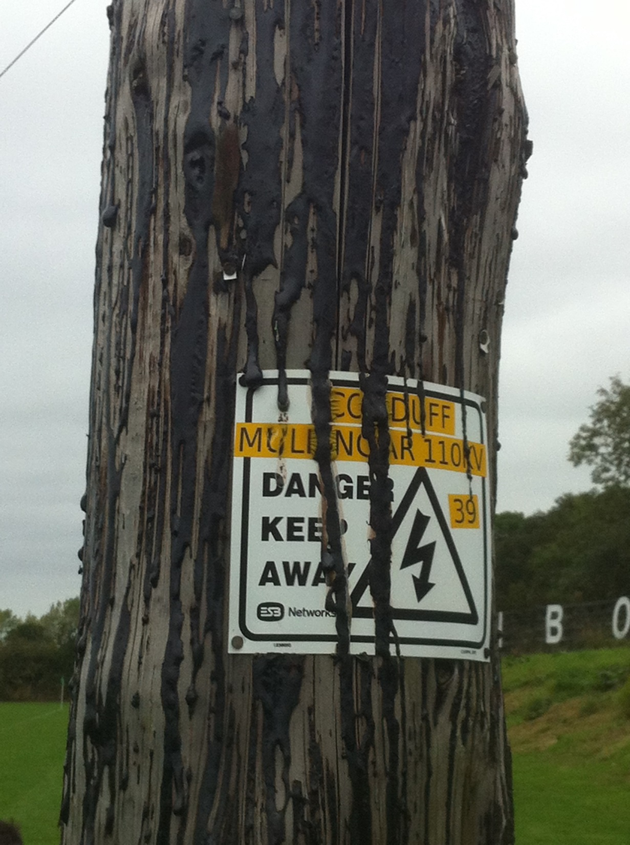
Preservation Tar oils
Tar oils paint melts and leaches in the hot weather.
Extremely toxic to surrounding plants.
Nearly impossible to remove from clothes.
Photo taken by Niall Delaney

Slide 7
Water-soluble Preservatives
These are toxic chemicals which are mixed with water. They are suitable for use in both internal and external situations. The wood can be painted subsequently. They are odourless and non-flammable.
Note: As the toxic chemicals are water soluble, some of the types available are prone to leaching out when used in wet or damp conditions.
You don’t need PPE with Water Borne Treatments- Discuss?
False PPE should Always be worn- Why?.

Slide 8
Organic Solvent Preservatives
These consist of toxic chemicals which are mixed with a spirit that evaporates after the preservative has been applied. This is an advantage because the moisture content of the timber is not increased. Quicker to dry. (Why?)
The use and characteristics of these types of preservatives are similar to those of water-soluble preservatives, but with certain exceptions. Some of the solvents used are flammable, so care must be taken when applying or storing them.
Some types also have a strong odour. In general, organic solvent preservatives are the most expensive type to use but are normally considered to be superior because of their excellent preservation properties.
PPE should be worn.

Slide 9
Preservation Methods of Application
To a large extent it is the method of application rather than the preservative that governs the degree of protection obtained. This is because each method of application gives a different depth of preservative penetration. The greater the depth of penetration the higher, the degree of protection. Preservatives can be applied using a number of methods, but all of these can be classed in two groups:
Non-pressure treatment, for example, brushing, spraying, dipping and steeping
Pressure treatment, for example, empty-cell process and full-cell process

Slide 10
Non-pressure treatments
Brushing
In this method the preservative is brushed on. It can be used for all types, but the effect is very limited as only a surface coating is achieved (very little penetration of the preservative into the timber).
Spraying
The preservative is sprayed on, but the effect is similar to brushing, that is, little penetration is achieved.

Slide 11
Non-pressure treatments
Dipping
In this method the timber is immersed in a container full of preservative. After a certain length of time the timber is taken out and allowed to drain. The depth of penetration depends upon the length of time that the timber is immersed. Although better than brushing or spraying, penetration may still be very limited.
Steeping
This is known as the hot and cold method. The timber is immersed in large tanks containing the preservative. The preservative is then heated for about two hours, the heat is then removed, and the preservative allowed to cool. As the preservative is heated, the air in the cells of the timber expands and escapes as bubbles to the surface. On cooling the preservative is sucked into the spaces left by the air. Fairly good penetration can be achieved, making this by far the best non-pressure method.

Slide 12
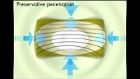
Pressure treatments
What is Pressure Treatment Timber?
Arnold Laver(5.38 Mins)

Slide 13
Pressure treatments
This is the most effective form of timber preservation, as almost full penetration of the cells can be achieved.
Empty-cell process
The timber is placed in a sealed cylinder. The air in the cylinder is then subjected to pressure which causes the air in the timber cells to compress. At this stage preservative is run into the cylinder and the pressure increased further.
This forces the preservative into the timber. The pressure is maintained at this high level until the required amount of penetration is achieved. The pressure is then released, and the surplus preservative is pumped back into a storage container. As the air pressure is reduced, the compressed air in the cells expands and forces out most of the preservative, leaving only the cell walls coated.

Slide 14
Pressure treatments
Full-cell process
The timber is placed into the sealed cylinder as before but this time, instead of compressing the air, it is drawn out.
This creates a vacuum in the cylinder, as well as a partial one in the cells of the timber.
At this stage, the preservative is introduced into the cylinder. When the cylinder is full, the vacuum is released, and the preservative is sucked into the timber cells by their partial vacuum.
This method is ideal for timbers which are to be used in wet locations, for example, marine work, docks, piers, jetties, etc. as water cannot penetrate into the timbers cells because they are already full of preservative.

Slide 15
Pressure treatments
Full-cell process Double Vacuum Method
A variation of these pressure treatments which is often used is the double-vacuum method. The timber is placed in a sealed cylinder as before and a vacuum is applied. An organic solvent preservative is introduced into the cylinder.
With the cylinder full the vacuum is released, and a positive air pressure applied. This causes the preservative to be sucked and forced into the timber.
Finally, the vacuum is once again applied to remove the excess preservative.
No further seasoning or drying of the timber is required before use.

Slide 16
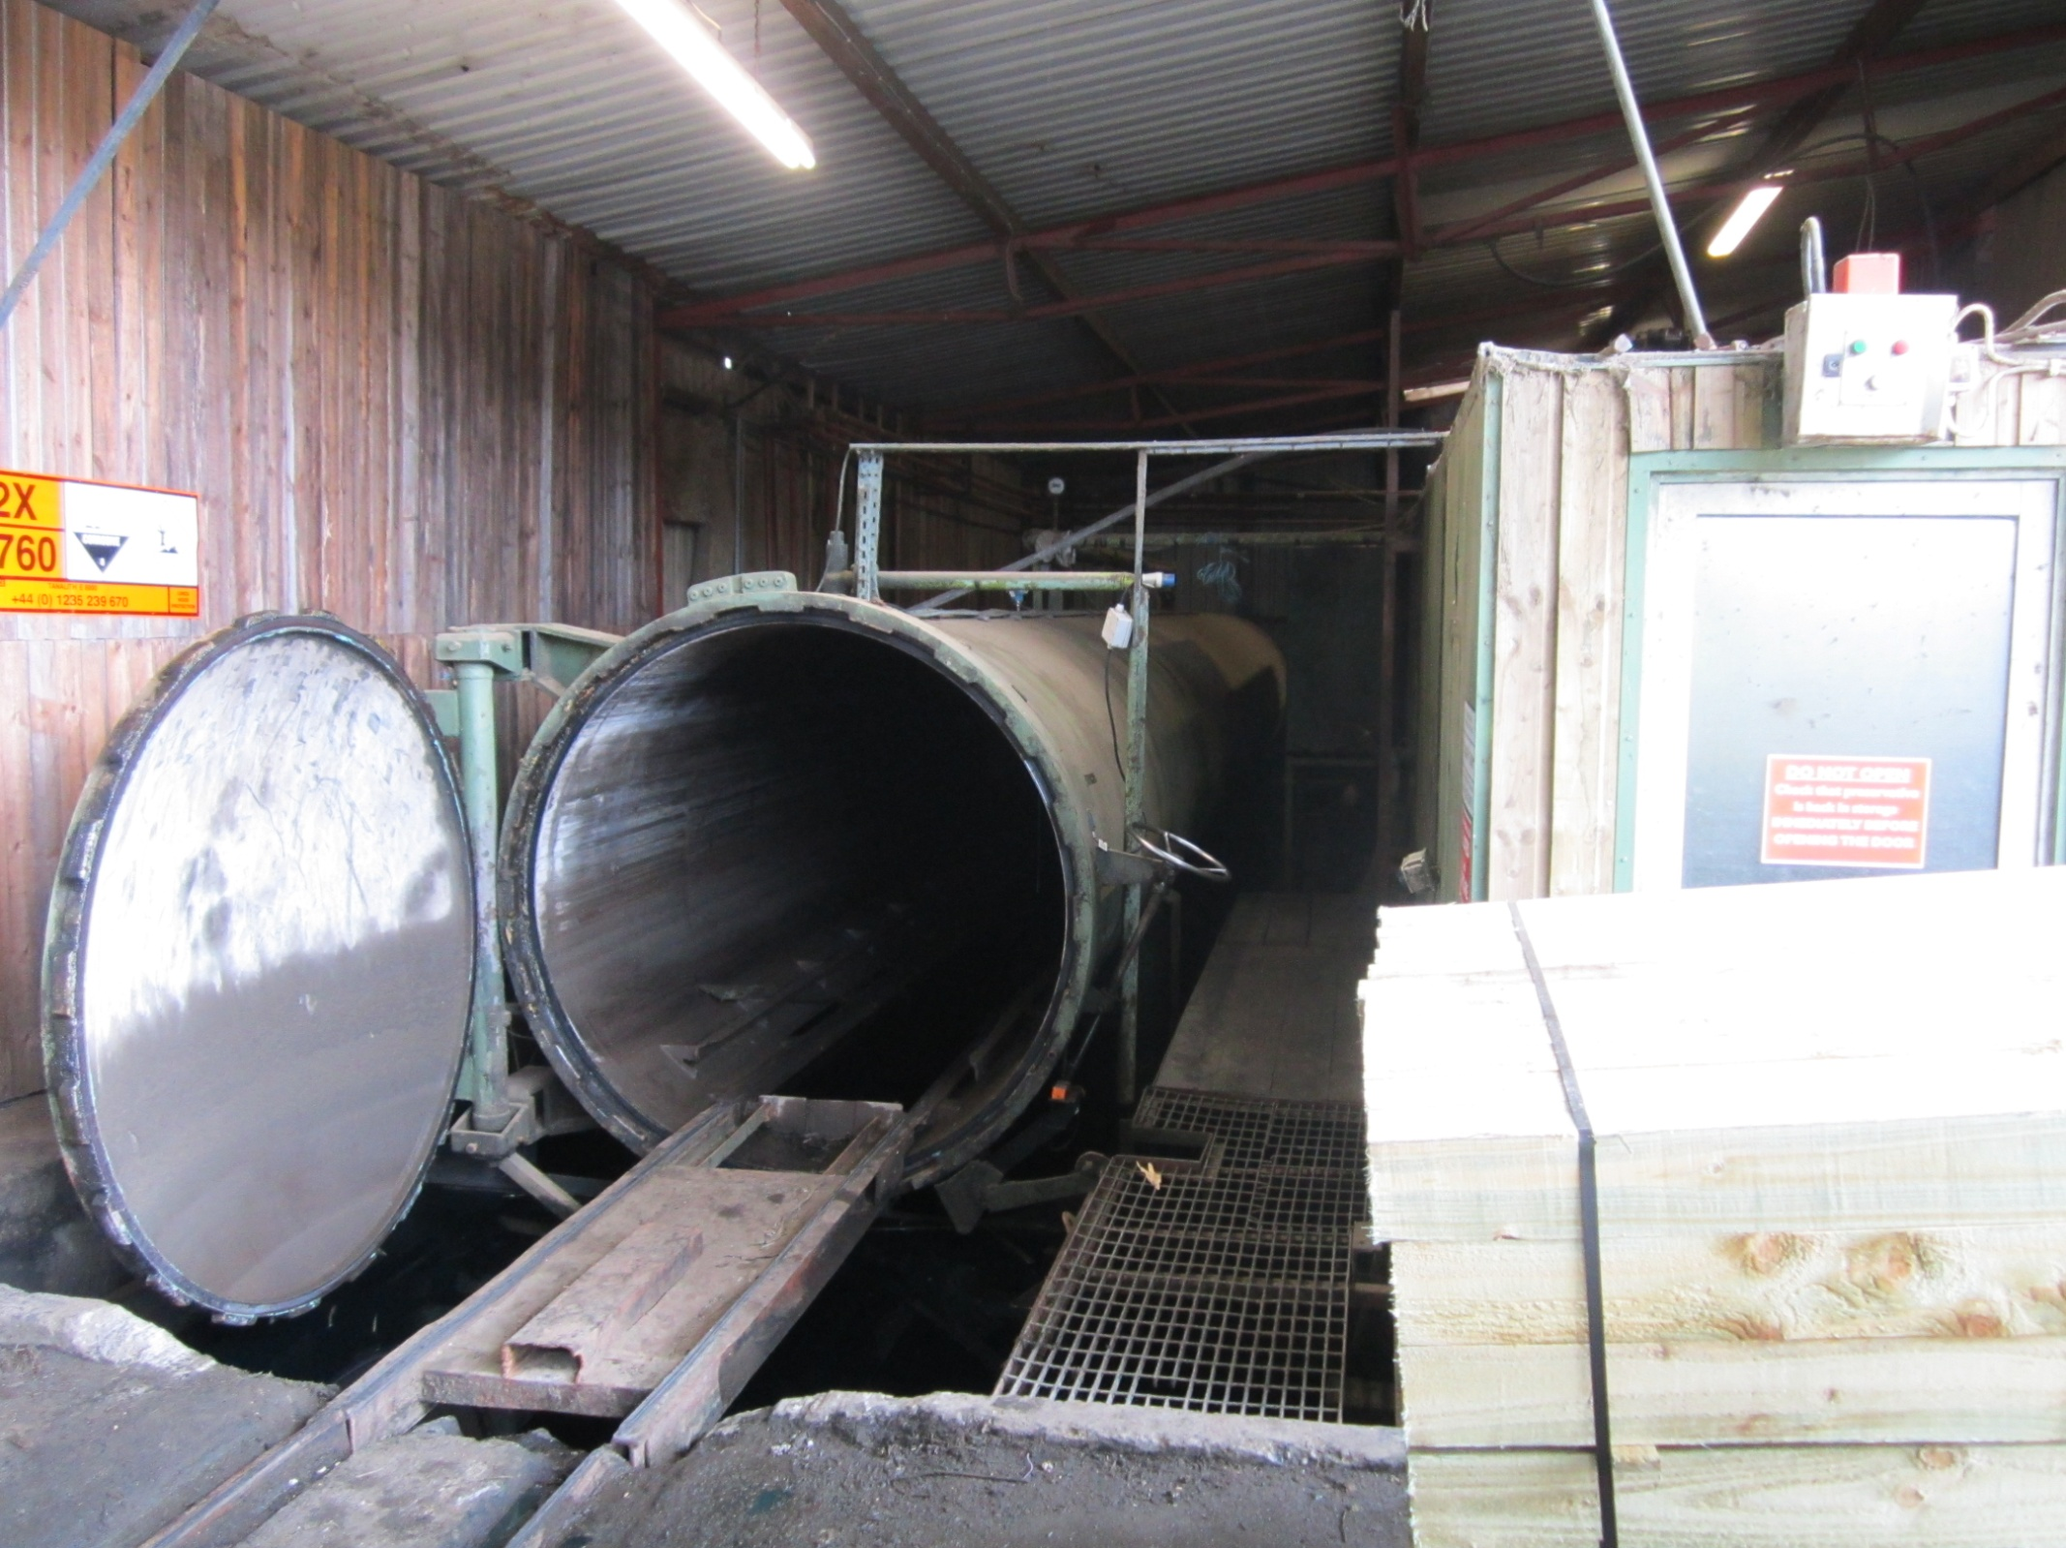
Pressure Treatment Cylinder/Vessel
Photographs taken
by Niall Delaney in Woodfab Timber Industries
Aughrim Co. Wicklow.

Slide 17
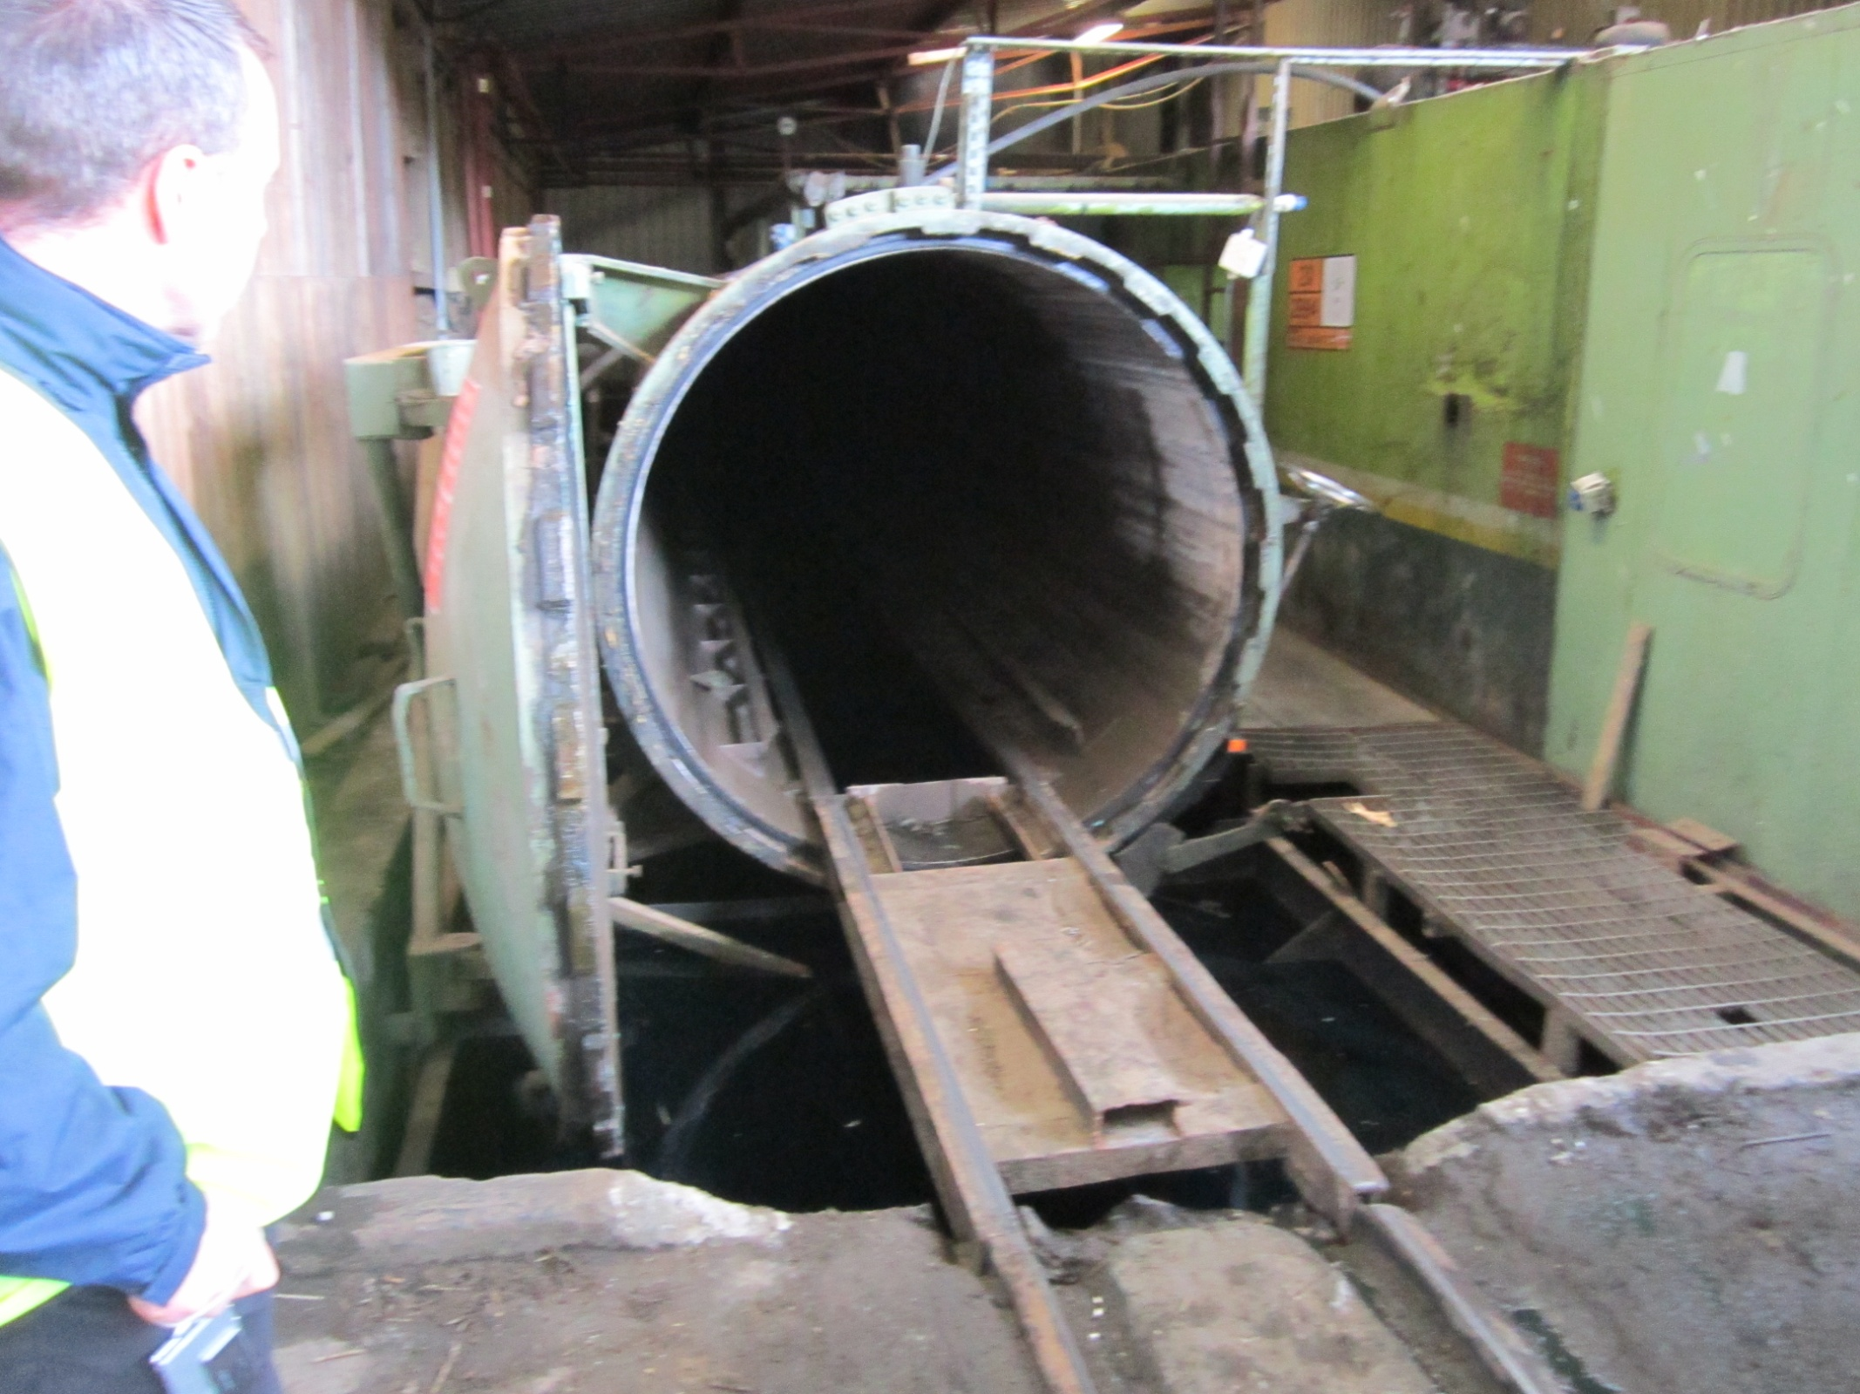
Original Pressure Treatment Vessel
This vessel/tank is situated at the bottom of the sawmill and is used to pressure treat stakes and railings.
Bales of timber is manually fed into this chamber using a forklift.
After treatment the bales are pulled out again using the forklift.

Slide 18
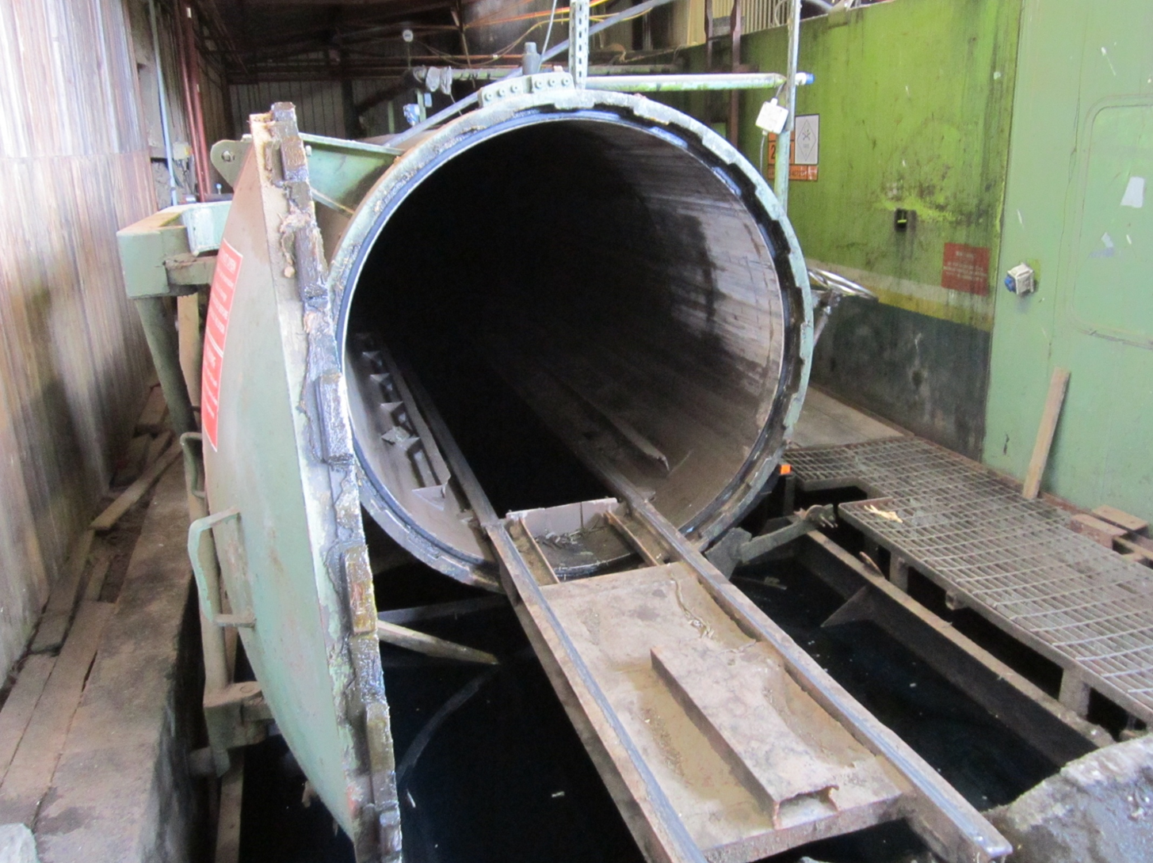
Tracks Inside the Tank.
As the bales are pulled out excess treatment flows into the vat below. This will be reused in further treatments.

Slide 19
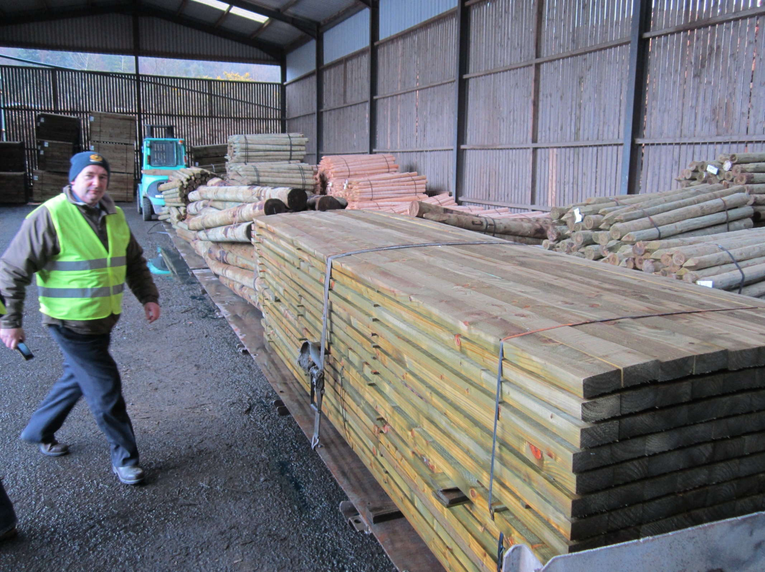
Treated Timber in the Post Plant
Treated bales of timber sitting on the trolley.
This trolley is pushed and pulled using the forklift.
After treatment the bales are set aside and allowed to drip dry. The trolley then gets loaded up with the next lot of timber.

Slide 20
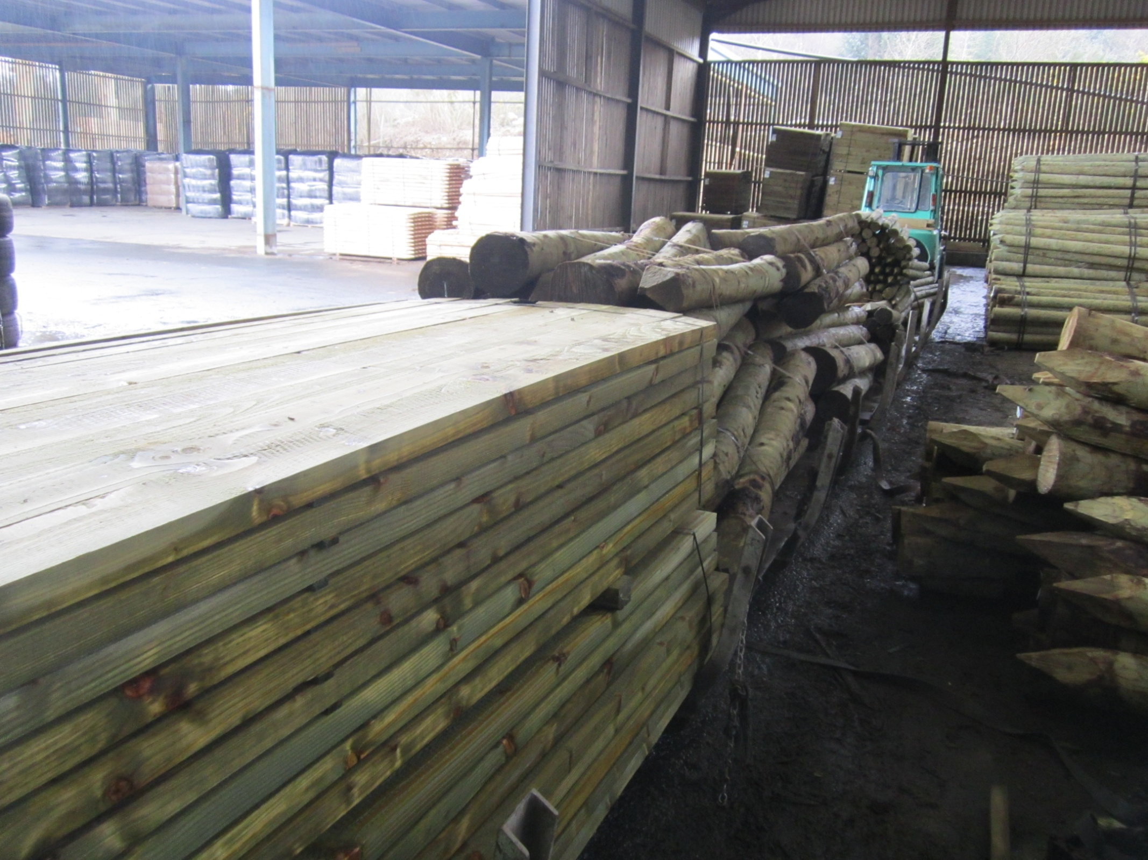
Stacked Treated Timber in the Post Plant
Same trolley load of timber bales photo taken from the opposite side.

Slide 21
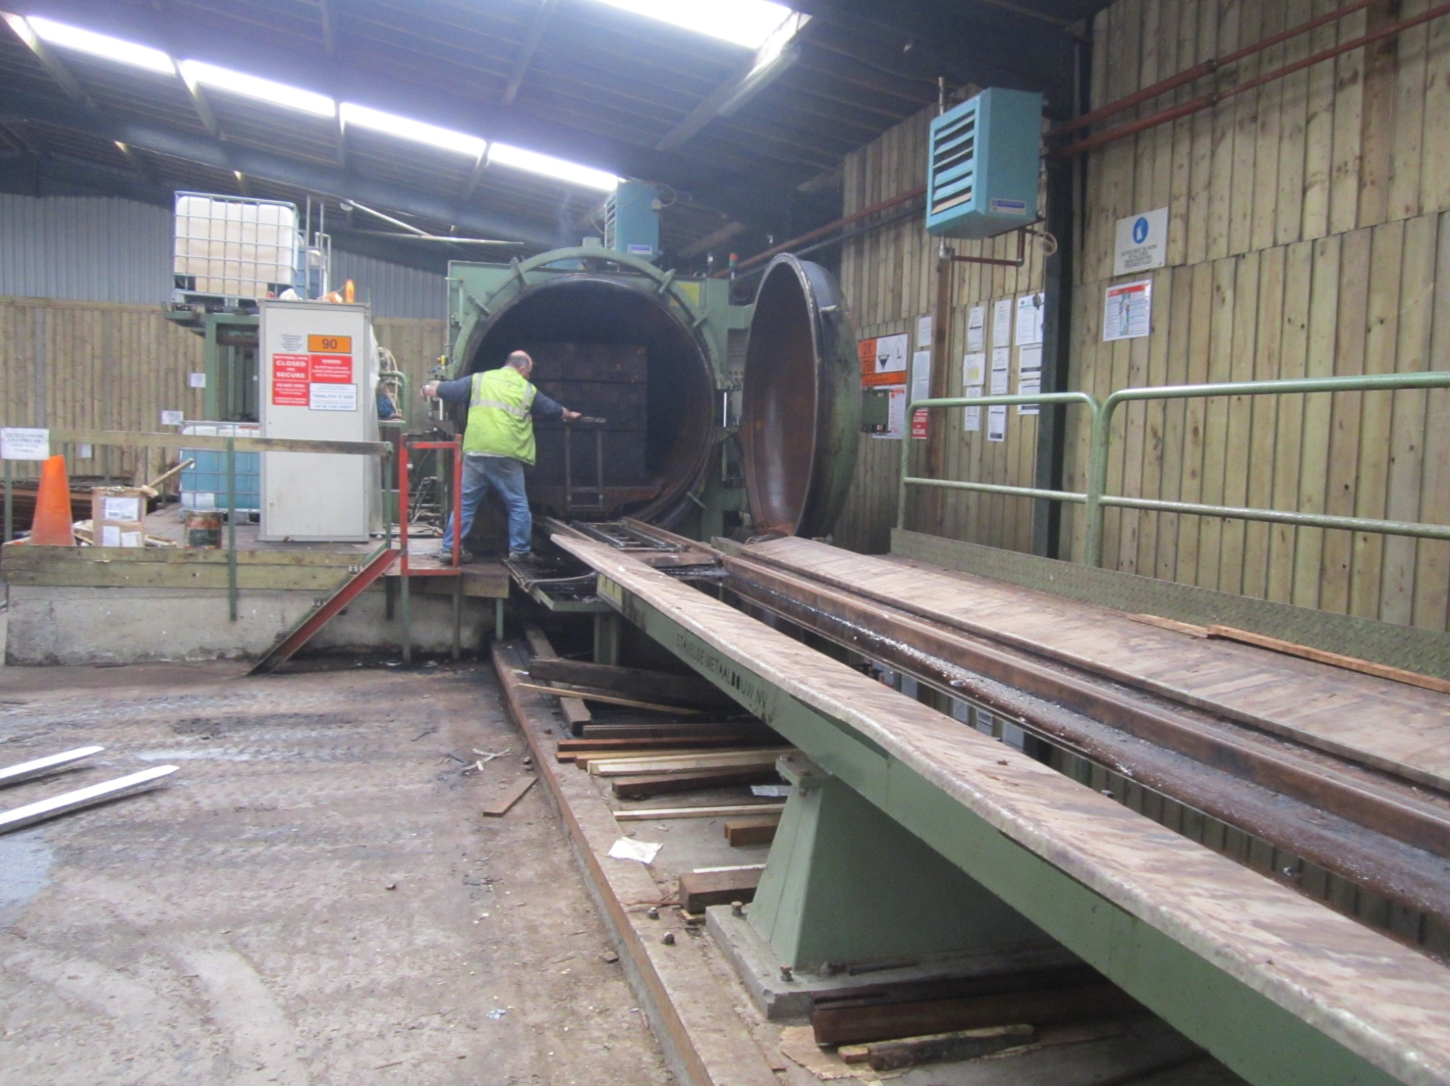
Second Treatment Plant
This tank is situated at the top of the yard and is used to pressure treat structural timber and fencing timber.
Bales of timber are automatically fed into this chamber.

Slide 22
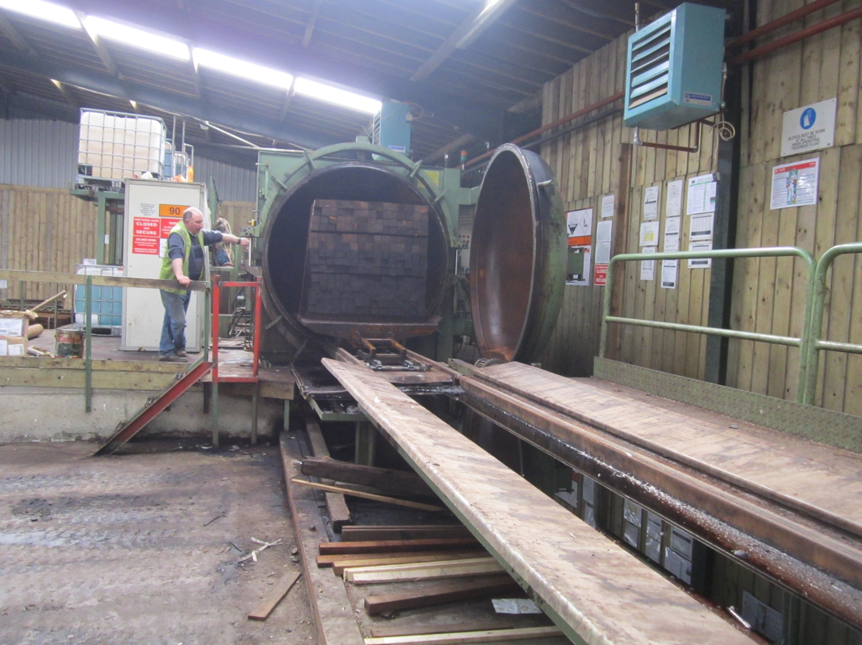
Treated Timber emerging from vessel
After treatment the chamber is drained and the bales of timber are removed from this chamber using automation.
This is controlled by the operator.

Slide 23
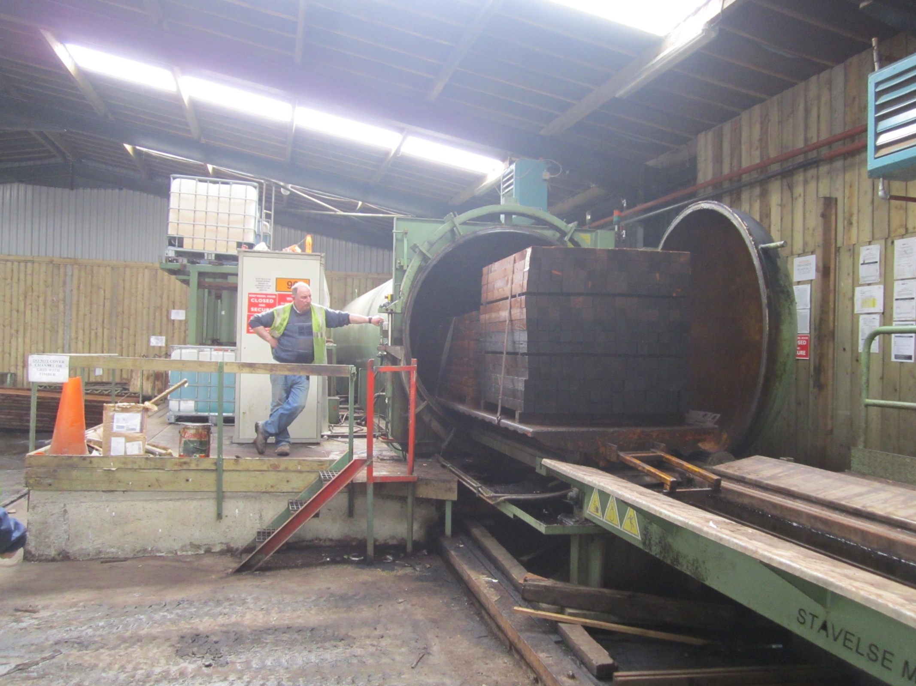
Post Treatment
Operator controlling the speed at which the bale of timber emerges.
Note that the bales are strapped down to the trolley. Why?

Slide 24
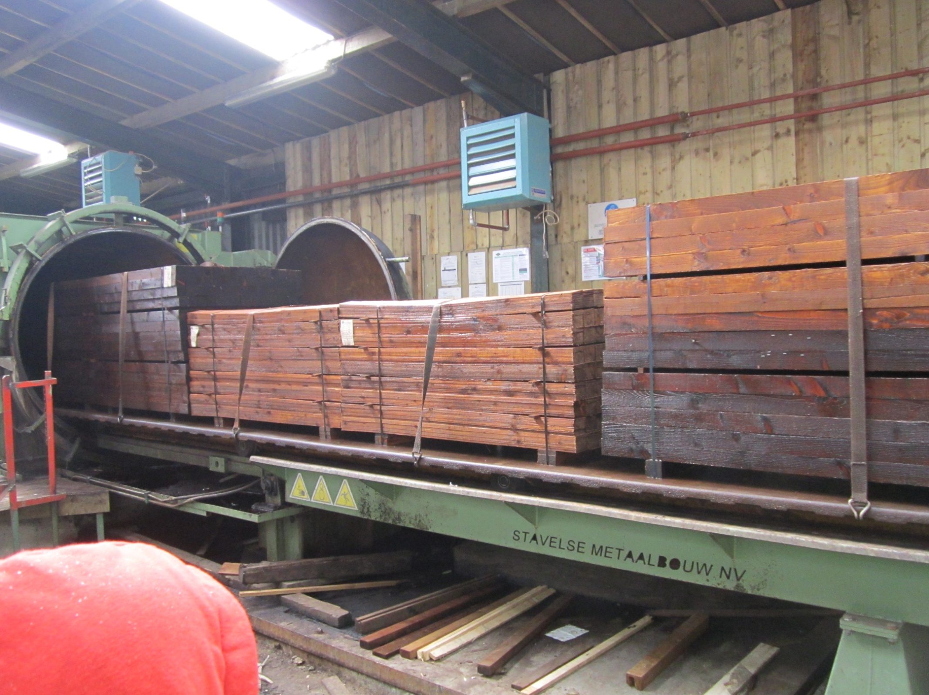
Bales of Freshly Treated Timber
After a few minutes the timber is fully out of the tank.
This timber will be removed to the drip dry area.

Slide 25
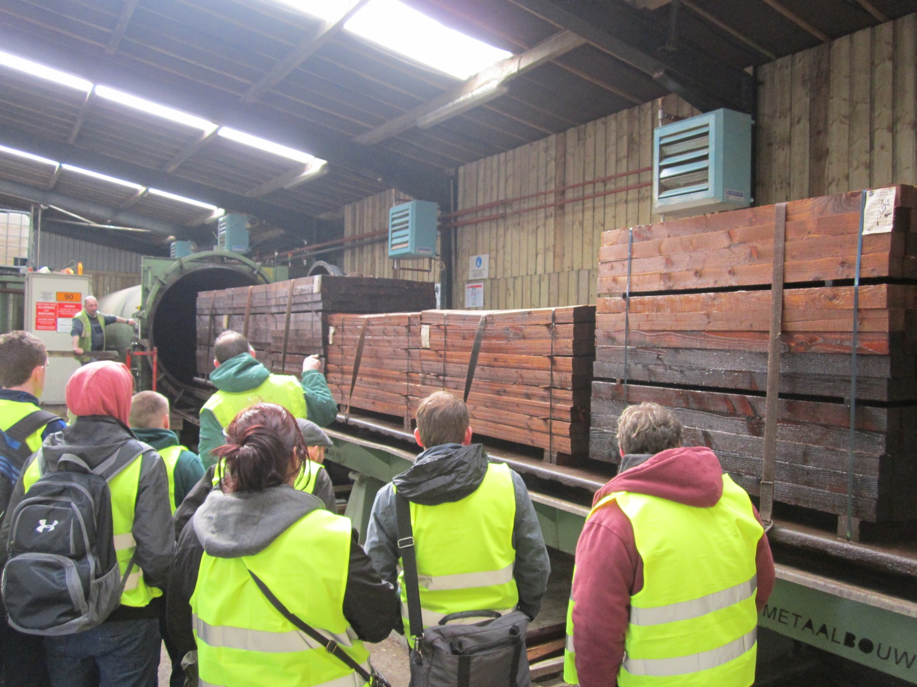
Bunch of Extremely Interested Observers
Can you identify
anyone?

Slide 26
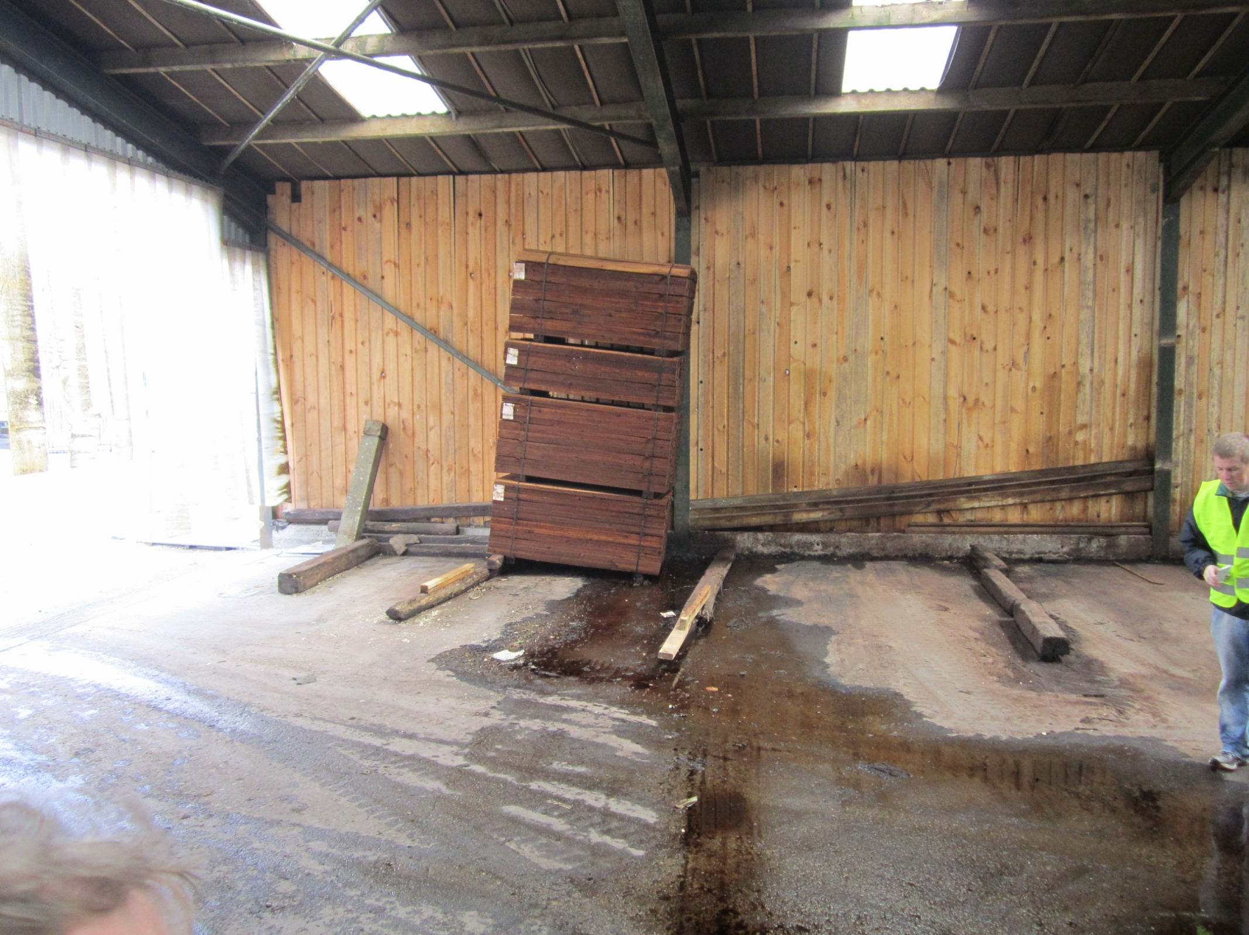
Wet Bales of Timber Left to Drip Dry
Run off flows in gulleys back to the treatment area to be used again.
This is filtered before being used in the tank.

Slide 27
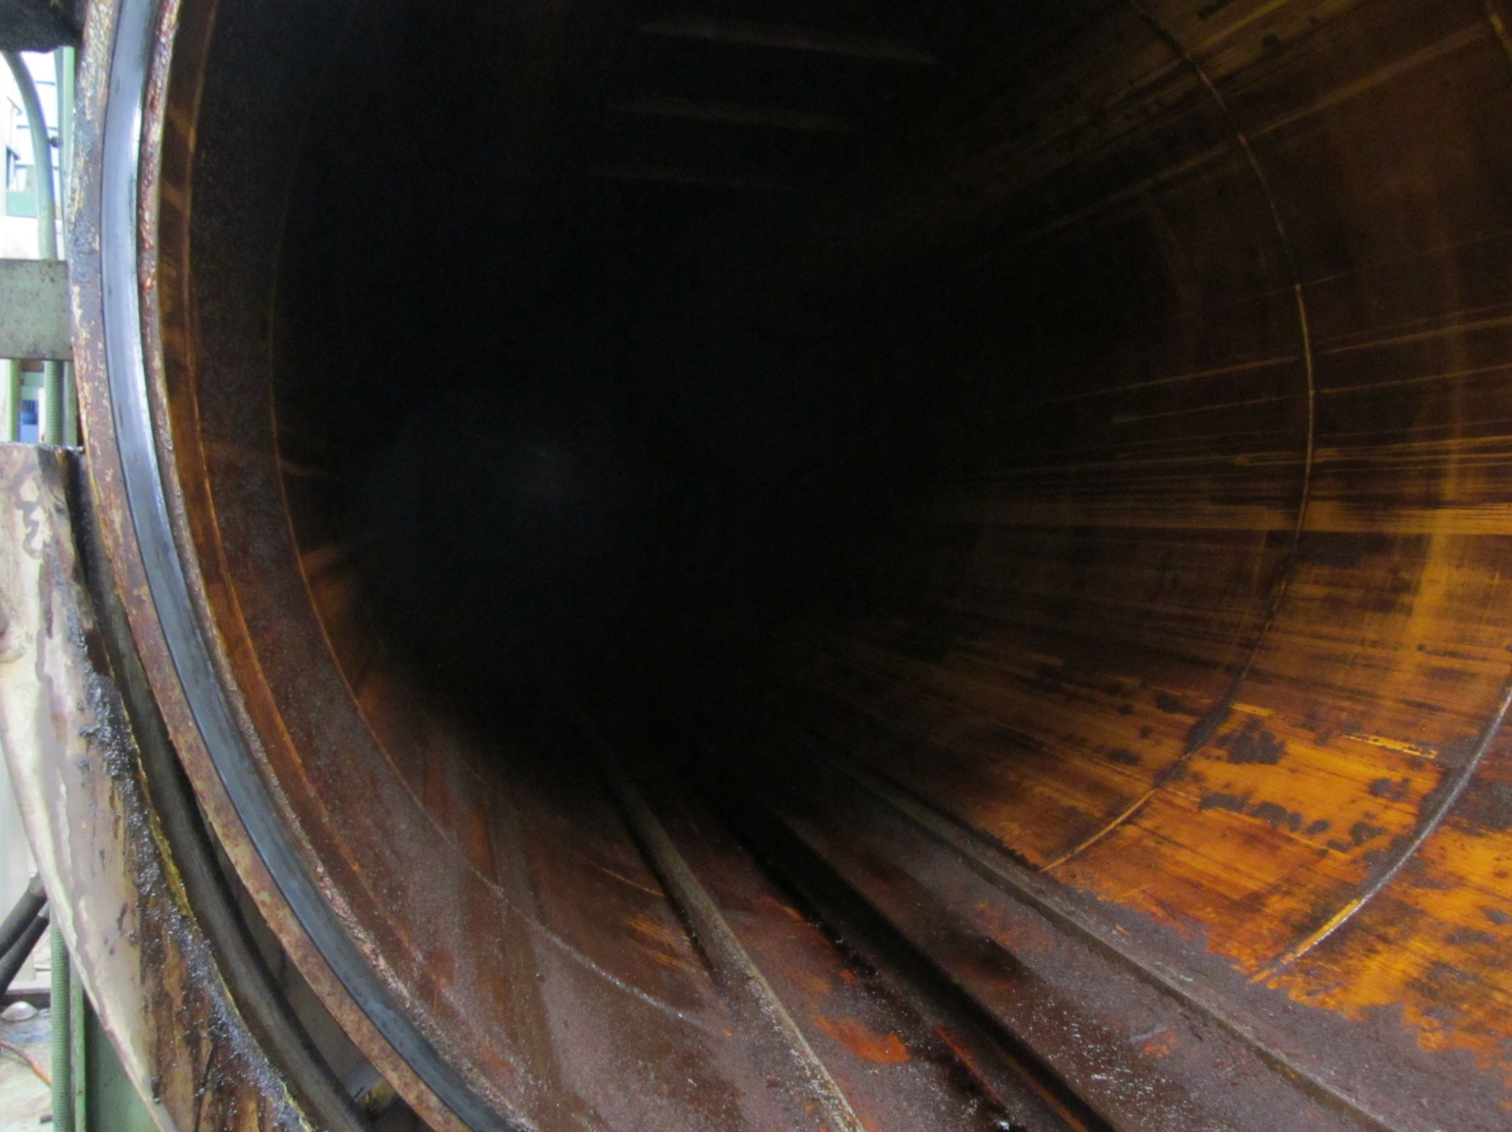
Fun Echo Chamber
Note gulley at the very bottom.
Also the corrosion on the cylinder walls.

Slide 28
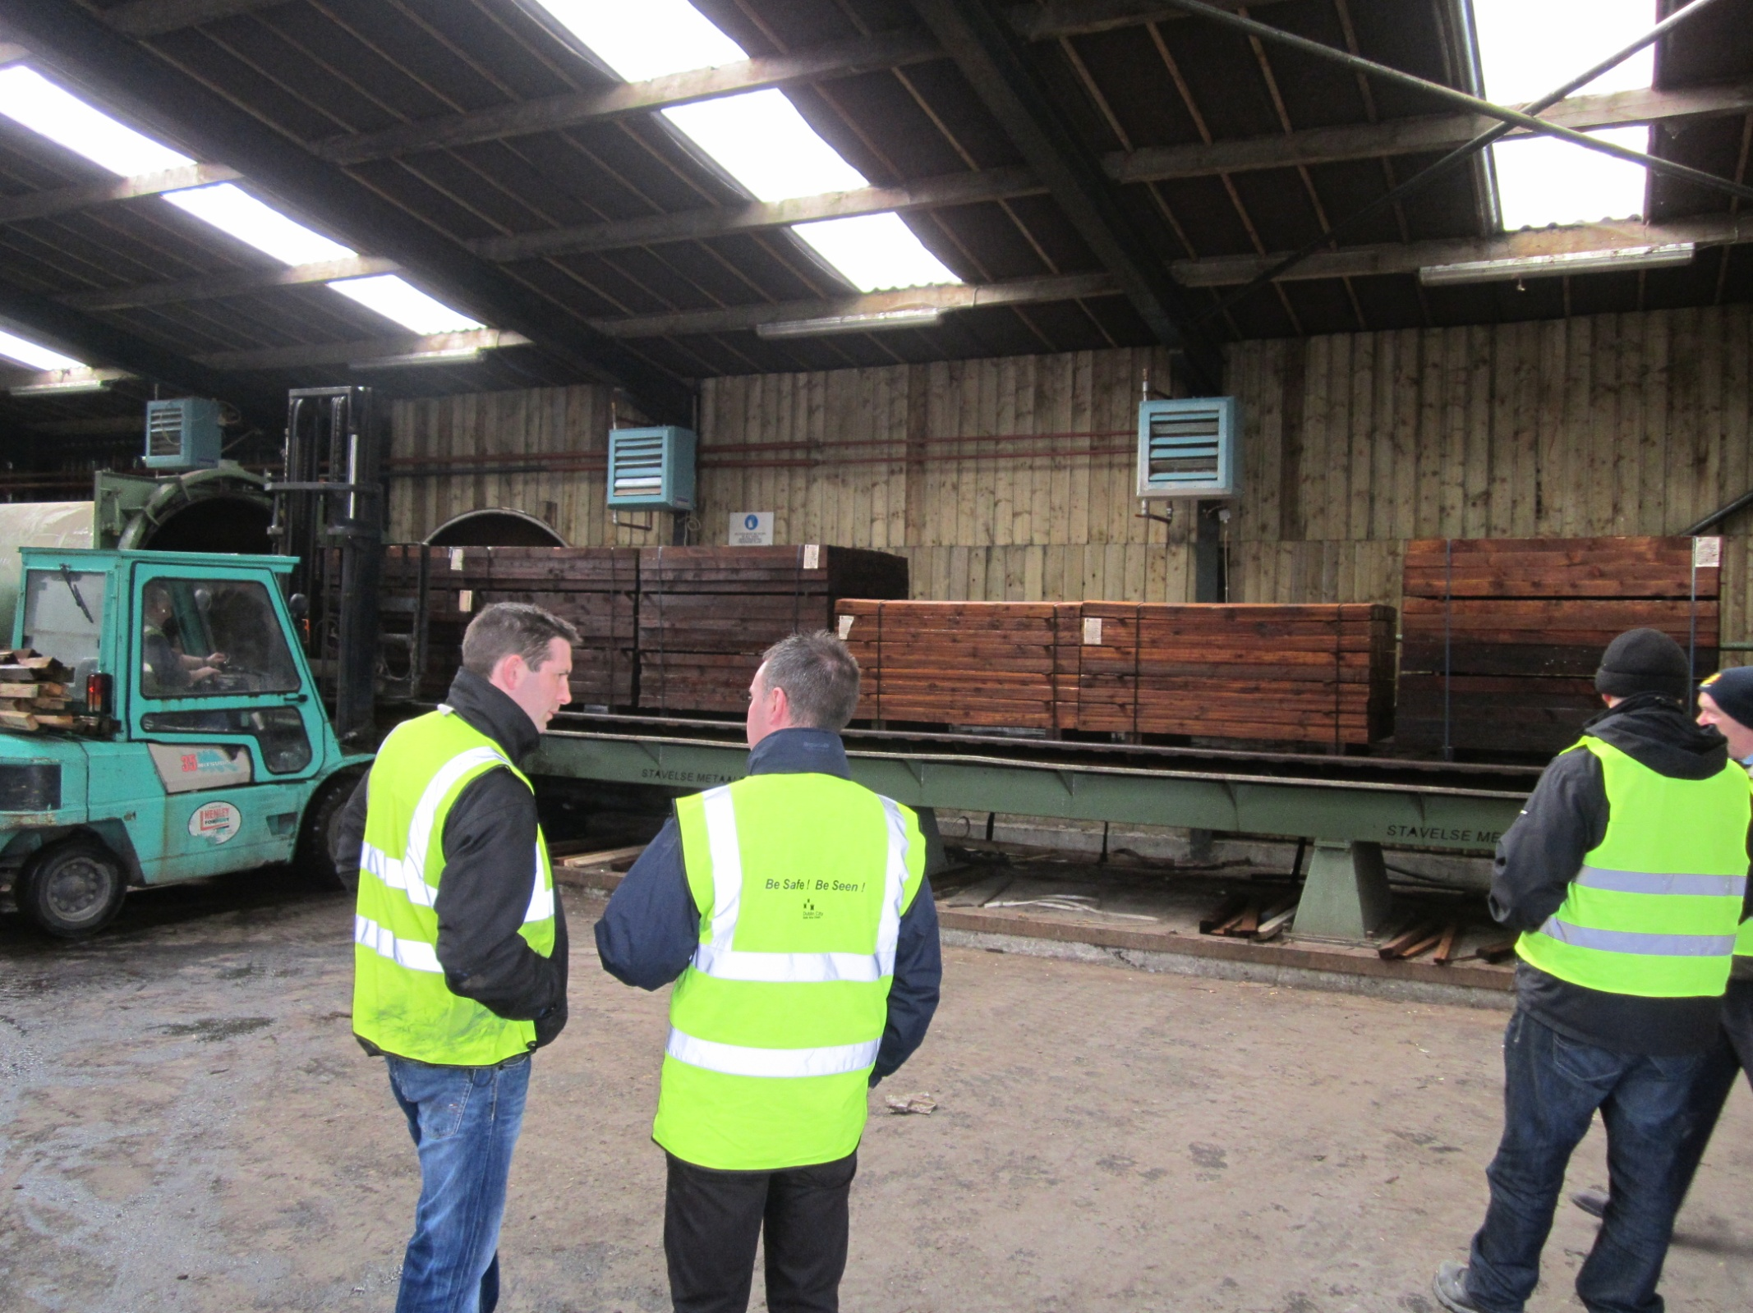
School Trip
These photos were taken during a school visit.

Slide 29
Alternative treatments
Diffusion
This method of application can only be used with green unseasoned timber and is mainly carried out in the country of origin before being shipped. Immediately after conversion a water-soluble preservative is applied to the timber, preferably by dipping. The timber is then close stacked and covered for several weeks, allowing the preservative to diffuse through the timber.
The main drawback to this method is that the timber is prone to leaching.

Slide 30
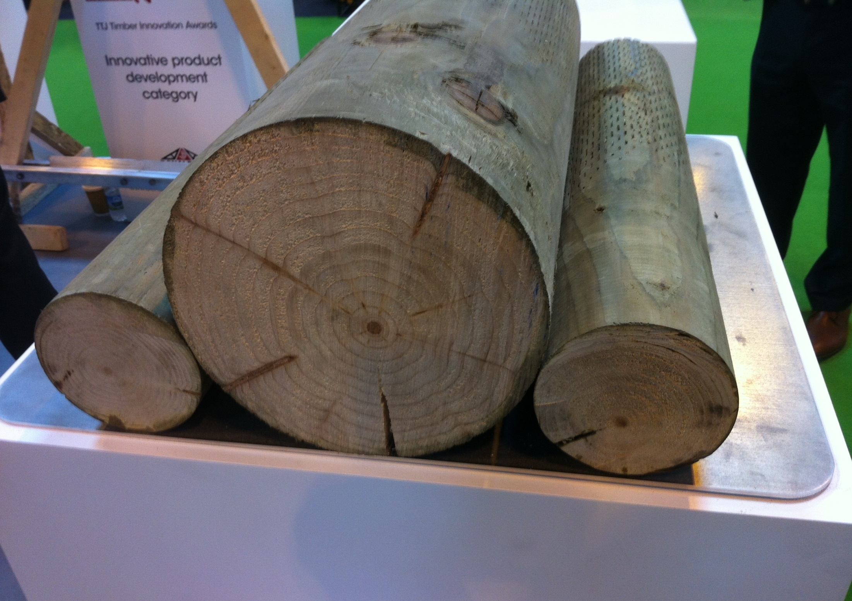
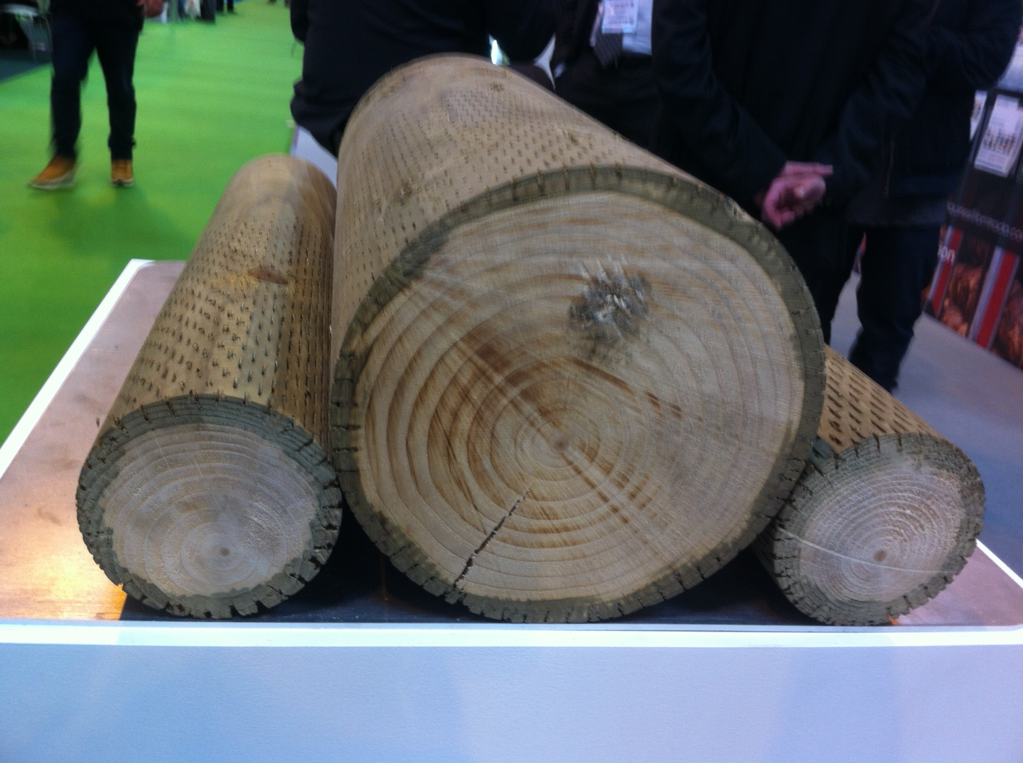
Penetration of Treatment
No incisions
Incised along the grain

Slide 31
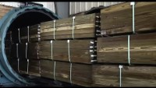
Pressure Treating Wood at Viance.
How wood is pressure treated 4.42m

Slide 32

Shou Sugi Ban?
Shou Sugi Ban (6.54 Mins)

Slide 33

Revision Questions
Scan the QR Code and answer the questions

